Slide 1
BUILDING ESTIMATION
Presented by :
Ar. Vivek Painuli

Slide 2
INTRODUCTION
In various engineering works it is required beforehand to know the probable cost of construction which is known as the estimated cost. If money available is less than the estimated cost, then attempts have to be made to reduce the cost by changing the specification or by reducing the work.
The subject matter of estimation is simple but knowledge of drawing of structures requires special skills like AUTOCAD, STAAD PRO, etc. One who understands the drawing can find out dimensions such as length, breadth, height, etc.
Following requirements are necessary for preparing estimate-
Drawings like plan, elevation and sections of important points like beam, staircase, footing, and column.
Detailed specification of workmanship and properties of materials.
Standard schedule of rates for the current year.

Slide 3
The complete work is divided into various items of work such as earthwork concreting, brickwork, reinforced concrete, plastering etc. The details of measurements are taken from drawings and entered in respective columns of prescribed proforma.
For calculating the cost of the building structure, the rates of materials are derived from Standard Schedule Rates which comprises of the prices of list of items in a tabular form.
Also, LumpSum items in estimate are included in the estimate-
Water supply and sanitary arrangements.
Electrical installation like meter, motor, etc.
Architectural features.
Contingencies and unforeseen items.

Slide 4
TYPES OF ESTIMATE
Following are the different types of estimation-
Preliminary estimate or Approximate estimate or Abstract Estimate or Rough Cost Estimate
Detailed Estimate or Item Rate Estimate
Plinth Area Estimate
Cube Rate Estimate or Cubical Content Estimate
Approximate Quantity Method Estimate
Revised Estimate
Supplementary Estimate
Supplementary and Revised Estimate
Annual Repair or Maintenance Estimate

Slide 5
OBJECTIVE
Required Quantity of Materials
Cost of Materials
Finding cost of various works like Brickwork, RCC, Reinforcement, etc.

Slide 6
METHODOLOGY
Mensuration Method- This method of measuring lengths, areas, volumes using mensuration in its meaning is to measure, is widely used where geometrical figures are thoughtful and where one has to determine various physical quantities such as area, volume, length, etc. In estimation it is a common practice to use mensuration method to calculate quantities of items.
Centre Line Method- This method consists to find out total length of centre line of walls. Brickwork has been found out by this method in this project.
Engineering Method- With this technique, the system being costed is broken down into low level components each of which is costed separately for direct labour, other costs and direct material.

Slide 7
PROBLEM STATEMENT
To perform Double Storeyed Building Estimation and to calculate the cost of building structure from a given Plan, Elevation and Cross section of elements present in the building.
Salient features:
Utility of building: Residential
complex
No of stories: G+1
No of staircases: 5
No of lifts: 1
Type of construction: R.C.C framed structure
Types of walls: brick wall
Height of plinth: 0.76 m

Slide 8
Geometric details:
Ground floor: 3.3 m
Floor to floor height: 3.3 m.
Depth of foundation: 1.68 m.
Clear Cover: 40 mm in Column, 50 mm in Footing, 25 mm in Beam and 15 mm in Slab
Materials:
Concrete grade: All Concrete Mix M20 (1:1.5:3) unless otherwise specified
All steel grades: Fe 500 grade
Bearing Capacity of soil: 18 M.T./m²
All Dimensions in the Drawings are in Feet and Inches.

Slide 9
PLAN OF
GROUND FLOOR
FIRST FLOOR
TERRACE FLOOR
& ELEVATION

Slide 10
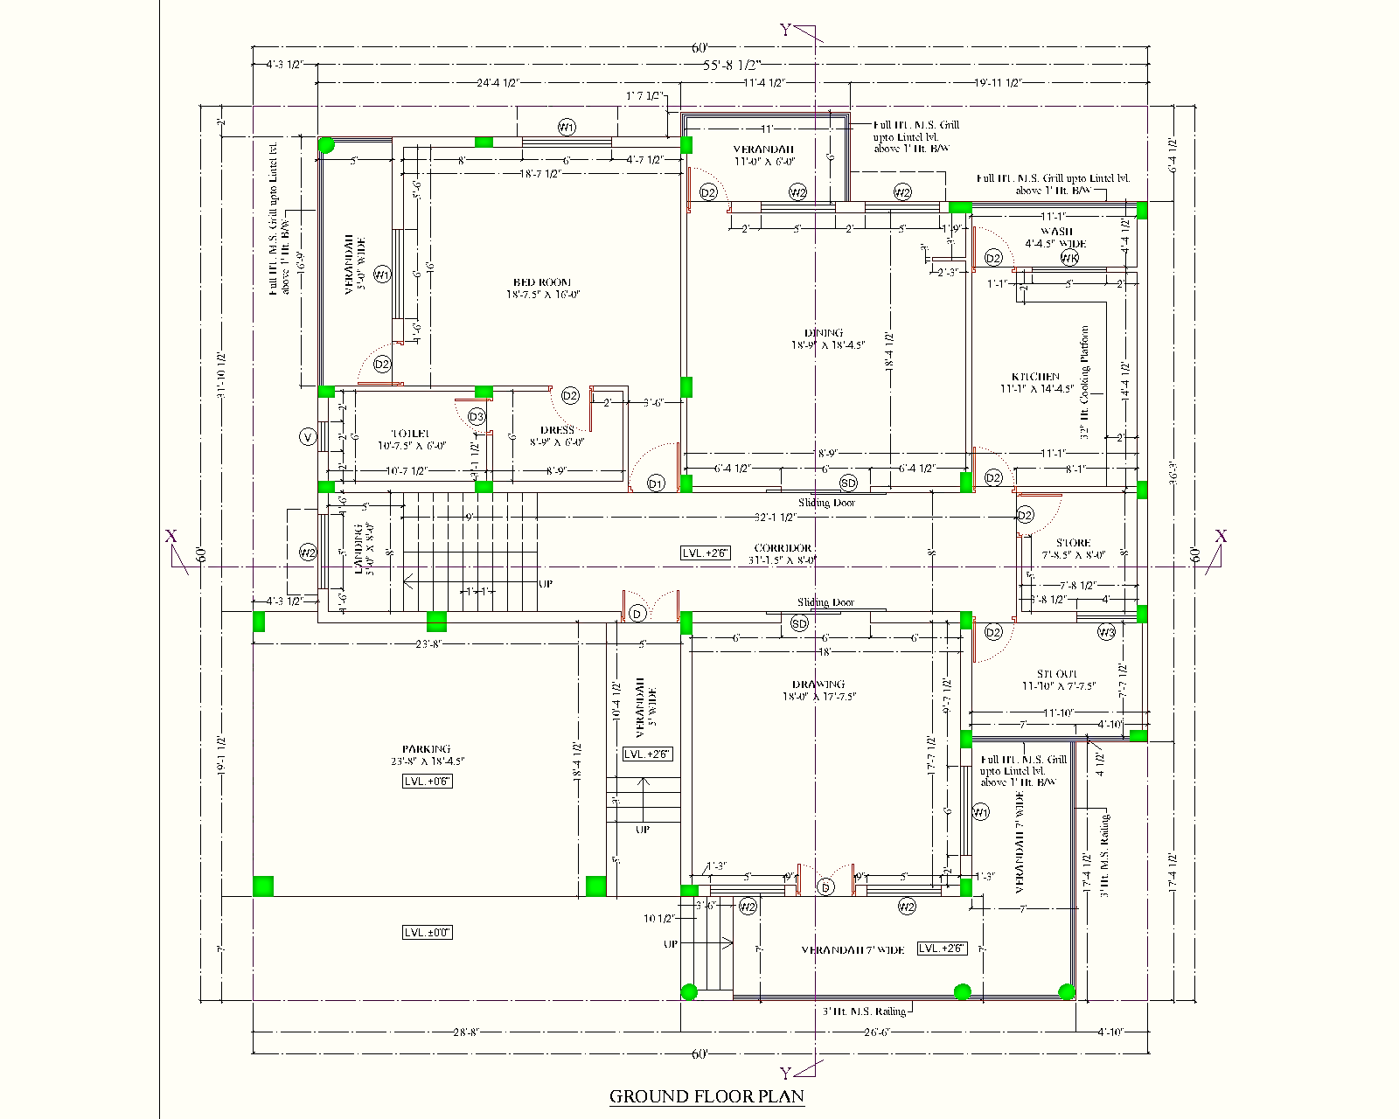

Slide 11
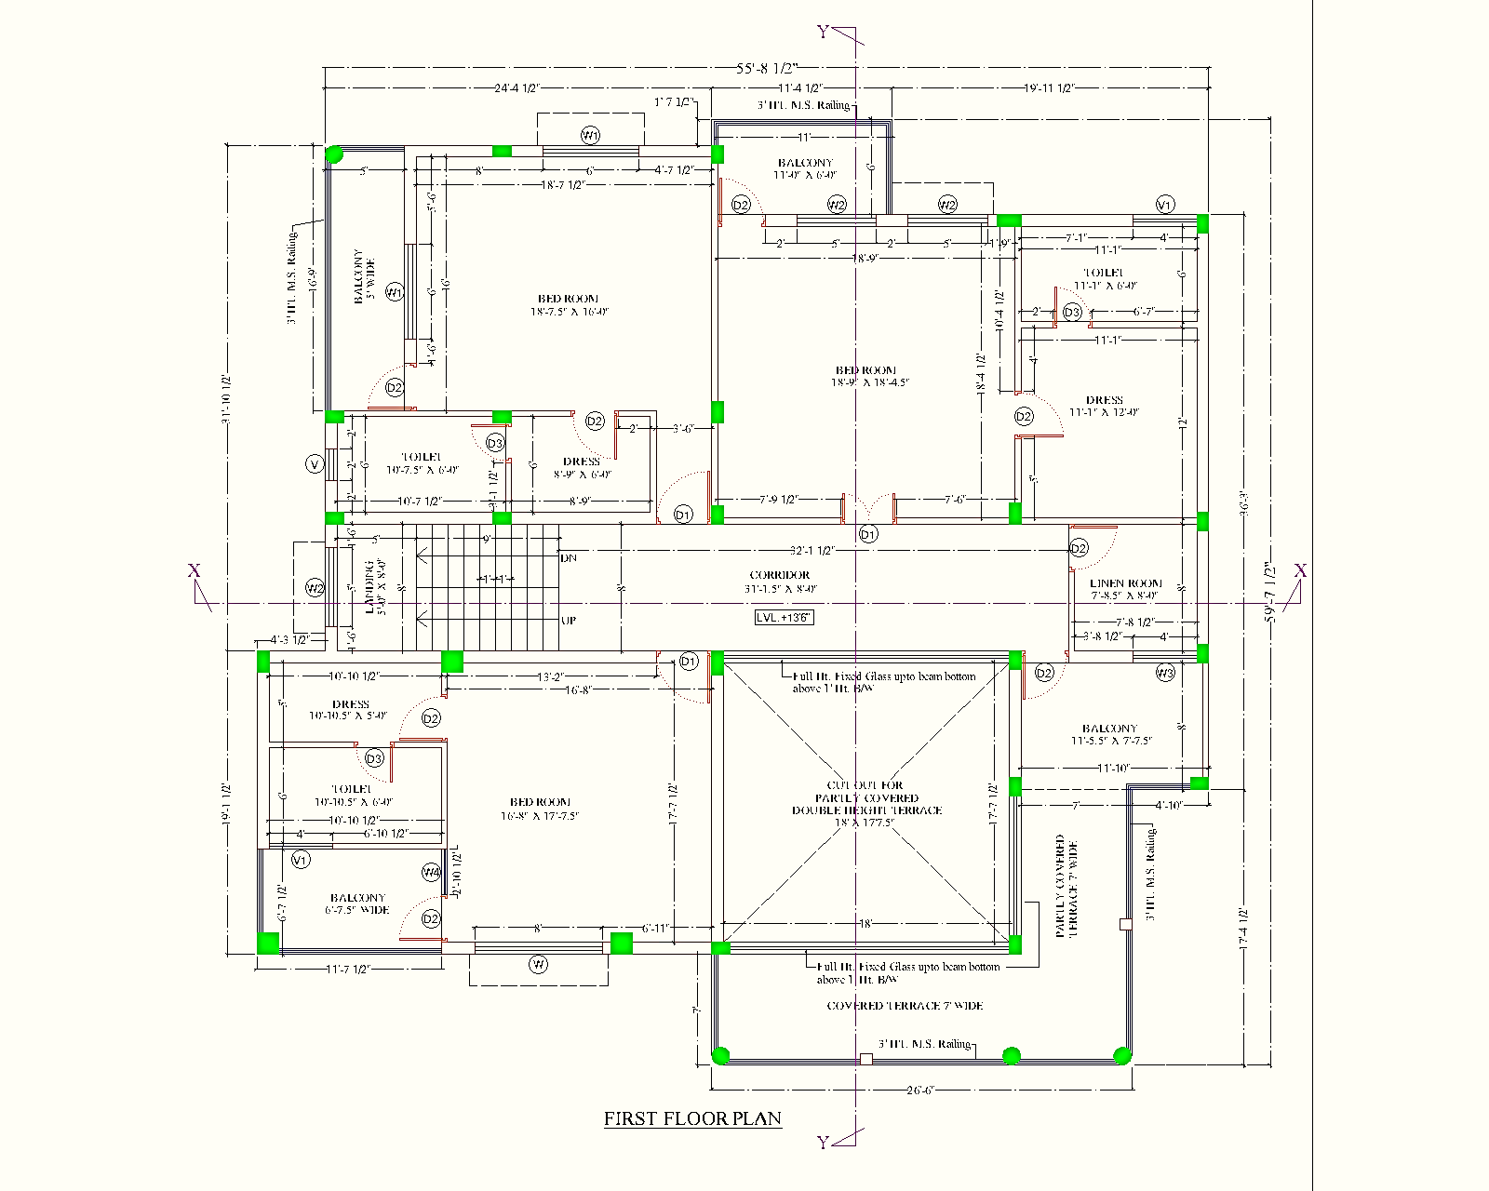

Slide 12
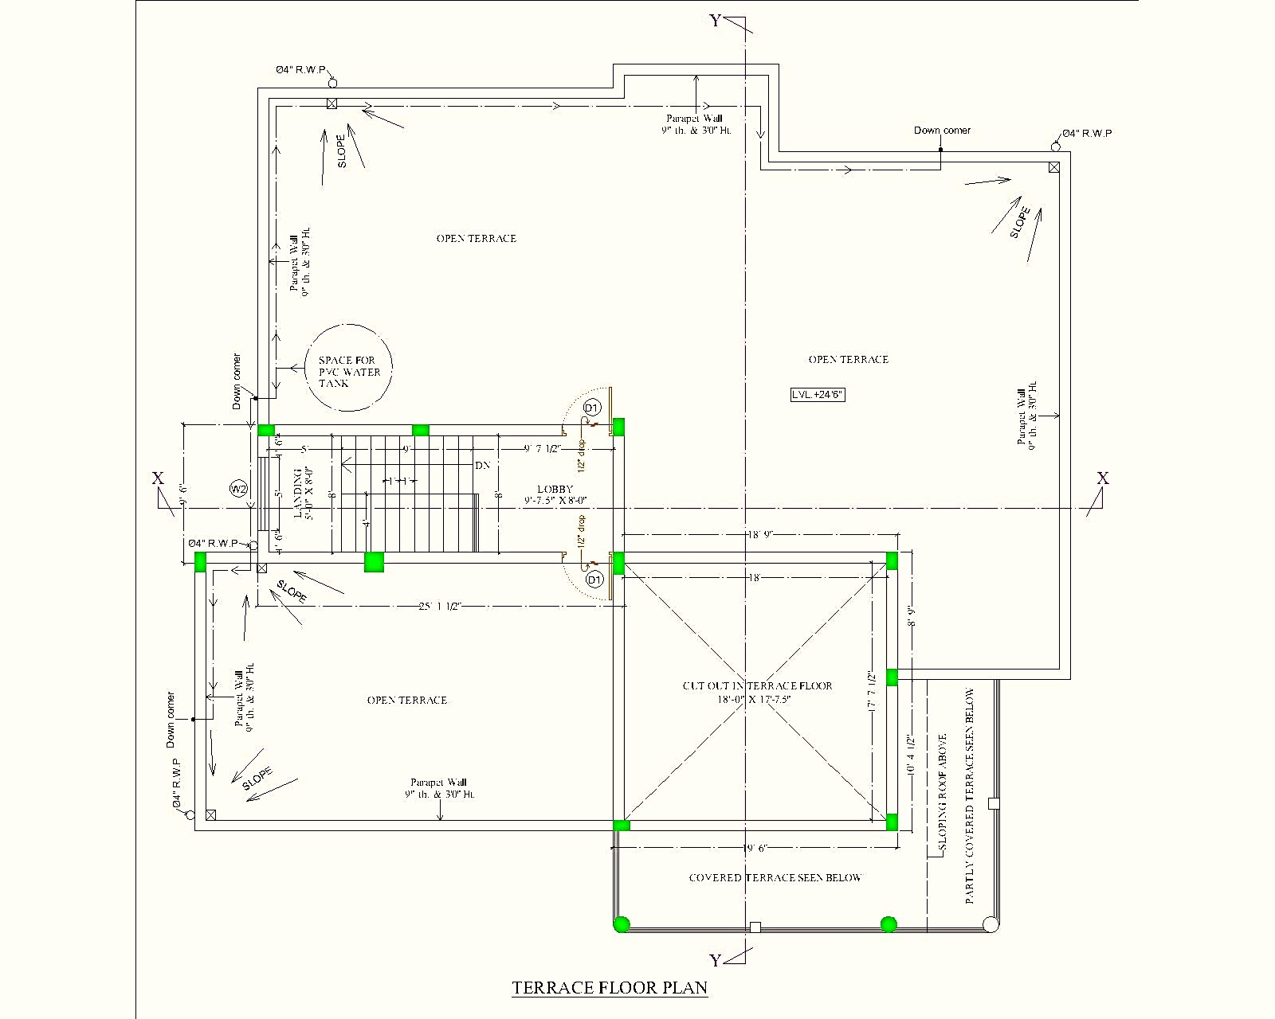

Slide 13
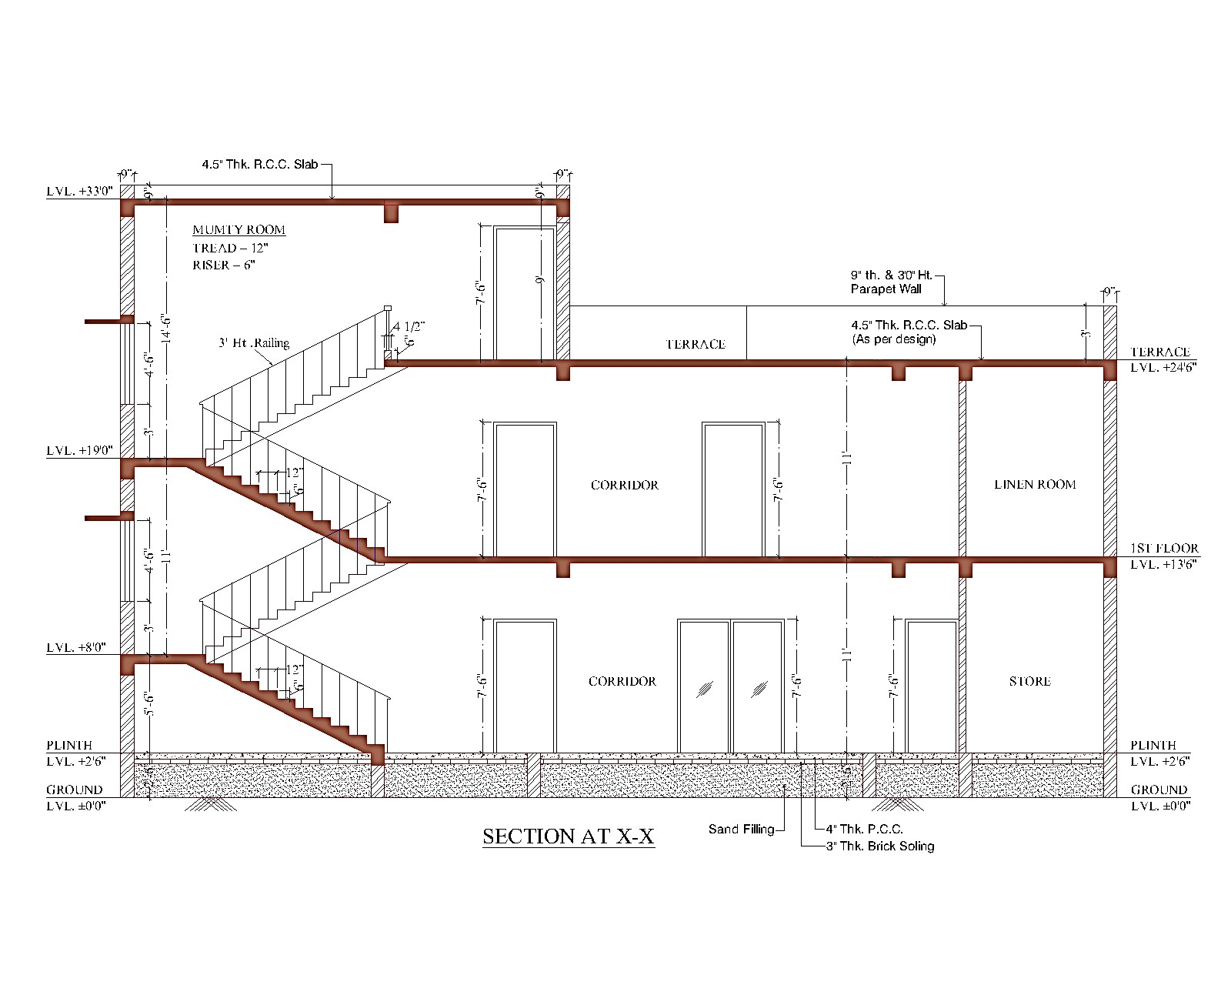

Slide 14
GENERAL ABSTRACT OF THE ESTIMATE OF PROPOSED (G+1) RESIDENTIAL BUILDING
Sl. No. | Description | Unit | SOR Rate (Rs.) | Qty | Amount
1 | Cost of Civil Works for Building as per CPWD 2013-14 |  |  |  | 4,365,939.82
2 | 30% Escalation for current year |  |  |  | 5,675,721.77
3 | Cost of electrical work - 7.5% of civil cost |  |  |  | 425,679.13
4 | Cost of plumbing & sanitary work - 7.5% of civil cost |  |  |  | 425,679.13
 |  |  | Total Rs. |  | 6,527,080.04
5 | Add 1% contingency for unforseen item if any |  |  |  | 65,270.80
 |  |  | Grand Total Rs. |  | 6,592,350.84
 |  |  |  | Say Rs. | 6,592,351.00
(Rupees Sixty Five Lakh Ninety Two Thousand Three Hundred Fifty One Only)

Slide 15
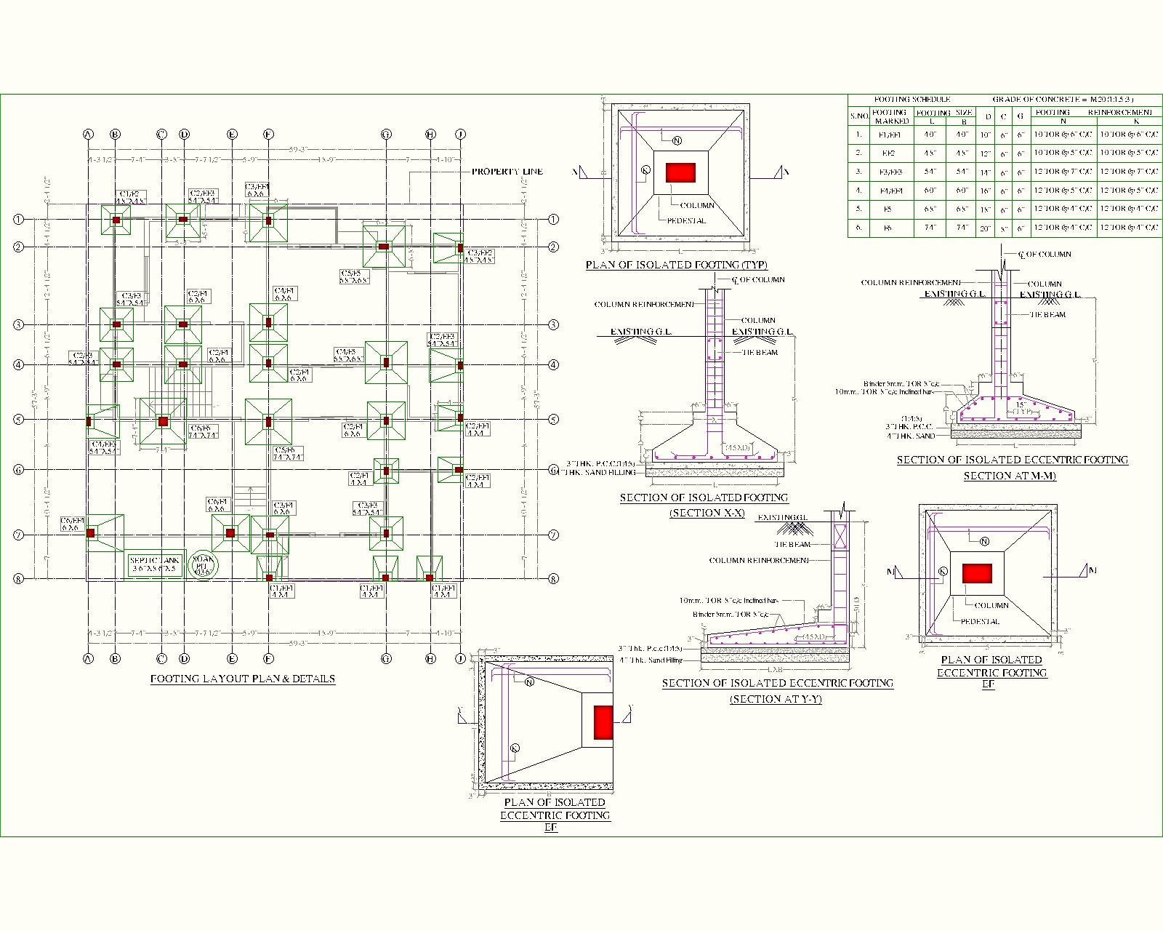
FOOTING

Slide 16
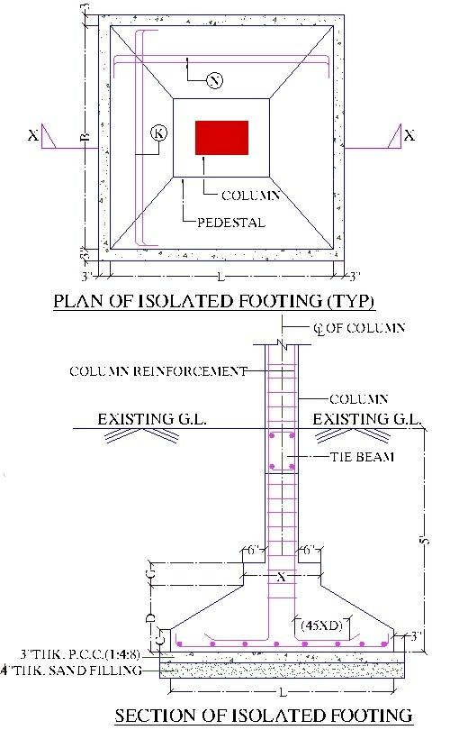
FOOTING F1
 | Feet | Inch | Metre | Reinforcement details
L = | 4 | 0 | 1.20 | D2(Diameter of bars) | T(Spacing)
B = | 4 | 0 | 1.20 | 10 mm | 0.15 m
D = | 0 | 10 | 0.25
C = | 0 | 6 | 0.15
G = | 0 | 6 | 0.15
L1(Length of Column)= | 0 | 14 | 0.36
B1(Breadth of Column)= | 0 | 9 | 0.23
D1(Depth for Excavation)= | 5 | 7 | 1.68
P1(PCC | 0 | 3 | 0.08
S1(Sand Filling Thickness)= | 0 | 4 | 0.10
W1(Bottom Wire Mesh Spacing)= | 0 | 6 | 0.15
Sl No. | Particulars | Calculation | Quantity | Nos. of F1 Footing | Total Quantit y
1 | Earthwork in Excavation | ((L+0.3) x (B+0.3) x D1) m³ | 3.78 m³ | 1 | 3.78 m³
2 | 1:4:8 PCC | ((L+0.15) x (B+0.15) x P1) m³ | 0.14 m³ | 1 | 0.14 m³
3 | Sand Filling | ((L+0.15)x(B+0.15)xS1) m³ | 0.19 m³ | 1 | 0.19 m³
 | RCC in Footing
 | a)Upper Rectangular Portion | (L1+0.3) x (B1+0.3)xG | 0.05 m³

Slide 17
4 | b) Bottom Rectangular Portion |  | (L x B x C) m³ | 0.22 m³
 | c) Trapezoidal Portion |  | {0.5 (L + (L1+ 0.3 )} x {0.5(B+(B1+0.3)} x (D-C) _{m}3 | 0.08 m³
 | Total |  |  | 0.35 m³ | 1 | 0.35 m³
5 | Reinforcement |  |  | 10.9 kg | 1 | 10.9 kg
 | a)Main bar in Foundation
 | Transverse direction | No. of bars (N2)= (Q/T)+ 1 | 8
 |  | L-2 x Clear Cover (Q) | 1.1 m
 | Longitudinal direction | No. of bars (N1)= (P/T)+ 1 | 8
 |  | B-2 x Clear Cover (P) | 1.1 m
 |  |  | Length=P x N1+Q x N2
 |  |  | Weight= Lengthx((D2 x D2)/162)
6 | Shuttering |  | Area= 4L x C | 0.73 | 1 | 0.7 m²

Slide 18
TOTAL QUANTITY IN FOUNDATION
Item | Quantity |  |  |  |  |  |  |  |  |  |  |  | Total Quantity
 | F1 | F2 | F3 | F4 | F5 | F6 | EF1 | EF2 | EF3 | EF4 | EF3" | EF4"
E/W in Excavation | 3.78 m³ | 4.87 m³ | 18.20 m³ | 37.00 m³ | 17.80 m³ | 21.00 m³ | 18.88 m³ | 4.87 m³ | 12.13 m³ | 14.80 m³ | 6.07 m³ | 7.40 m³ | 166.78 m³
PCC(1:4:8) | 0.14 m³ | 0.18 m³ | 0.70 m³ | 1.45 m³ | 0.71 m³ | 0.84 m³ | 0.65 m³ | 0.17 m³ | 0.45 m³ | 0.56 m³ | 0.23 m³ | 0.29 m³ | 6.38 m³
Sand Filling | 0.19 m³ | 0.25 m³ | 0.94 m³ | 1.93 m³ | 0.94 m³ | 1.12 m³ | 0.87 m³ | 0.23 m³ | 0.59 m³ | 0.74 m³ | 0.31 m³ | 0.39 m³ | 8.50 m³
RCC (M20) | 0.35 m³ | 0.51 m³ | 2.06 m³ | 4.84 m³ | 2.41 m³ | 3.41 m³ | 1.71 m³ | 0.48 m³ | 1.33 m³ | 1.85 m³ | 0.69 m³ | 0.91 m³ | 20.55 m³
Reinforcement | 10.86 kg | 8.85 kg | 72.08 kg | 211.56 kg | 135.34 kg | 164.39 kg | 104.86 kg | 33.09 kg | 84.22 kg | 137.85 kg | 42.11 kg | 68.93 kg | 1074.14 kg
Shuttering | 0.7 m² | 0.9 m² | 2.9 m² | 5.5 m² | 2.4 m² | 3.6 m² | 6.1 m² | 1.7 m² | 4.6 m² | 5.9 m² | 1.0 m² | 1.1 m² | 36.3 m²
For RCC
Grade of Concrete | Ratio Of Cement | Ratio of Sand | Ratio of Aggregate
M20 | 1 | 1.5 | 3
Total Volume of Concrete | Volume of Cement | Volume of Sand | Volume of Aggregate | No of Bags
20.55 m³ | 5.76 m³ | 13.29 m³ | 26.59 m³ | 166
For PCC
Grade of Concrete | Ratio Of Cement | Ratio of Sand | Ratio of Aggregate
M7.5 | 1 | 4 | 8
Total Volume of Concrete | Volume of Cement | Volume of Sand | Volume of Aggregate | No of Bags
6.38 m³ | 0.76 m³ | 4.65 m³ | 9.30 m³ | 22

