Slide 1
Building Services
Presented by: Ar. Kavita Nagpal

Slide 2
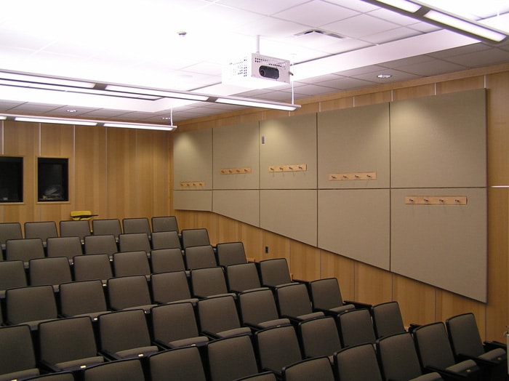
Sound Treatment Approach for Lecture Halls
Sound-Absorbing Panels – Acoustic Treatment Options
Decreasing reverberations times will help reduce background noise, which will make listening easier. To achieve lower reverberation times, side walls should be treated with sound-absorbing material. Acoustic-absorption panels are one of the most popular choices for this type of treatment.

Slide 3
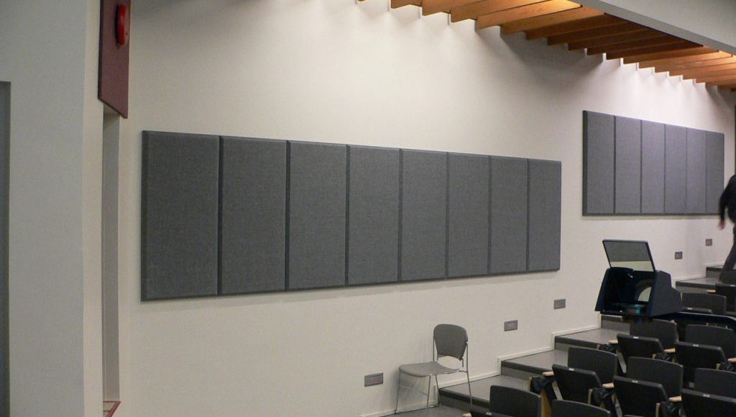
Sound Diffusion: Distance from Speaker to Listener
It may sound evident, but keeping as short of a distance as possible between the last row of audience seating and the speaker is essential.
Not only will this make listening easier for the entire audience, it will also create better sight lines so that everyone in the room can both see and hear the speaker.

Slide 4
Sound Treatment for Mechanical Systems
Mechanical systems are often the main source of intrusive noise in classrooms and lecture halls. HVAC and other mechanical systems are needed to keep the building running, but can often create a lot of noise.
For new buildings, you can minimize noise by locating machinery away from walls to avoid additional structure-borne noise from vibrations. You can also use buffer zones, like storage facilities, to build distance between noise-sensitive rooms and machinery.
If working on an existing building where machinery cannot be relocated, treat the parts with sound-absorbing material to reduce noise at the source.

Slide 5
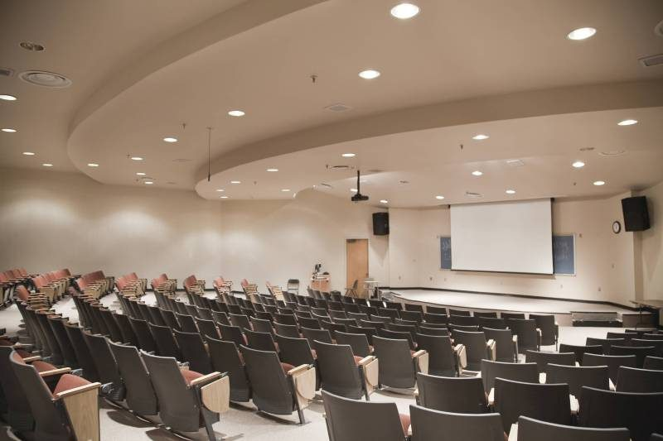
Lecture Hall Acoustics
In an area that is so critical for speech comfort and intelligibility, acoustic treatment must be considered during the design phase of these classrooms. Ensure that you implement sufficient acoustic treatment, and design geometries for clear vision and minimal reverberation.

Slide 6
Thanks

