Slide 1
Building Services
Presented by: Ar. Kavita Nagpal

Slide 2
Acoustics for Auditorium

Slide 3
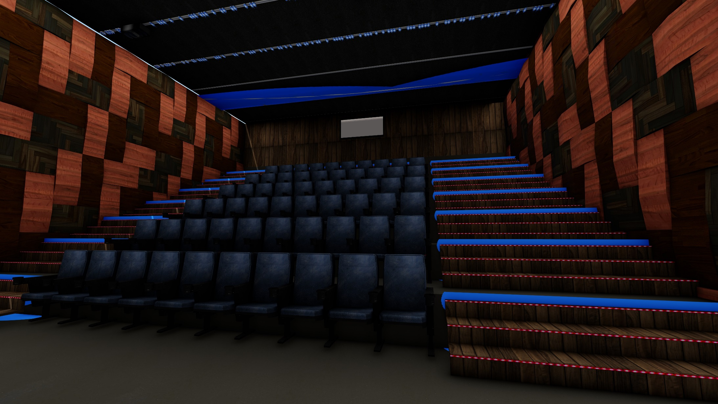
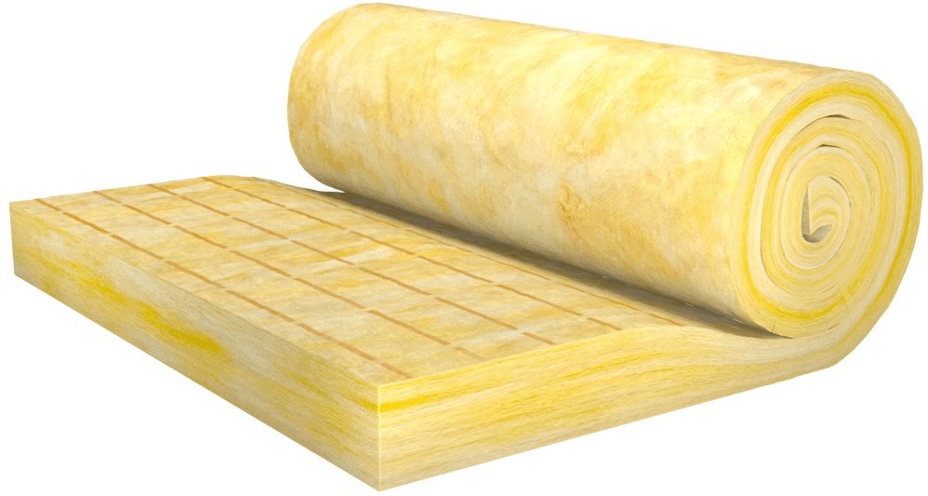
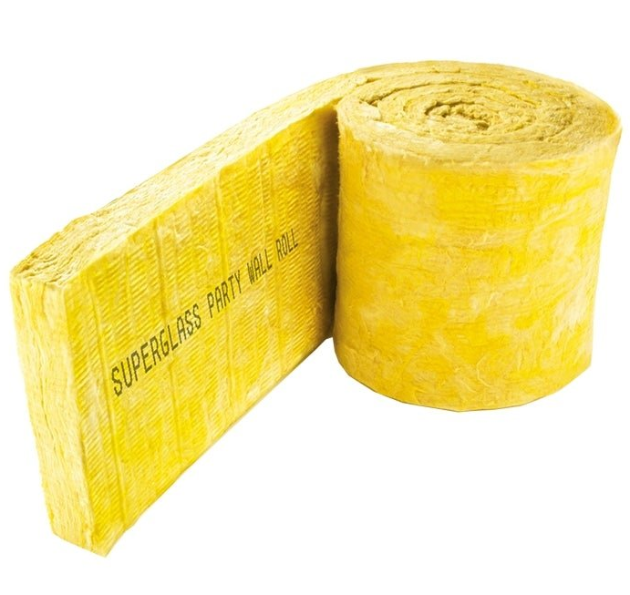
Acoustic materials for auditorium
Acoustic materials in the form of sound absorbers or absorbers there are several types, the following is an explanation.
Glass wool

Slide 4
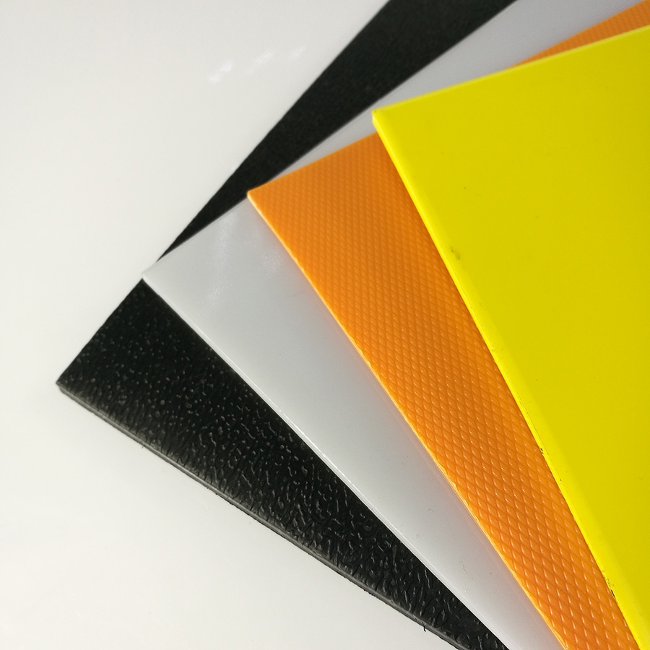
Glasswool is a silencer made of wool textured fiberglass with a thickness of 25mm50mm.
NRC on this material is relatively small and in its use is not durable because this material can absorb water so that there can be a decrease in sound absorption.
Polyethylene Terephtalate (PET)
This material is widely used by manufacturers because of the function which can be both an absorbent and a silencer.
Its ability to block sound is better than other materials. PET is very easy to shape and apply and safe to use because it comes from recycled material.

Slide 5
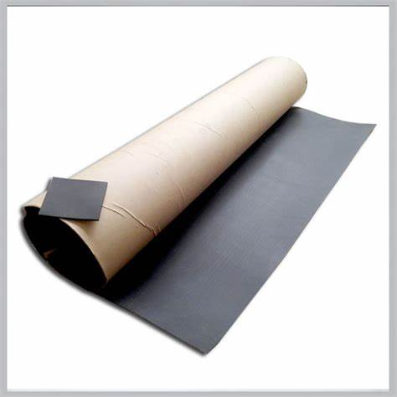
Acourete Mat Resin 2A
This material is in the form of black sheets made of rubber and a mixture of chemicals.
The installation is very easy. This material can insulate sound better than other materials and its durability can be more than 15 years

Slide 6
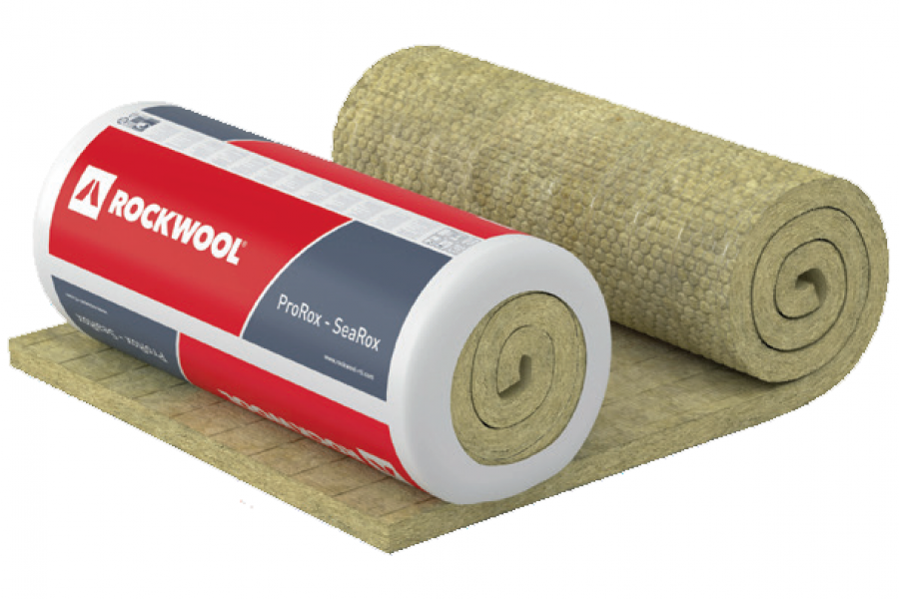
Rockwool
Rockwool is a sound - absorbing material composed of lightweight mineral fiber products that can absorb sound and heat. Rockwool is a non-flammable material.

Slide 7
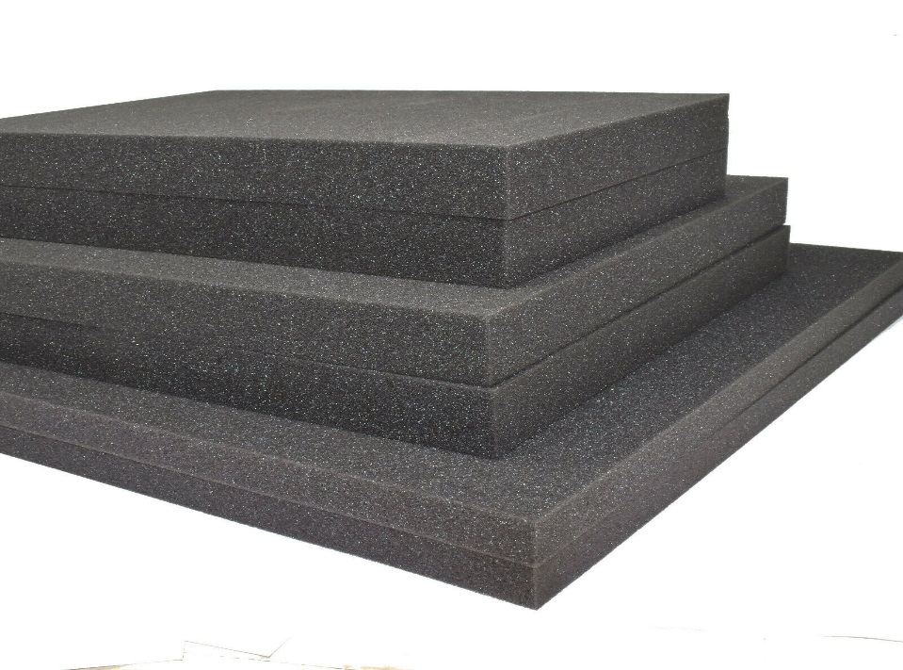
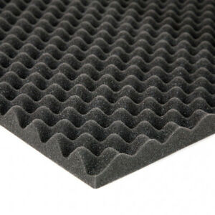
ACOUSTIC MATERIALS AVAILABLE IN MARKET
BASOTECT
DAMPING MAT
It is used in building services like arid ceiling panels for office and conference suit etc.
It has good thermal insulation.
Barrier mats are used to reduce vibration in sheet, metal and other resonant surfaces such as vehicle body parts.

Slide 8
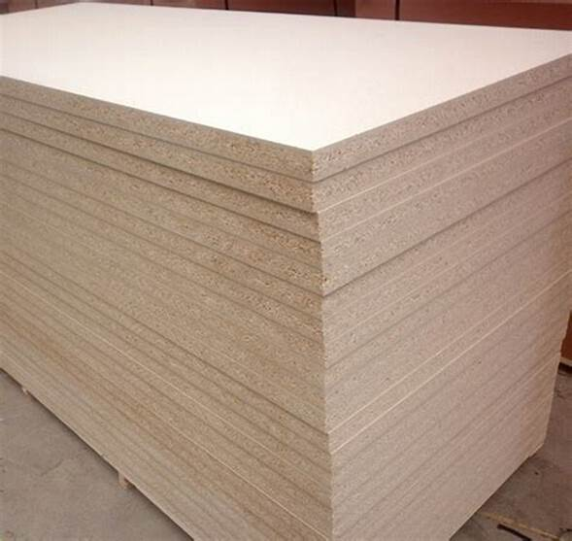
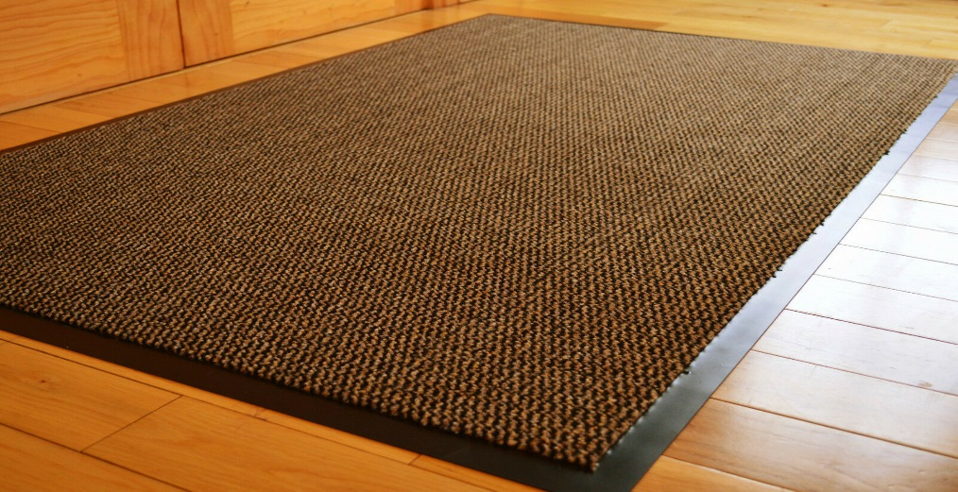
SOUND FIBRE ROCK
BARRIER MATS
It consist of thermoplastic polymer with phthalate esters and mineral fillers, making it an extremely durable and flexible product.
It is resistance to high temperature.
It has excellent sound and thermal qualities, making it an ideal choice for cavity wall, floor and ceiling insulation.

Slide 9
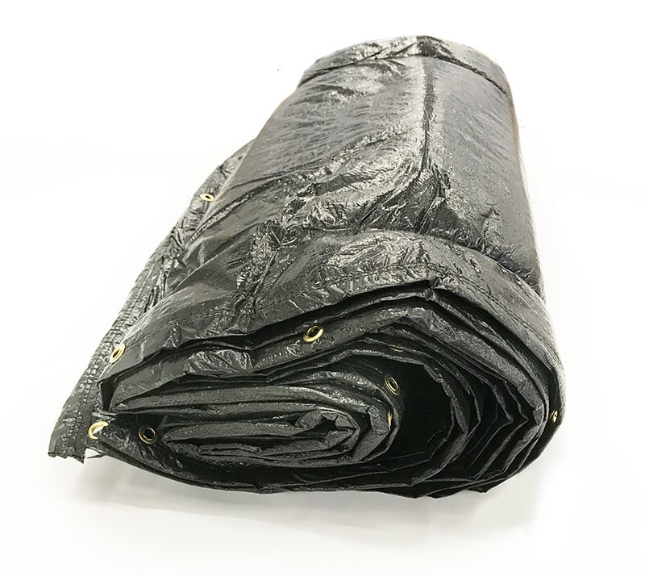
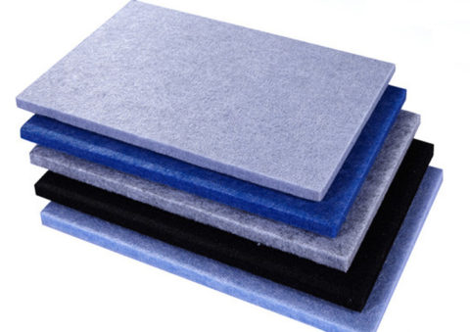
INSULATION BLANKET
SOUND FIBRE POLY
Degree of durability.
They are fire resistant and also resistant to most common fluids, mineral oil and petroleum.
It is manufactured from non-irritating water repellent polyester fibres.
It is designed for use in acoustic.

Slide 10
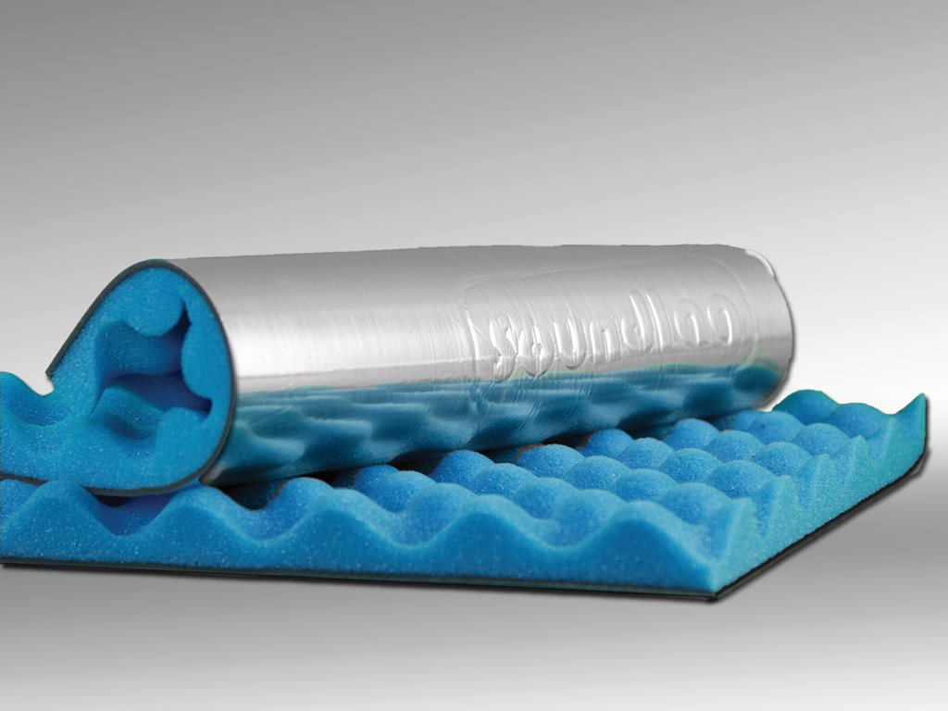
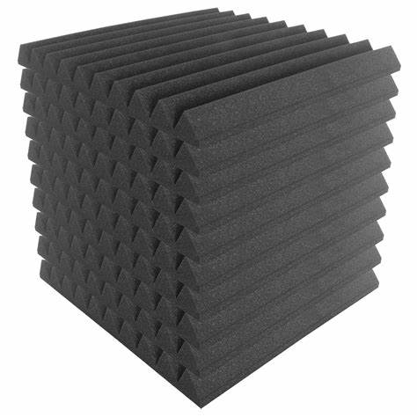
SOUND LAG
SOUND FORM S
Sound Lag L is requiring a high level of thermal insulation and improved sound absorption.
It is used extensively in the motor industry for vehicle and compressors, generators, enclosures

Slide 11
THANKS

