Slide 1
Subject: Advance Material & Technology in Architecture
Topic: Green Building Concept – II
Presented by: Kavita Nagpal

Slide 2
INDIAN GREEN BUILDING COUNCIL
The Indian Green Building Council (IGBC) was formed in the year 2001 by Confederation of Indian Industry (CII).
The aim of the council is to bring green building movement in India and facilitate India to become one of the global leaders in green buildings by 2015.

Slide 3
IGBC RATING SYSTEM
IGBC has developed green building rating programmes to cover commercial, residential, factory buildings, etc.
Each rating system divided into different levels of certification are as follows:
„Certified‟ to recognise best practices.
„Silver‟ to recognise outstanding performance.
„Gold‟ to recognise national excellence.
„Platinum‟ to recognise global leadership.

Slide 4
GREEN BUILDINGS PROJECT IN INDIA
Suzlon Energy Limited-Pune
Biodiversity Conservation India-Bangalore
Olympia Technology Park-Chennai
ITC Green Centre-Gurgaon
The Druk White Lotus School-Ladakh
Doon School-Dehradun
Raintree Hotels-Chennai
Nokia-Gurgaon
Rajiv Gandhi International Airport-Hyderabad
Hiranandini-BG House, Powai
ABN Amro Bank, Chennai
Palais Royale at Worli, Mumbai
Punjab Forest Complex,Mohali

Slide 5
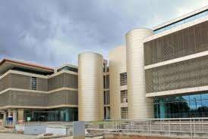
SUZLON ENERGY LIMITED,PUNE:
Several accolades continue to shower upon Suzlon‟s global headquarter in Pune “One Earth”.
LEED certified it as
„PLATINUM‟ and it is built on an area of 10.13acres.
One Earth can be counted as among the largest green building projects in India.

Slide 6
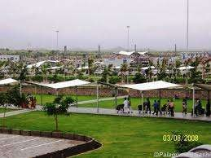
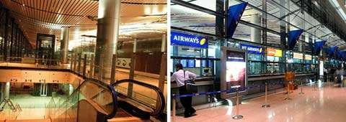
RAJIV GANDHI INTERNATIONAL AIRPORT- HYDERABAD:
India‟s first Greenfield airport is undeniably among the top 10 green buildings in India.
First airport in asia to be certified with „SILVER‟ rating.
This green building ensures optimal use of natural light and minimal wastage of electricity or energy consumption.

Slide 7
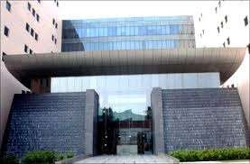
NOKIA-GURGAON:
„GOLD‟ rated building by LEED.
Its smart lighting, heat recovery wheel and high efficiency chillers makes this office stand out from the rest.

Slide 8
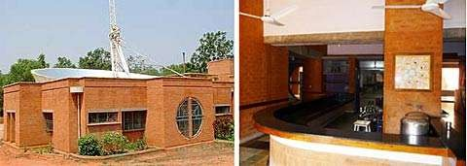
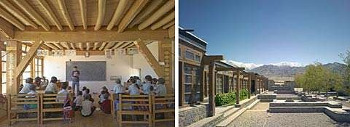
SOME IMAGES OF GREEN
BUILDINGS

Slide 9
DIFFERENT FROM OTHER BUILDINGS
The design,maintaince and construction of buildings have tremendous effect on our enviornment and natural resources.
Green Building is different from the other buildings because it use a minimum amount of nonrenewable energy, produce minimal pollution, increases the comfort, health and safety of the people who work in them.
It also minimize the waste in construction by recovering materials and reusing or recycling them.

Slide 10
THANKS

