Slide 1
Topic: Green Building
Presented by: Ar. Kavita Nagpal

Slide 2
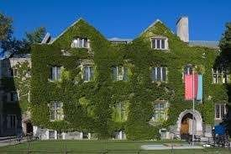

Slide 3
INTRODUCTION
Green building (also known as green construction or sustainable building) expands and complements the building design concerns of economy, utility, durability, and comfort.
A Green Building is one which uses less water, optimizes energy efficiency, conserves natural resources, generates less waste and provides healthier space for occupants as compared to conventional buildings.

Slide 4
OBJECTIVES OF GREEN
BUILDING
Green Buildings are designed to reduce the overall impact on human health and the natural environment by the following ways:
Using energy, water and other resources efficiently.
By reducing waste, pollution, and environmental degradation.

Slide 5
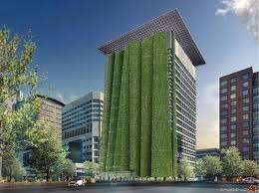
FUNDAMENTAL PRINCIPLES
Structure design efficiency
Energy efficiency
Water efficiency
Materials efficiency
Waste and toxic reduction

Slide 6
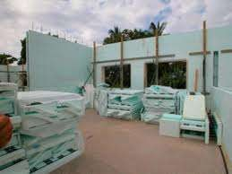
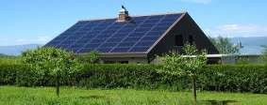
STRUCTURE EFFICIENCY:
It is the concept of sustainable building and has largest impact on cost and performance.
It aims to minimize the enviornmment impact associated with all life-cycles.
ENERGY EFFICIENCY:
The layout of the construction can be strategised so that natural light pours for additional warmth.
Shading the roof with trees offers an eco-friendly alternative to air conditioning.

Slide 7
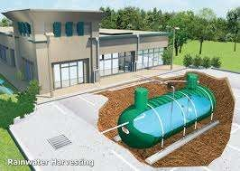
WATER EFFICIENCY:
To minimize water consumption one should aim to use the water which has been collected, used, purified and reused.

Slide 8
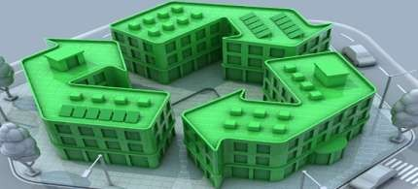
MATERIAL EFFICIENCY:
Materials should be use that can be recycled and can generate surplus amount of energy.
An example of this are solar power panels,not only they provide lightening but they are also a useful energy source.
WASTE AND REDUCTION:
It is probable to reuse resources.
What may be waste to us may have another benefit to something else.

Slide 9
Thank you

