Slide 1
Subject: History of Architecture-II
Topic: Buddhist Architecture in India-2
Presented by: Hiba Gul

Slide 2
Buddhist architecture
IN INDIA

Slide 3
CHAITYAS
A Buddhist shrine or prayer hall with stupa at one end
Made for large-gathering of devotes.
Made in rock-cut due to permanency of structure.
Chaityas were influenced by ascetic lifestyle of vedic period and tendency of hermits to retire in solitude

Slide 4
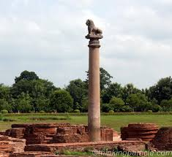
Pillars of ashoka
Pillars retaining their animals. The most celebrated capital the four-lion one at sarnath [uttar Pradesh] erected by emperor ashoka circa 250 BC. Also called “ASHOKA COLUNM”.
Four lions are seated back to back.
This is one of the nineteen surviving columns erected or at least inscribed with edicts by the emperor ashoka during his reign in the 3rd century BCE.

Slide 5
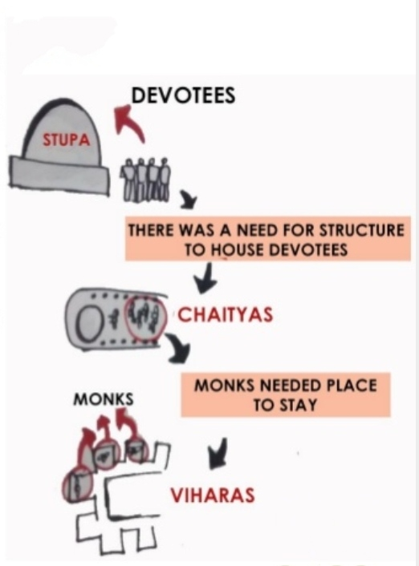
Why a chaitya hall
The stupa evolved from being a funerary mound carrying object of worship, had a sacral value.
Building needed to accommodate copies of stupa and provided shelter.
A structural house for religious activities.
Birth of temples with idol worship.
Building had almost circular plan and a domed roof.

Slide 6
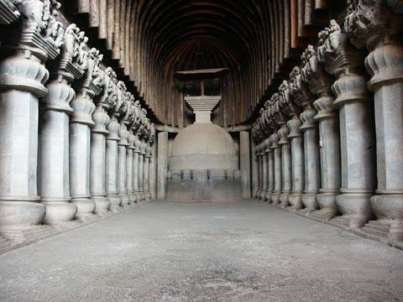
CHAITYAS {CAVES}
Architecturally, chaityas show similarities to Roman design concepts of columns and arch.
The monks built many structures which were carved out of a single massive rock,done with hammer and chisel , bare hands.
The chaityas were almost 40 metres long, 15 metres wide and 15 metres high.

Slide 7
ARCHITECTURAL FEATURES
Wooden construction inspired from vedic period imitated in natural rock.
Supplemented with wooden surfaces for eg.. Screens etc.
Shows similarities to roman concept of column and arch, but no evidence of any relation.
Rectangular halls with finely polished interiors walls.
Well proportioned pillars with capitals{around 35}
Semi circular roof.
Pillar had three parts: prop, base buried in ground and shaft.
Stupa at the end.
Extensive use of motifs, decorative and symbolic.

Slide 8
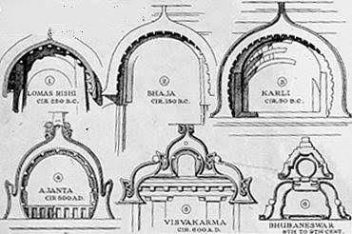
Chaitya Arch
Chaityas normally had a great- horseshoe archway with a wall or screen below.
There was sun window in centre of the archway for light.

Slide 9
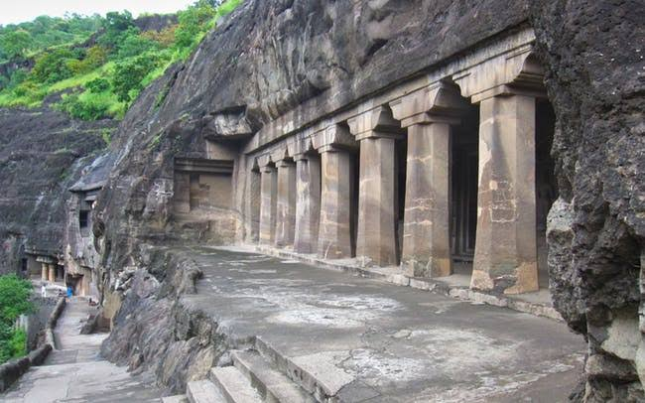
viharas
A monastery arrangement of cells for accommodation of monks.
Dwellings were simply wooden construction/ thatched bamboo huts .
Near settlements on trade routes.
After first century AD, viharas came in as educational institutes.

Slide 10
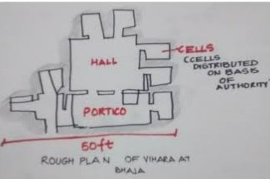
Basic Characteristics
Quadrangular court for gathering.
Surrounded by small cells.
Front wall incorporated a shrine for image of Buddha .
Cells had rock cut platforms or beds.
Viharas were not a like in design.
Doorways were on sides of the walls of main hall.

Slide 11
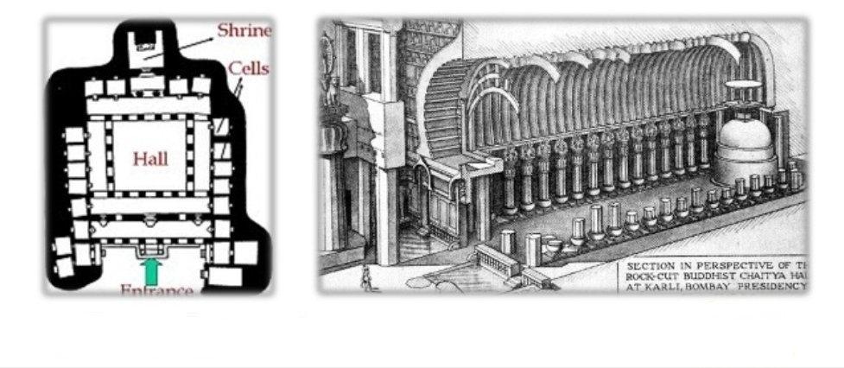
Viharas {monasteries}
They were the residential places of the Buddhist priest {monks}
The main hall was entered through a doorway, leading to an assembly hall, dining chambers and meditation cells.
The walls depict figures of the Buddha.
The columns were of 60 metres height and well- chiseled.

Slide 13
THANKU

