Slide 1
Subject: History of Architecture-II
Topic: Buddhist Architecture in India-I
Presented by: Hiba Gul

Slide 2
Buddhist architecture
IN INDIA

Slide 3
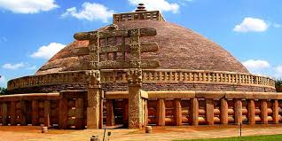
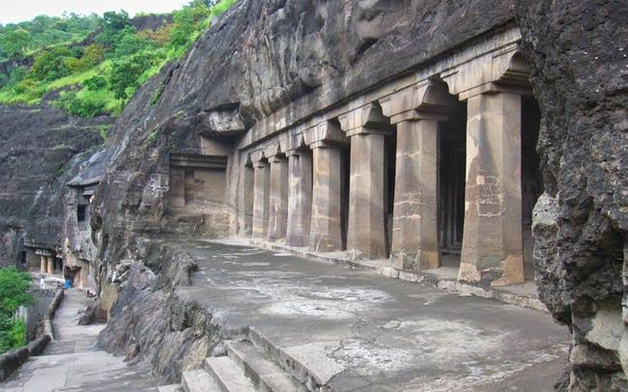
INTRODUCTION
The Buddhist Architecture began with the development of various symbols, representing aspects of the Buddha’s life[563BCE-483BCE]
Indian emperor ashoka, not only established Buddhism as the state religion of his large magadh empire,but also opted for the architectural monuments to spread Buddhism in different places.
The major features of this style are stupas, stambhas, chaityas, viharas.

Slide 4
Features of Buddhist architecture

Slide 5
Features of Buddhist architecture
The major features of this style are:
Stupas {Buddhist shrine}
Stambhas {pillars}
Chaityas {caves}
Viharas {monasteries}
Out of these ,the prominent examples of Chaityas Hall and Viharas can be found in rock-cut architecture.
Even the stupas can be found in certain chaitya halls in a miniature form.

Slide 6
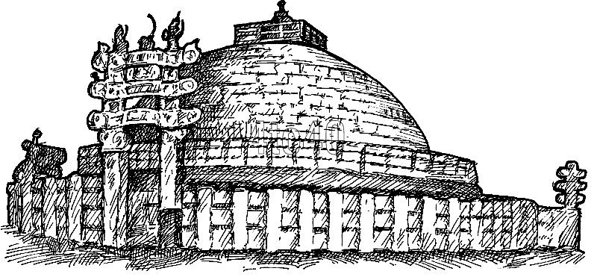
Stupas {domes}
DEFINATION: Dome-shaped structures used to house sacred relics of the monks and hence also known as “relic-shrines”
CONSTRUCTION MATERIALS: Earth materials covered with stones or bricks. The plan, elevation and the basic structure all derived from the circle.

Slide 7
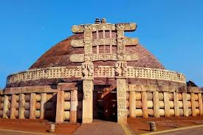
Buddhist Architecture - STUPA
STUPA IS MOUND OF THE EARTH ENCLOSING A RELICCAN BE COMPARED WITH THE MASSIVE FORM THE GREAT PYRAMIDS OF EGYPT.
THEY ALSO CALLED AS THUPPA IN PALI, DAGABAINSIMBALI,TOPE IN ENGLISH AND DHATUGRABH IN SANSKRIT.[DHATTUGRABH =RELICS PRESERVED IN VESSEL.
CLASSIFIED INTO THREE TYPES.
SARIKA STUPA-raised over body relics.
PARIBHOJIKA STUPA- erected over the articles, like the bowl, the sanghati
UDDESHUIKA STUPA- stupas built as commemorative monuments.

Slide 8
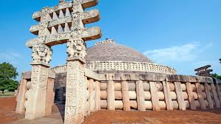
Torans at sanchi
Torans are associated with Buddhist stupas like the great stupa in sanchi,as well as with jain and hindu structures, and also with several secular structures.
In the 1st century BCE, four elaborately carved toranas {ornamental gateways} and a balustrade encircling the entire structure were added around the sanchi stupa built during Mauryan period.

Slide 9
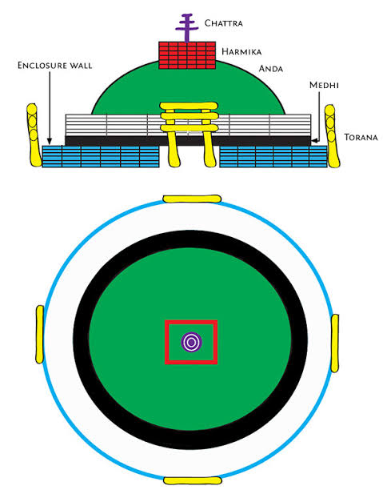

Slide 10
THANKU

