Slide 6
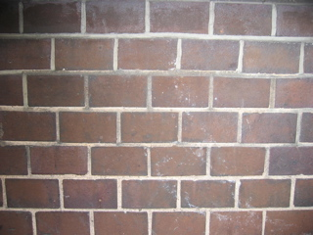

Slide 7
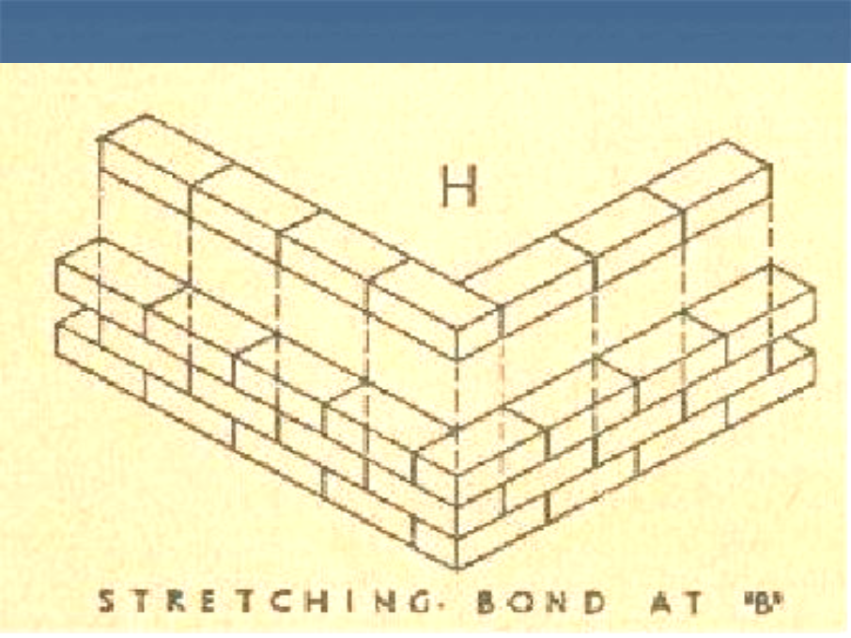
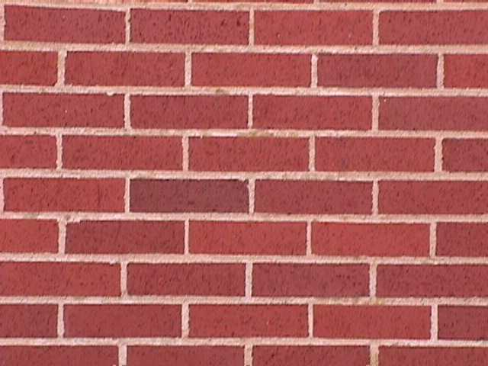
The majority of modern structures were built using a running, or stretcher bond pattern. With this design, stretchers are placed end to end along the length of a row. The stretchers above and below this row are staggered to prevent the joints from lining up. Stretcher patterns are quick and easy to build, and thus less expensive than other brick bonds. At the same time, they are also less durable and offer much less decorative appeal.

Slide 8
English, or Old English patterns represent the oldest and strongest type of brick bonds. This pattern consists of alternating rows of stretchers and headers, so that a full horizontal row of stretchers is sandwiched between full rows of headers. English bonds are very durable because the brick joints are unlikely to overlap. This bond pattern is also considered visually appealing, though less so than some newer bond designs.

Slide 10
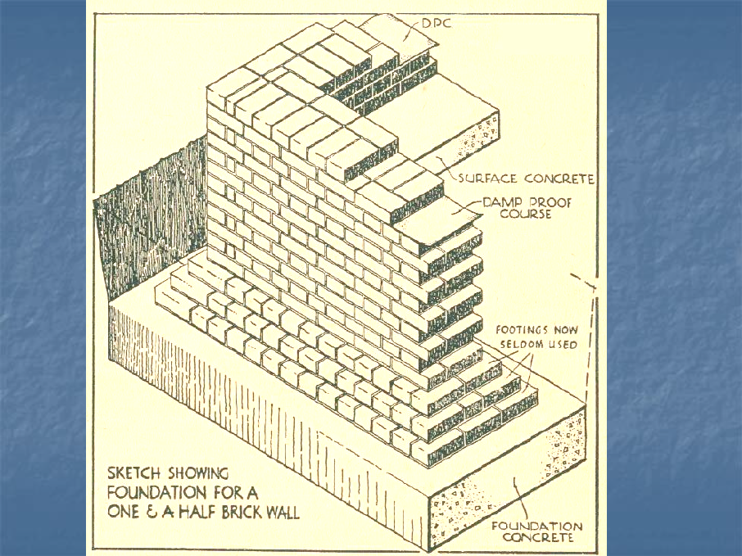

Slide 11
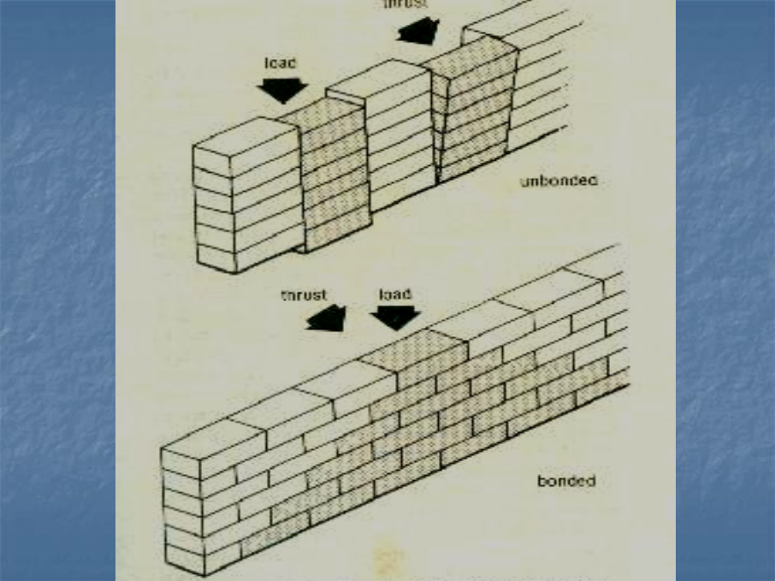

Slide 13
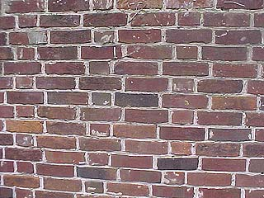
Flemish Garden Wall Bond
A variant of Flemish Bond, with three stretchers between each header, and the header centred over the stretcher in the middle of a group of three in the row below.

Slide 14
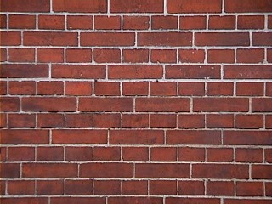
English Cross Bond or Dutch Bond A form of bond similar to Old English bond. This bond uses alternate headers and stretcher courses. The joints of the stretchers center on the stretchers two courses above and below; headers center on headers. This type of bond is used where strength and beauty are required.

