Slide 1
Beginning of
history in Architecture
Ar. Manish kumar

Slide 2
BEGINNING OF HISTORY OF ARCHITECTURE & THE BUILT ENVIRONMENT
BC = Before Christ - THE YEARS BEFORE THE BIRTH OF JESUS CHRIST
A.D. = Anno Domini (year of our Lord) The number of years since the birth of Jesús Christ. THE YEARS AFTER THE BIRTH OF JESUS CHRIST

Slide 3
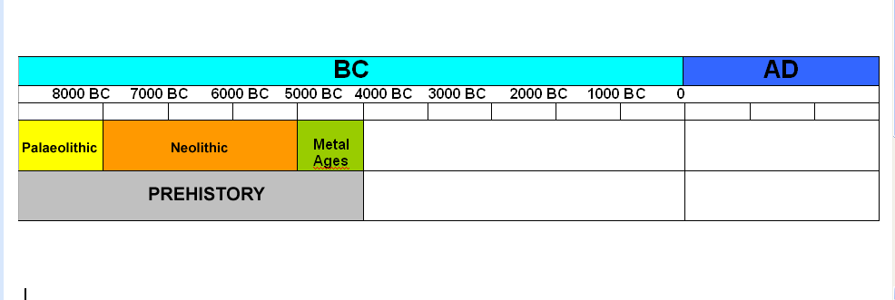
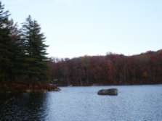
BEGINNING OF HISTORY OF ARCHITECTURE & THE BUILT ENVIRONMENT
The human race appeared on Earth 2.000.000 or 3.000.000 years ago and...
...Paleolithic started
Life in prehistory : The fight for survival
Humans are living creaturas.… What do we need to survive?
PROTECTION
WATER
FOOD

Slide 4
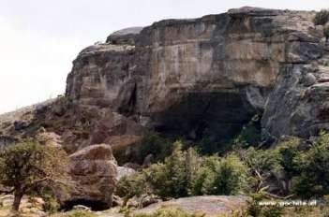
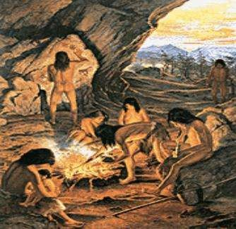
In Palaeolithic people were NOMADIC
BEGINNING OF HISTORY OF ARCHITECTURE & THE BUILT ENVIRONMENT
People moved from one place to another...
Protection from bad weather, dangers…
They sheltered in caves

Slide 5
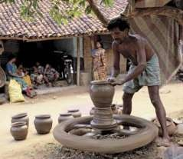
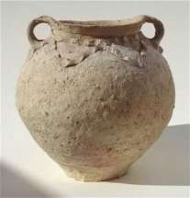
BEGINNING OF HISTORY OF ARCHITECTURE & THE BUILT ENVIRONMENT
Survival was not easy...
The storage of water?
They learnt to make containers that can store water
POTTERY

Slide 6
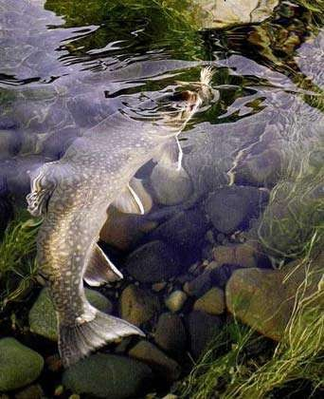
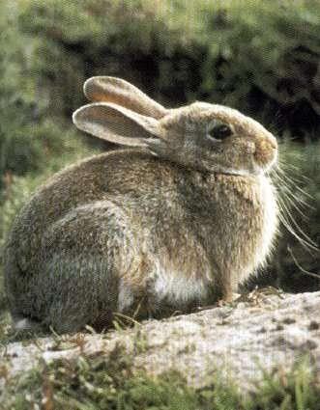
They had...
BEGINNING OF HISTORY OF ARCHITECTURE & THE BUILT ENVIRONMENT
Wild fruits and vegetables
Fish
Meat

Slide 7
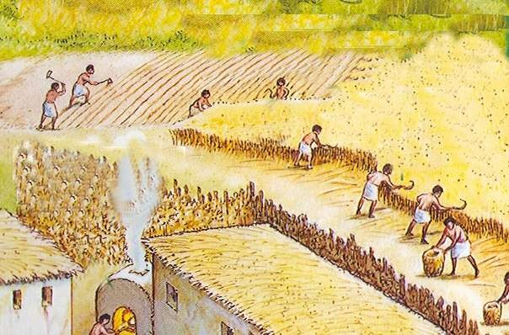
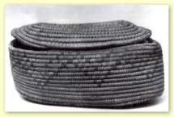
There were a lot of problems!
BEGINNING OF HISTORY OF ARCHITECTURE & THE BUILT ENVIRONMENT
It’s difficult to find wild fruits and vegetables during the cold winters
They learnt to farm the land
They learnt to make containers
that can store food
BASKETS
POTTERY

Slide 8
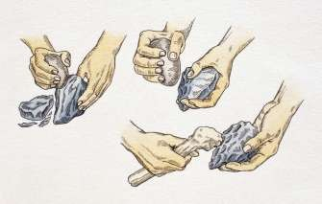
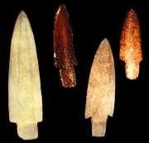
BEGINNING OF HISTORY OF ARCHITECTURE & THE BUILT ENVIRONMENT
Hunting was also not easy…
Animals are stronger, bigger and faster than men
They learnt to shape stones into tools or weapons

Slide 9
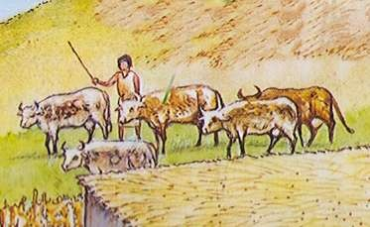
BEGINNING OF HISTORY OF ARCHITECTURE & THE BUILT ENVIRONMENT
Could they hunt and fish always?
No, it’s difficult to find animals during the cold winter Difficulties to hunt and fish during the cold winter
They learnt to take care of animals

Slide 10
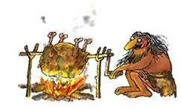
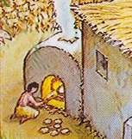
BEGINNING OF HISTORY OF ARCHITECTURE & THE BUILT ENVIRONMENT
THE USES OF FIRE
COOKING FOOD: Humans learnt how to use fire to cook, so
their diet became healthy and tasty
Roasting some meat
Baking bread
The vegetables soup is boiling

Slide 11
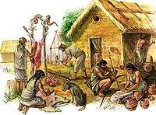
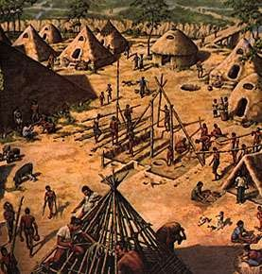
Cave is not a nice place to live
BEGINNING OF HISTORY OF ARCHITECTURE & THE BUILT ENVIRONMENT
They built huts They lived in settlements
In Neolithic people learnt to farm the land and take care of animals
In Neolithic people became SEDENTARY

Slide 12
Changes in society..
BEGINNING OF HISTORY OF ARCHITECTURE & THE BUILT ENVIRONMENT
World population grew
People began to grow more food than they would need – allowed people to do things other than farming
Trade increased
Establishment of Towns/Cities
Cities become centers of trade, politics and culture
Men became superior
Formalized religion
Ceremonies, rituals, and worship Built large temples

Slide 13
BEGINNING OF HISTORY OF ARCHITECTURE & THE BUILT ENVIRONMENT
Social classes ..
Based on occupations, wealth, and influence
rulers, priests, and nobles
merchants and artisans
farmers and unskilled workers – majority
slaves

Slide 14
Organized Government
BEGINNING OF HISTORY OF ARCHITECTURE & THE BUILT ENVIRONMENT
Projects need planning-decision making
created laws
established systems of justice
supervised food production and building projects
gathered taxes
organized defense

Slide 15
NEED TO STUDY HISTORY OF ARCHITECTURE & BUILT ENVIRONMENTS
To locate our self , that we are not individual, we are connected to the entire world.
Experience from the past , largely influence today's decision.
We get to know that each era since the beginning of time formed its own unique style ..
Every action is sequel to another , so without studying past we cant move further..
Thus we need to study about our past and change has happens through time
to know how

