Slide 1
Subject: History of Architecture -IV
Topic: Architecture in Colonial India
Presented by: Hiba Gul

Slide 2
Architecture in Colonial India
British Colonial era lasted in India for over three centuries starting from 1615 to 1947.
Colonization of India also had a great impact on architecture
Colonization marked a new chapter in Indian architecture.
Colonial architecture culminated into what is called the Indo-Saracenic architecture.
The Indo-Saracenic architecture combined the features of Hindu, Islamic and western elements
Colonial architecture exhibited itself through institutional, civic and utilitarian buildings
such as post offices, railway stations, rest houses and government buildings

Slide 3
Anglo-Indian church builders to follow the model set by Gothic art in Italy/England
Indo Saracenic Architecture:
Indo-Saracen is Revival architecture also referred as Indo-Gothic, Neo-Mughal, Mughal-Gothic and Hindu-Gothic.
It was a combination of the Gothic revival style with that of the Neo-Classical, Indo-Islamic and Indian architectural style that was initiated by the British architects.

Slide 4
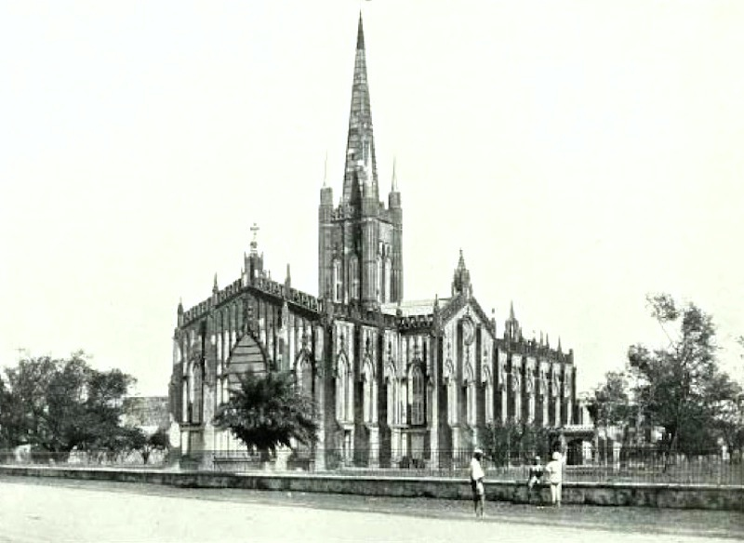
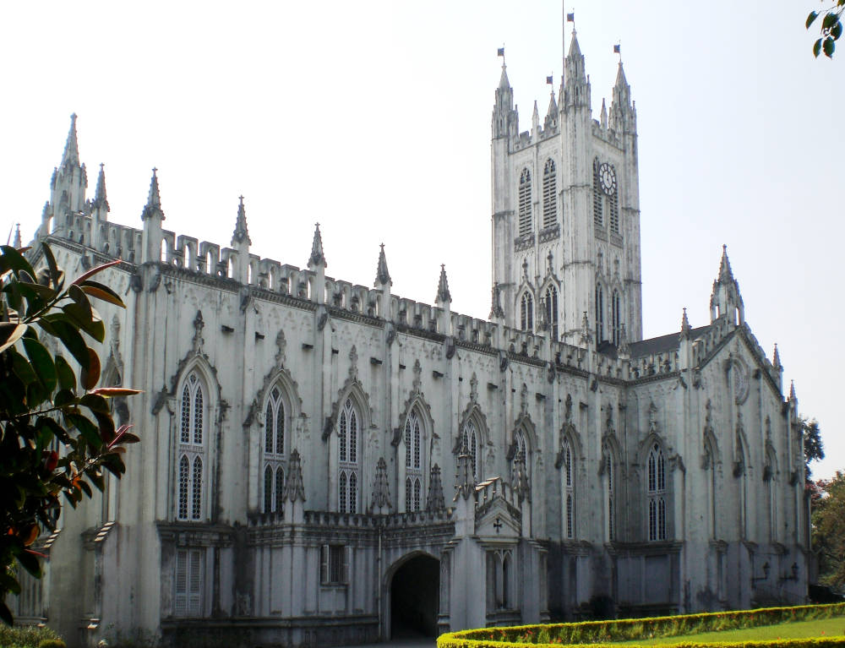

Slide 5
St Paul's Cathedral, Kolkata
St Paul's Cathedral, Kolkata, India. Architect: William Nairn Forbes (1796-1855)
The first stone was laid in 1839, and the building was completed in 1847.
This makes St Paul's the first Anglican cathedral of the Victorian age
The building was constructed in a peculiar brick the dressings were of Chunar stone
The whole edifice was covered inside and out with polished chunam“ The latter is a kind of stucco, and it gives the cathedral almost an ethereal aspect.

Slide 6
St Paul's as the very first Anglican cathedral outside Britain, was inspired by James Gibbs's St Martin's-in-the-Fields by Trafalgar Square in London.
The cathedral was to lose its steeple later on, as a result of earthquakes, but the redesigned early twentieth-century tower is still "on the pattern of the Bell Harry Tower of Canterbury Cathedral"

Slide 7
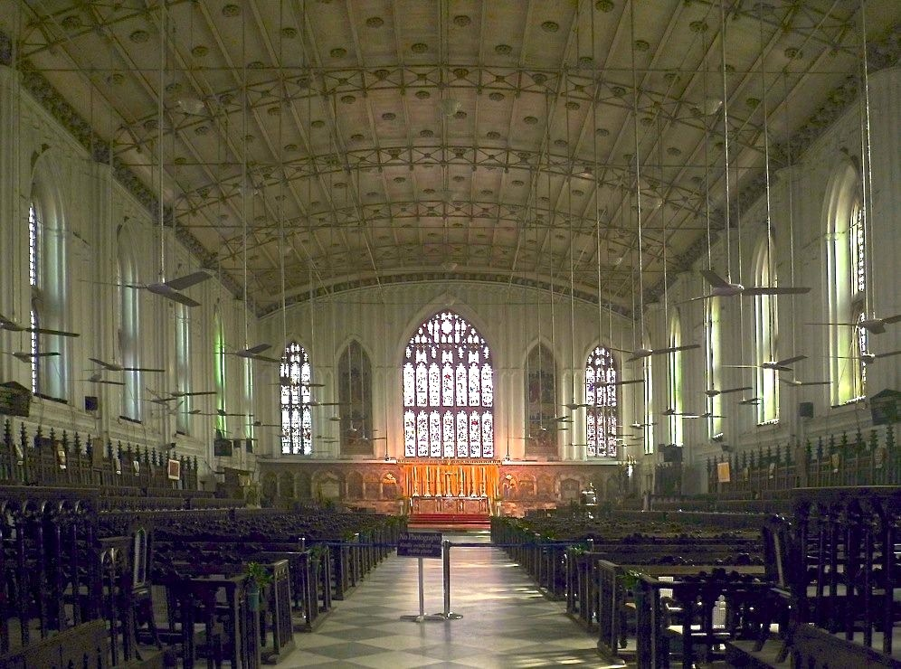
Interior
"The roof is unusual. It is a shallow curve spanned by iron trusses adorned with Gothic tracery," explains Davies: "when built, it was one of the largest spans in existence"

Slide 8
Town Hall
Town Hall is one of the most majestic structures among the other heritage buildings in the city of Mumbai.
The Town hall was colloquially called as 'Tondal' during the 19th century.
The Town Hall houses the 'Asiatic society of Bombay' (Mumbai)
Mumbai's Town Hall is a colonial structure and was built in 1833.

Slide 9
Architecture
The Town Hall was designed by Colonel Thomas Cowper who was one of the best engineers in Bombay (Mumbai).
With a span of 200 feet and height of 100 feet, the structure was inspired by Greek and Roman styles of architecture.
The entrance of the building is adorned with a Grecian portico and 8 impressive Doric styled pillars.
There is a flight of 30 steps leading to the entrance of the Town Hall.
The entire construction was made of stones brought from England and was beautifully designed in a neo-classical fashion.
Within the building, the floors are covered in ancient wood, the staircases are spiral and the terraces are adorned with beautiful wrought iron.
The hall boasts of a collection of remarkable marble statues of Indian patrons of the 19th century.

