Slide 1
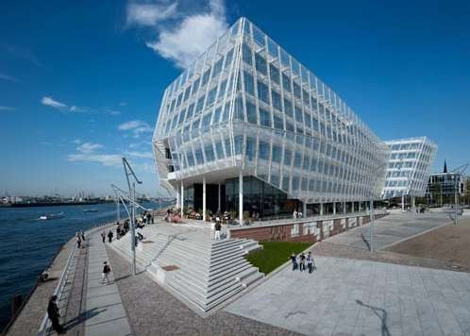
Architecture famous building
Ar. Manish Kumar

Slide 2
Examples of Architecture

Slide 3
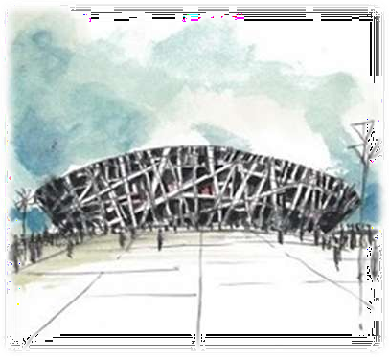
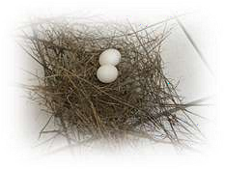
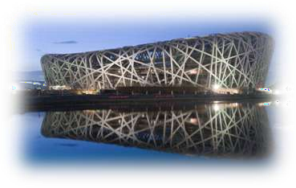
Beijing National Stadium 2008 Olympics
This is a huge structure and Herzog and DeMeuron have contributed some green solutions into their design including a rainwater collecting system, a translucent roof providing sunlight for the natural grass below and a passive
ventilation system. “Just as birds stuff the spaces between the woven twigs of their nests with a soft filler, the spaces in the structure of the stadium will be filled with inflated cushions to regulate wind, weather and sunlight.”

Slide 4
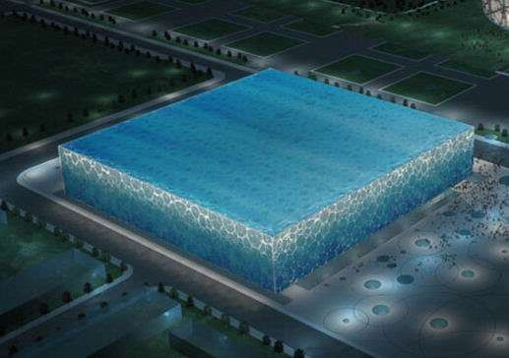
Beijing National Swimming Center: Blue

Slide 5
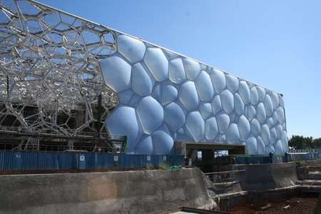
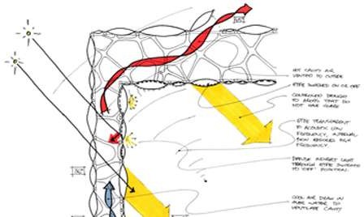
Looking at forms and patterns found in nature, the group started designing the skin. They quickly focused on soap bubbles and what happens to their geometry when they congregate.
It looks blue, but it's green.
As big, eye-catching Olympics architecture goes, nothing may be as sustainable as the Water Cube.
Adopting an ETFE pneumatic die cushion structure, the Water Cube is the world's largest membrane structure building.
The 100,000 square meters of the Teflon- like translucent plastic ETFE that make up the building's bubble cladding allow in more solar heat than glass, making it easier to heat the building, which cuts energy costs by up to 30 percent. That's especially important for a swimming pool, which requires an enormous amount of heating.
Besides the solar energy, all backwash water of the center is filtered and returned to the swimming pools.

Slide 6
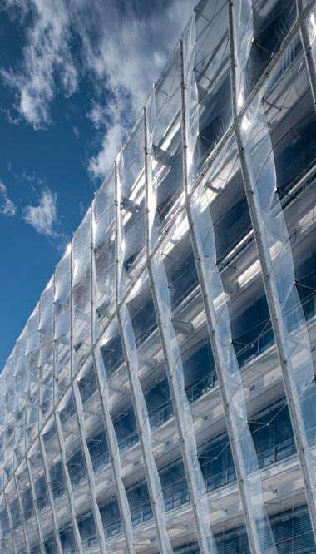
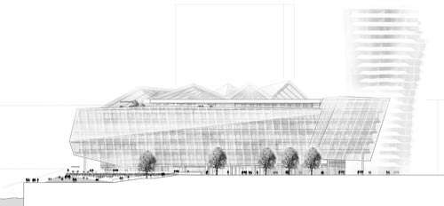
UNILEVER GERMANY HEADQUARTERS HAMBURG, GERMANY, 2007–2009

Slide 7
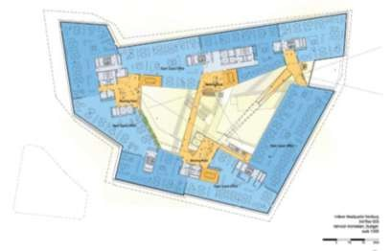
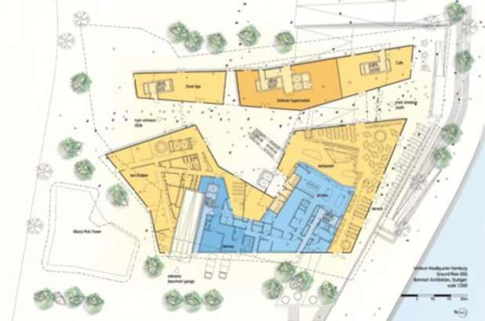
The central element and heart of the design is the generous atrium, flooded by
daylight, which, on the ground floor,
gives
passers-by the opportunity to get to know
the company better while browsing in the shop stocked with Unilever products, sitting in the cafe or relaxing in the spa.
The atrium is also the central location for people to meet and communicate.

Slide 8
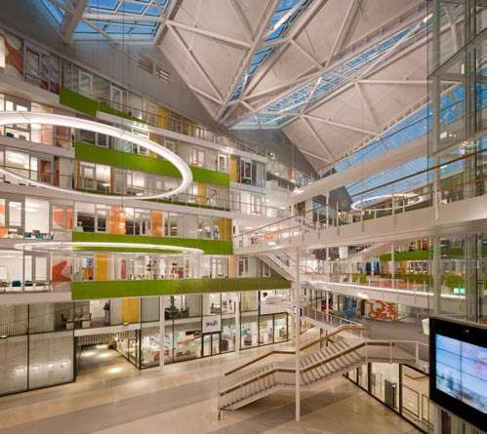
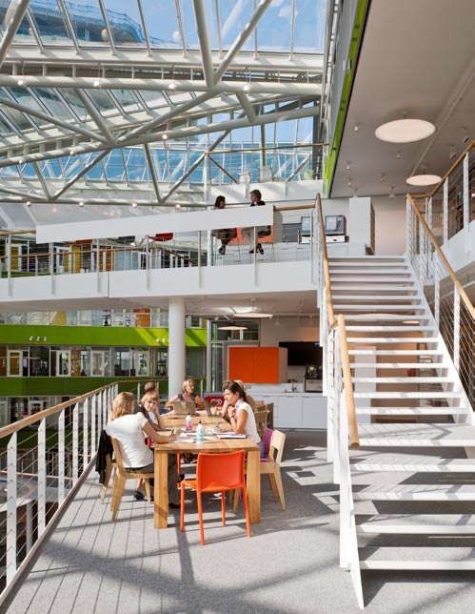
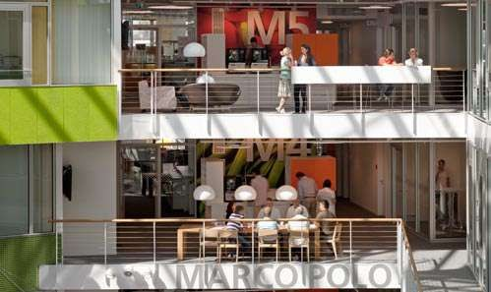

Slide 9
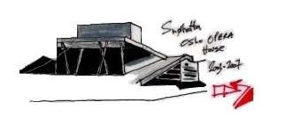
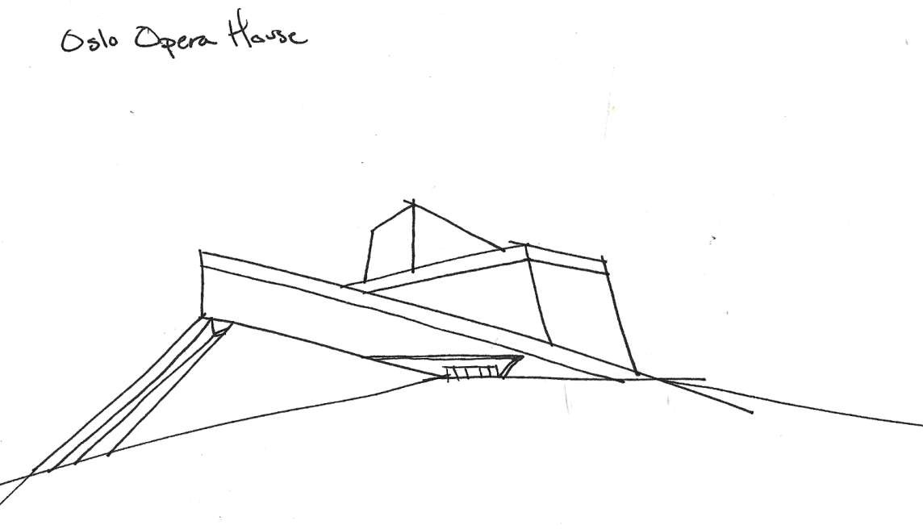
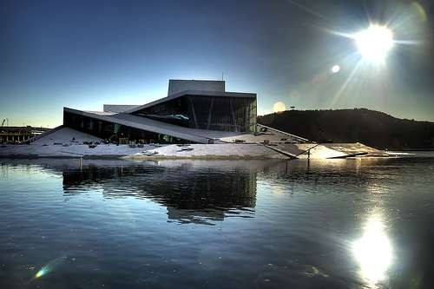

Slide 10
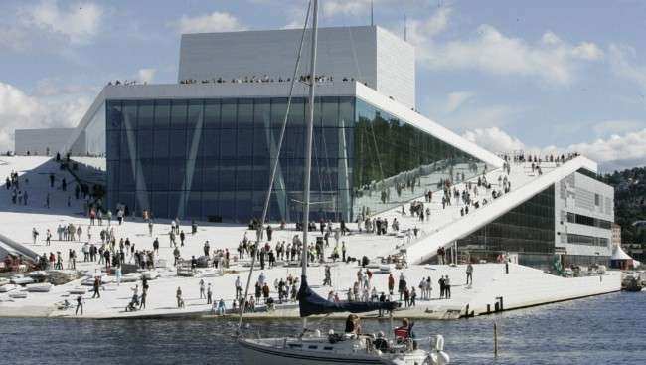
The roof landscape will be open to the public. The horizontal and sloping roofs express monumentality, and give the building a dramatically
different appearance than its neighbors.
The expression of openness and accessibility both indoors and out will result in the building appealing to a wide range of users.

Slide 11
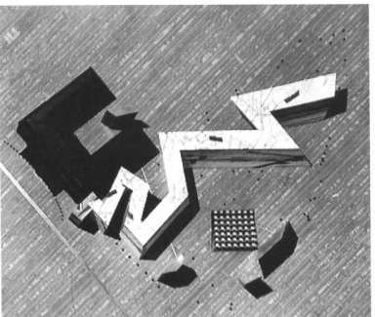
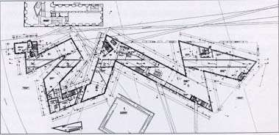
Museum Berlin
This geometry is intended to make you feel physcially ill
and recreates the terrible purpose behind the camps
Libeskind creates a dialogue between the past and the present of the Holocaust, and
Most importantly, LIbeskind poses
the question, how do we deal with the scars from the past?

Slide 12
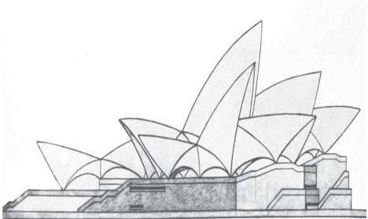
SYDNEY OPERA HOUSE
The Sydney Opera House is a masterpiece of late modern architecture and an iconic building of the 20th century. It is admired internationally and treasured by the people of Australia. Created by an architect who had been an avid sailor and understood the sea, the Sydney Opera House inhabits the world-famous maritime location on Sydney Harbour with such grace that it appears that the building belongs there naturally. The massive concrete sculptural shells that form the Sydney Opera House’s roof appear like billowing sails filled by the sea winds with the sunlight and cloud shadows playing across their shining white surfaces.
The Sydney Opera House is unique as a great building of the world that functions as a world-class performing arts centre, a great urban sculpture and a public venue for community activities and tourism. This monumental building has become a symbol of its city and the Australian nation.

Slide 13
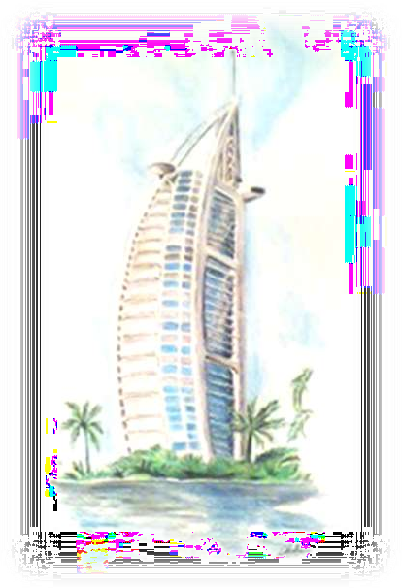
Burj Al Arab in Dubai

Slide 14
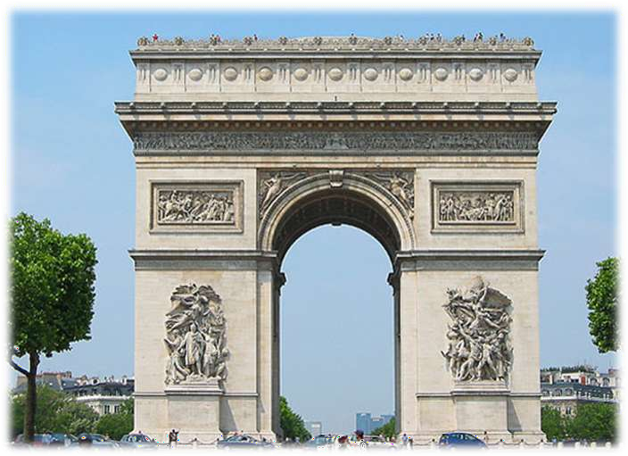
The Arc de Triumph
a symbol of victory and progress going back thousands of years

