Slide 1
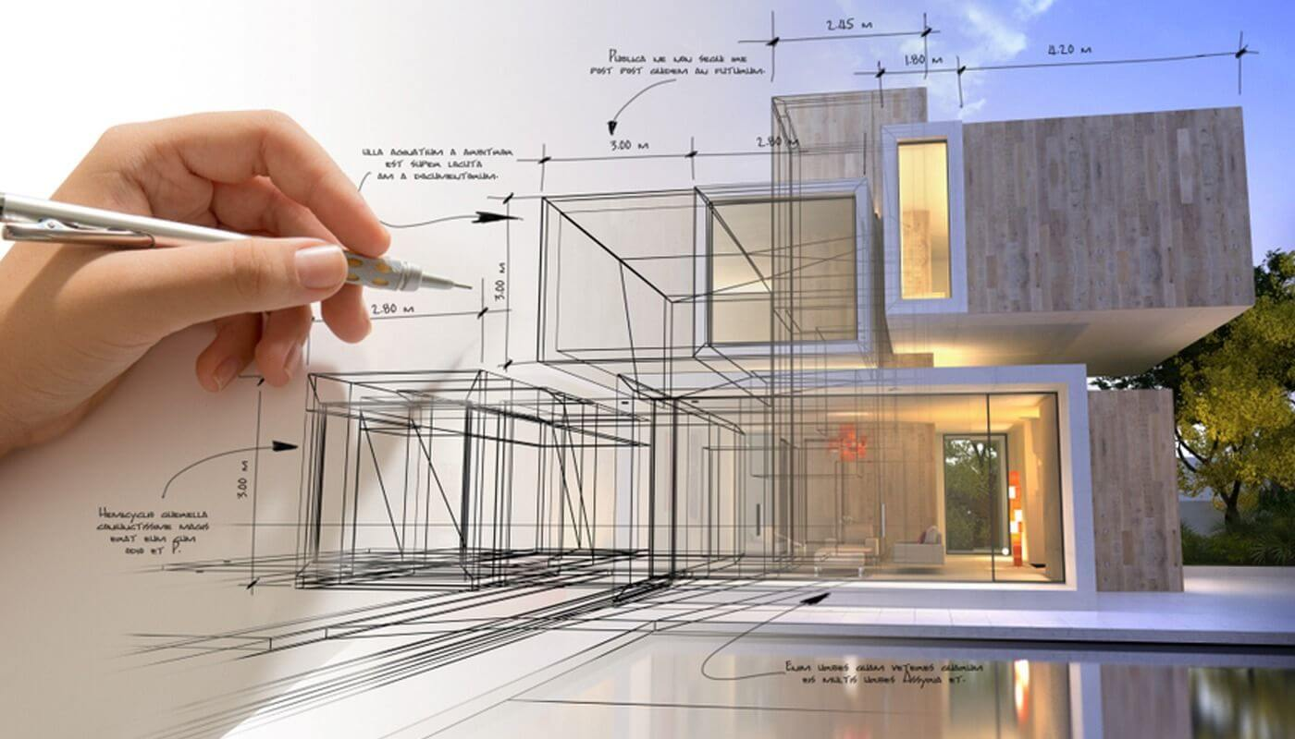
What is Architecture
Ar. Manish Kumar

Slide 2
Frank Lloyd Wright on Architecture
What is architecture anyway? Is it the vast collection of the various buildings which have been built to please the varying taste of the various lords of mankind? I think not.
No, I know that architecture is life; or at least it is life itself taking form and therefore it is the truest record of life as it was lived in the world yesterday, as it is lived today or ever will be lived. So architecture I know to be a Great
Spirit
Architecture is that great living creative spirit which from generation to generation, from age to age, proceeds, persists, creates, according to the nature of man, and his circumstances as they change. That is really architecture

Slide 3
Vincent Scully
Architecture is a continuing dialogue between generations -
which creates an environment across time.
Mies van der Rohe
“Architecture is the will of an epoch translated into space
Philip Johnson
“All architecture is shelter, all great architecture is the
design of space that contains, cuddles, exalts, or
stimulates

Slide 4
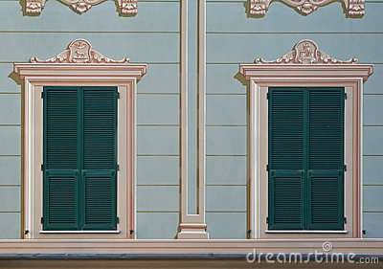
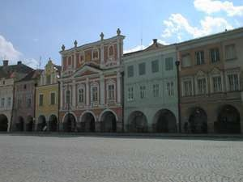
Architecture is not about decoration
it is true that many architects often treat their work as just applying candy floss to a box, but while this may occasionally produce what might be called 'good craft,' it is more usually just bad architecture, and certainly not good art.

Slide 5
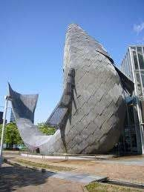
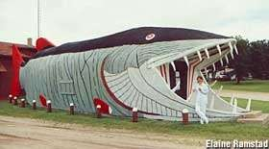
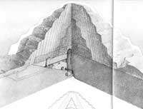
Architecture is not about representation
Architecture does not do literal representation well unless you simply view architecture as a signboard. Architecture is in fact closer to Aristotle's concept of mimesis: as Wright said: architecture involves "making human life more natural, and nature more humane."
The Egyptian Stepped Pyramid at Saqqara. Not a place where you'd want to live - but of course, this wasn't a place to live.. This was a place to die, or at least in which to spend eternity as a corpse.
For thousands of years the Egyptians performed prodigious feats to celebrate death. They did it very well.

Slide 6
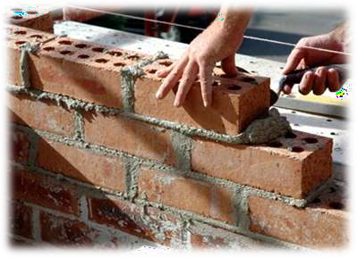
Architecture is not only about brick
Architecture is often thought of as just so many elevations and so many 'architectural features,' but to think in these terms is to miss the essence of architecture.
The stuff with which the architect works is space - human space.

Slide 7
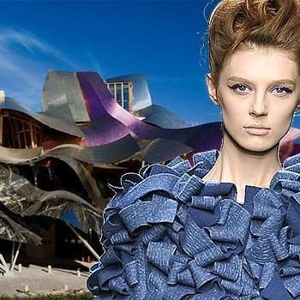
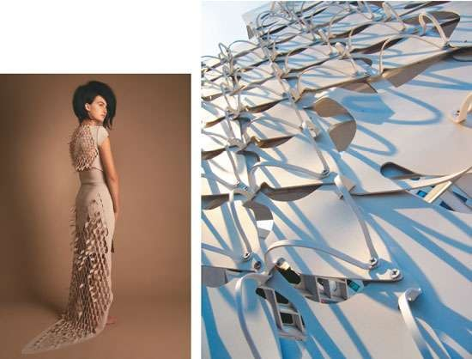
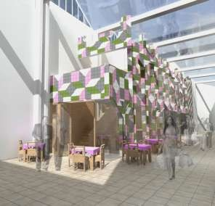
Architecture is not
fashion
You can’t apply anything any where…
We should only apply things when it makes sense.

Slide 8
Architecture does what no other art can do:
All other art forms recreate some portion of the world - a single human figure, or a two- dimensional scene on a canvas.
Only architecture can create a total environment, one that literally surrounds the viewer.
Architecture creates a man-made, idealized world - an environment created by the architect to fit the kind of life he sees as proper to man.
Architecture conveys a view of man indirectly, not by projecting an image of man himself [as sculpture, painting and literature do] but by projecting a proper environment for man to live in.

Slide 9
Terms of architectural work
Concept
Morphology
function
Symbolic
Dramatic
Productive architecture
Social
Economic
Environment friendly

Slide 10
Examples of Architecture

Slide 11
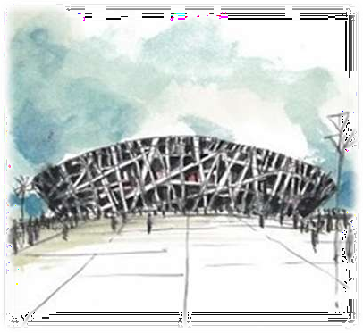
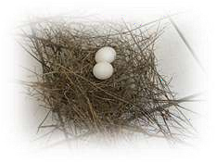
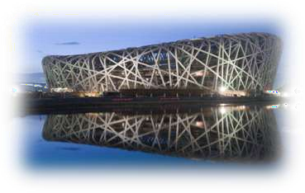
jing National Stadium 2008 Olympics
This is a huge structure and Herzog and DeMeuron have contributed some green solutions into their design including a rainwater collecting system, a translucent roof providing sunlight for the natural grass below and a passive
ventilation system. “Just as birds stuff the spaces between the woven twigs of their nests with a soft filler, the spaces in the structure of the stadium will be filled with inflated cushions to regulate wind, weather and sunlight.”

Slide 12
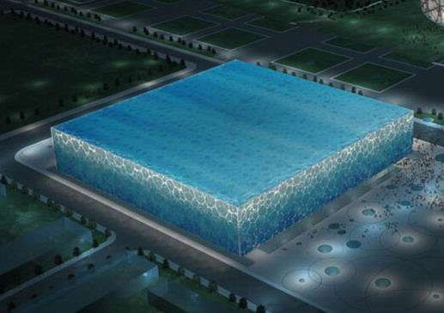
Beijing National Swimming Center: Blue
Beijing, China
PTW Architects,
CSCEC+Design, and rup

Slide 13
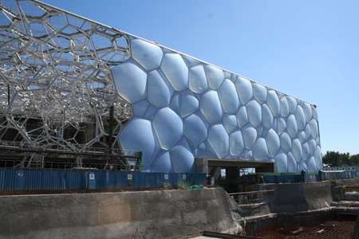
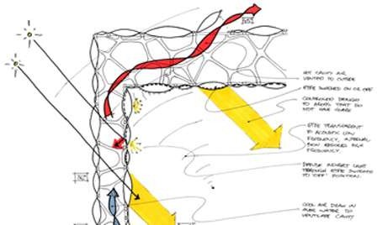
Looking at forms and patterns found in nature, the group started designing the skin. They quickly focused on soap bubbles and what happens to their geometry when they congregate.
It looks blue, but it's green.
As big, eye-catching Olympics architecture goes, nothing may be as sustainable as the Water Cube.
Adopting an ETFE pneumatic die cushion structure, the Water Cube is the world's largest membrane structure building.
The 100,000 square meters of the Teflon- like translucent plastic ETFE that make up the building's bubble cladding allow in more solar heat than glass, making it easier to heat the building, which cuts energy costs by up to 30 percent. That's especially important for a swimming pool, which requires an enormous amount of heating.
Besides the solar energy, all backwash water of the center is filtered and returned to the swimming pools.

Slide 14
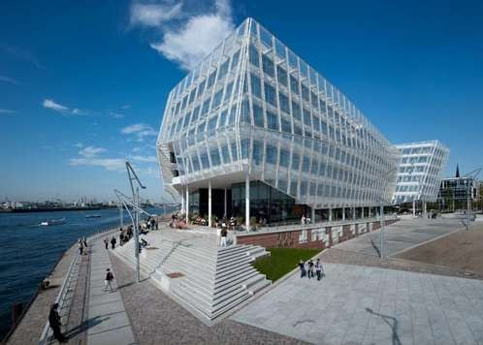
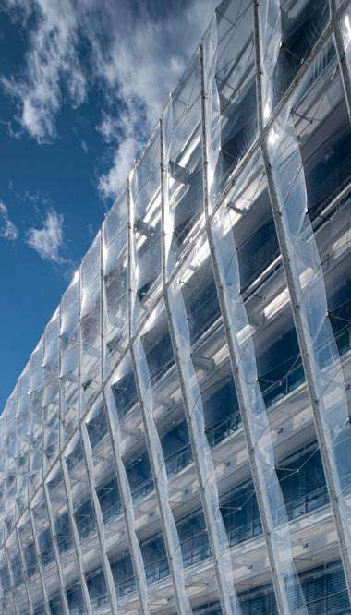
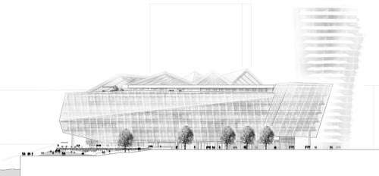
UNILEVER GERMANY HEADQUARTERS HAMBURG, GERMANY, 2007–2009

Slide 15
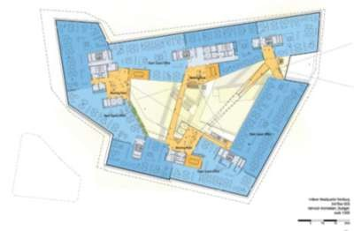
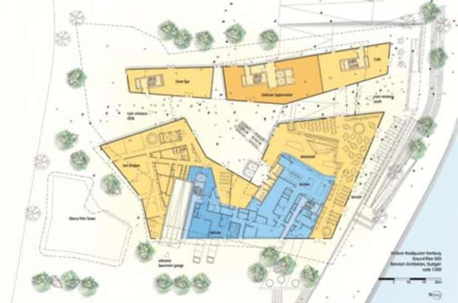
The central element and heart of the design is the generous atrium, flooded by
daylight, which, on the ground floor,
gives
passers-by the opportunity to get to know
the company better while browsing in the shop stocked with Unilever products, sitting in the cafe or relaxing in the spa.
The atrium is also the central location for people to meet and communicate.

Slide 16
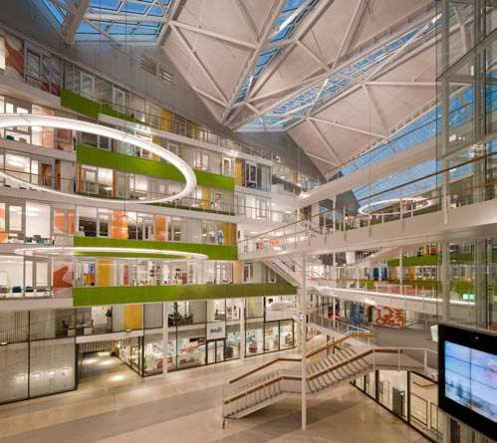
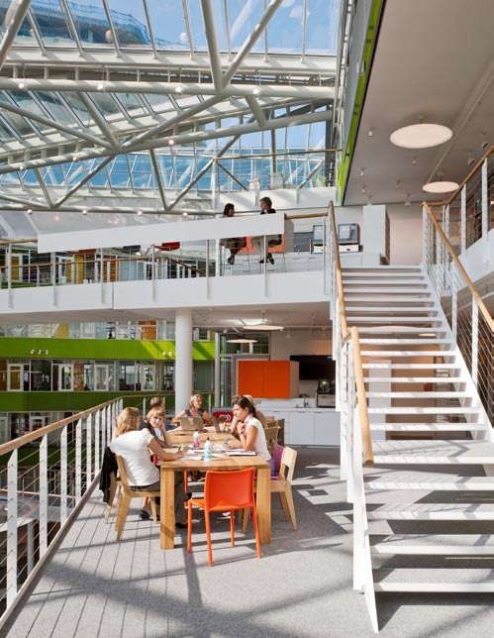
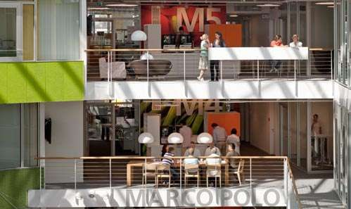

Slide 17
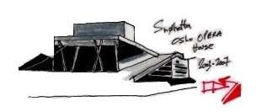
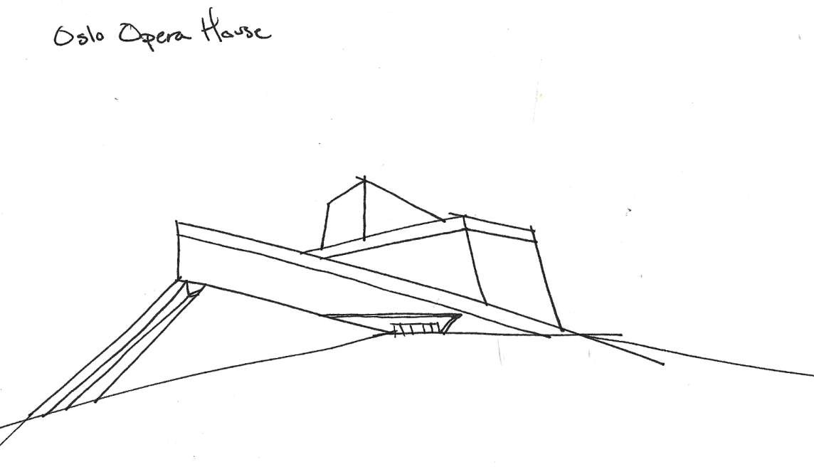
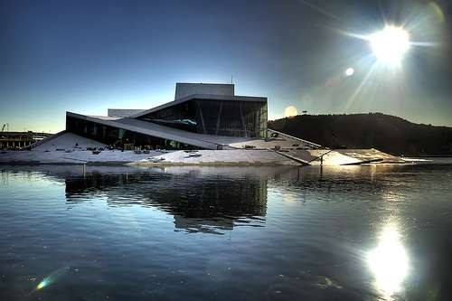

Slide 18
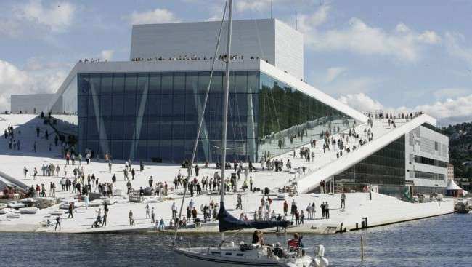
The roof landscape will be open to the public. The horizontal and sloping roofs express monumentality, and give the building a dramatically
different appearance than its neighbors.
The expression of openness and accessibility both indoors and out will result in the building appealing to a wide range of users.

Slide 19
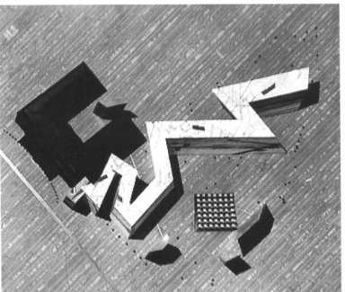
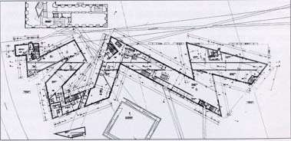
Museum Berlin
This geometry is intended to make you feel physcially ill
and recreates the terrible purpose behind the camps
Libeskind creates a dialogue between the past and the present of the Holocaust, and
Most importantly, LIbeskind poses
the question, how do we deal with the scars from the past?

Slide 20
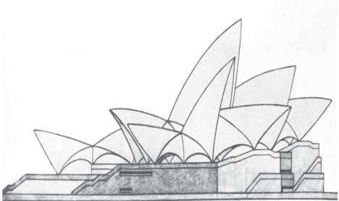
SYDNEY OPERA HOUSE
The Sydney Opera House is a masterpiece of late modern architecture and an iconic building of the 20th century. It is admired internationally and treasured by the people of Australia. Created by an architect who had been an avid sailor and understood the sea, the Sydney Opera House inhabits the world-famous maritime location on Sydney Harbour with such grace that it appears that the building belongs there naturally. The massive concrete sculptural shells that form the Sydney Opera House’s roof appear like billowing sails filled by the sea winds with the sunlight and cloud shadows playing across their shining white surfaces.
The Sydney Opera House is unique as a great building of the world that functions as a world-class performing arts centre, a great urban sculpture and a public venue for community activities and tourism. This monumental building has become a symbol of its city and the Australian nation.

Slide 21
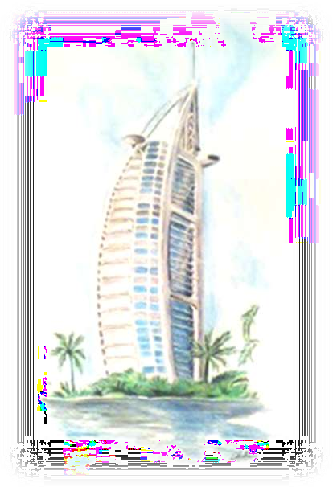
Burj Al Arab in Dubai

Slide 22
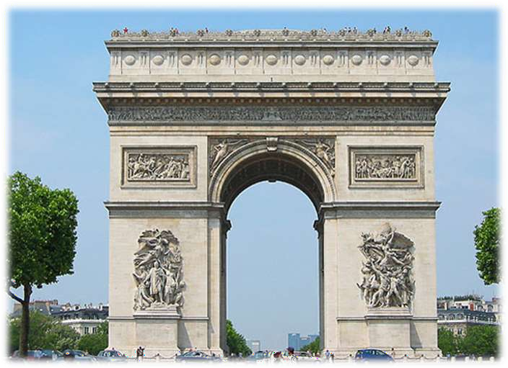
The Arc de Triumph
a symbol of victory and progress going back thousands of years

