Slide 1
ARCHITECTURE DESIGN - V
TOPIC- Architect’s Philosophy
Presented by:- Kavita

Slide 2
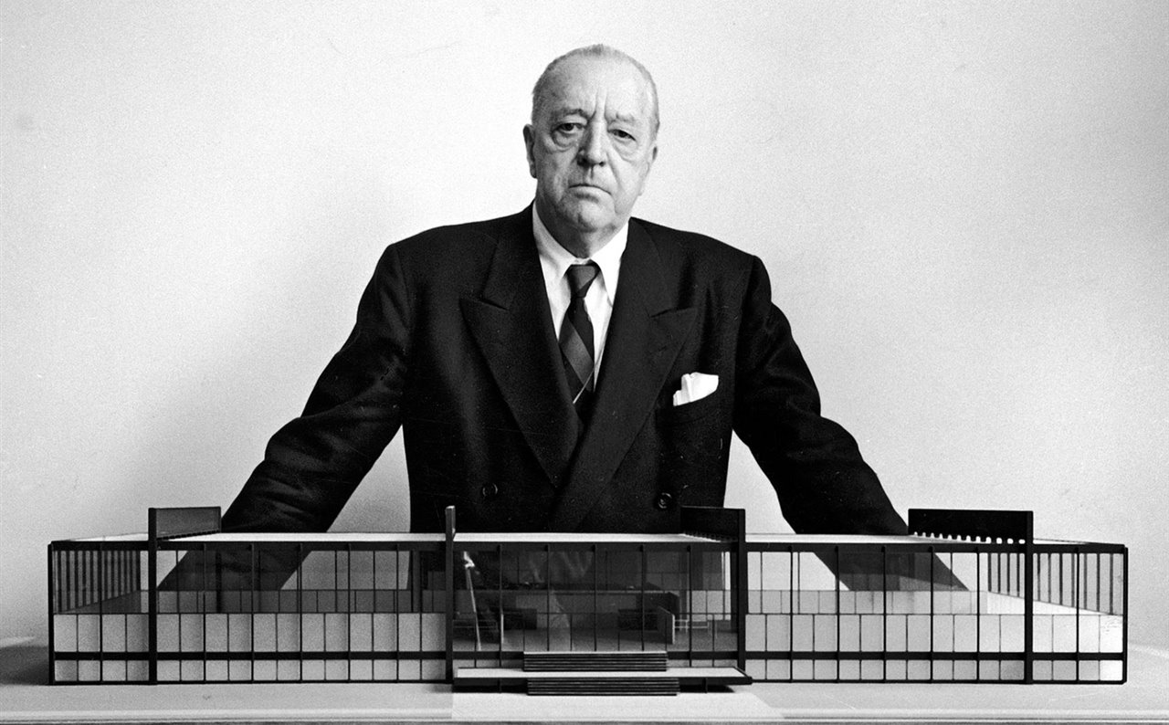
Ludwig Mies was born in Aachen, Nordhein Westfalen ,Germany, on March 27 1886. No formal training in architecture
Worked under Peter Behrens ,Succeeded Gropius as Bauhaus Director
Migrated to US and taught architecture at the Illinois Institute of Technology
Designed Skyscrapers Of Steel And Glass which became models of skyscraper design throughout the world.
“Less is more.” -van der Rohe
LUDWIG MIES VAN DER ROHE
27 March 1886-17 August 1969
CHARACTER OF WORKS:
Simple rectangular forms
Open, flexible plans and multi-functional spaces
Widespread use of glass to bring the outside in
Mastered steel and glass construction
Exposed and very refined structural details

Slide 3
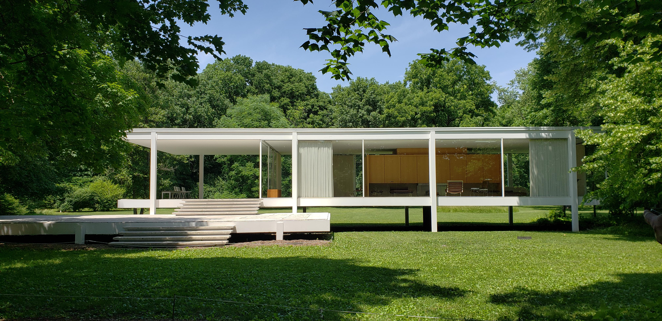
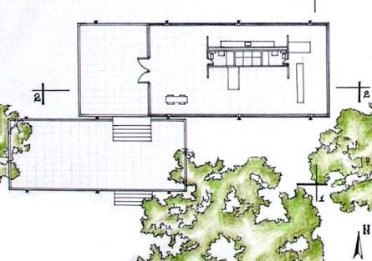
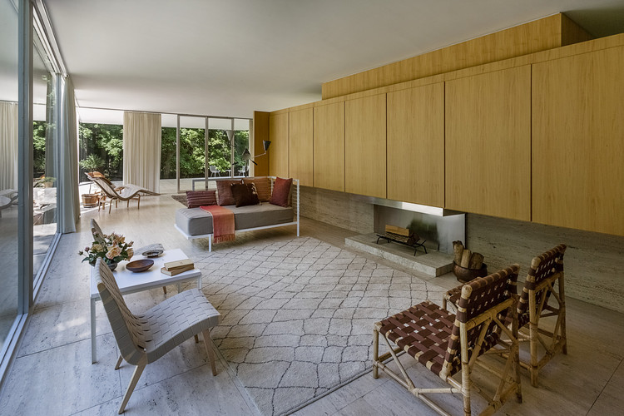
FARNSWORTH HOUSE
In 1946 he began work on the Farnsworth House a weekend retreat for doctor Edith Farnsworth.
It’s one of the most minimalist houses ever designed being composed of a transparent box framed by eight exterior steel columns with a single room subdivided by partitions and completely enclosed in glass.
It—two parallel planes held in suspension between the earth and sky by only eight steel columns—seems simple, but Mies worked through 167 drawings to come to his final, fearless design.

Slide 4
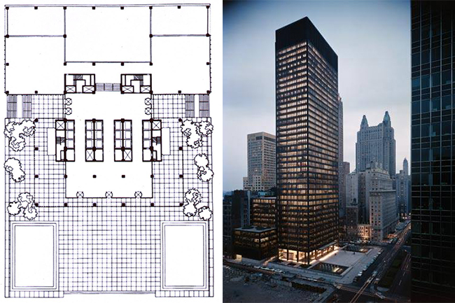
SEAGRAM BUILDING, 375 Park Ave, New York, NY, United States 1958
This 39-story, 516-foot tall office building was commissioned by Joseph E. Seagram & Sons Corporation, purveyors of Seagram liquors.
He floor of the Seagram's, as in the Lake Shore Drive, a rectangle of 5x3 squares structural modules.
But the elevation of the building achieves its expressive perfection, simulating a column with its three constituent parts classic.
His typology shows clearly the structure in front, meeting both an ornamental role, consisting of steel beams and columns of bronze, that without a structural role fits perfectly the large windows that are the most visible epidermis of the work.
German Pavilion , Barcelona 1929

Slide 5
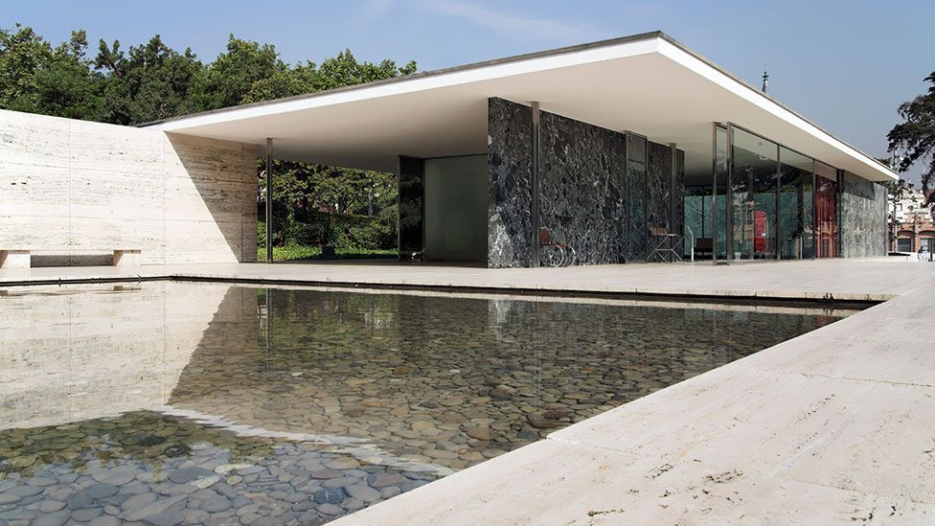
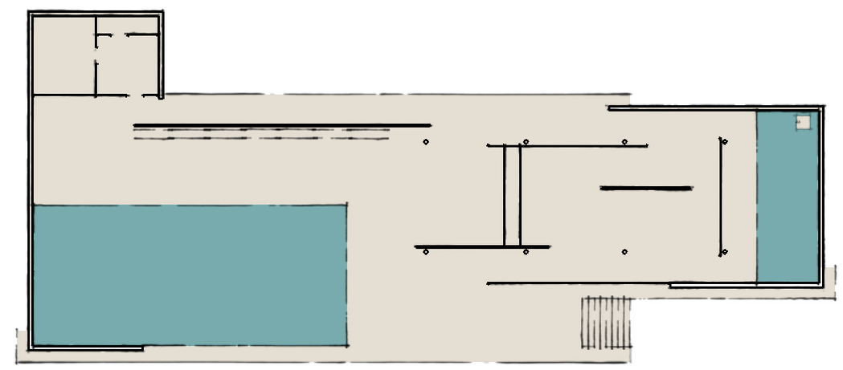
The architecture's mass is balanced by a pond (featuring a sculpture by Georg Kolb) and a shallow pool on either end
The Pavilion was innovative in that the design called for the roof to be supported by chrome columns which meant that the walls could be freely positioned since they did not support the structure  It was later dismantled but rebuilt in the 1980’s German Pavilion , Barcelona 1929

Slide 6
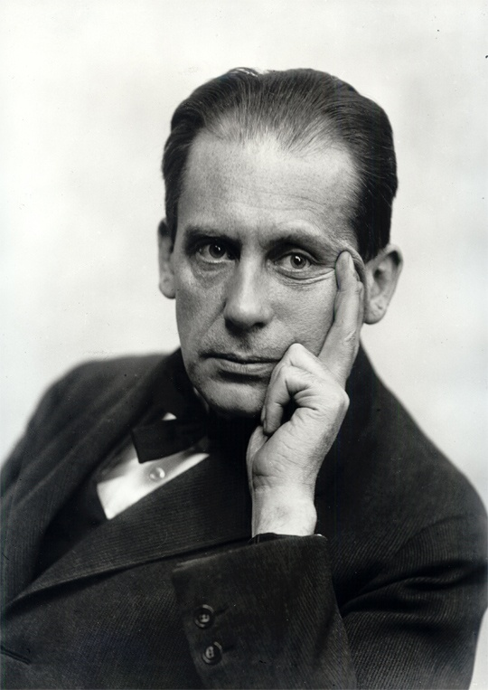
German Architect
Worked under Peter Behrens
Influenced by Frank Lloyd Wright
Founded the Bauhaus
Migrated to US and taught at the Harvard School of Architecture
CHARACTER OF WORKS:
Simple geometry, often rectangular
Use of modern materials like steel and glass
Smooth surfaces
Primary colors
Linear and horizontal elements
He was a German architect and founder of the Bauhaus School who, along with Ludwig Mies van der Rohe and Le Corbusier, is widely regarded as one of the pioneering masters of modern architect.
Walter Adolph Georg Gropius (May 18, 1883 – July 5, 1969)

