Slide 1
ARCHITECTURE DESIGN - V
TOPIC- Architect’s Philosophy
Presented by:- Kavita

Slide 2
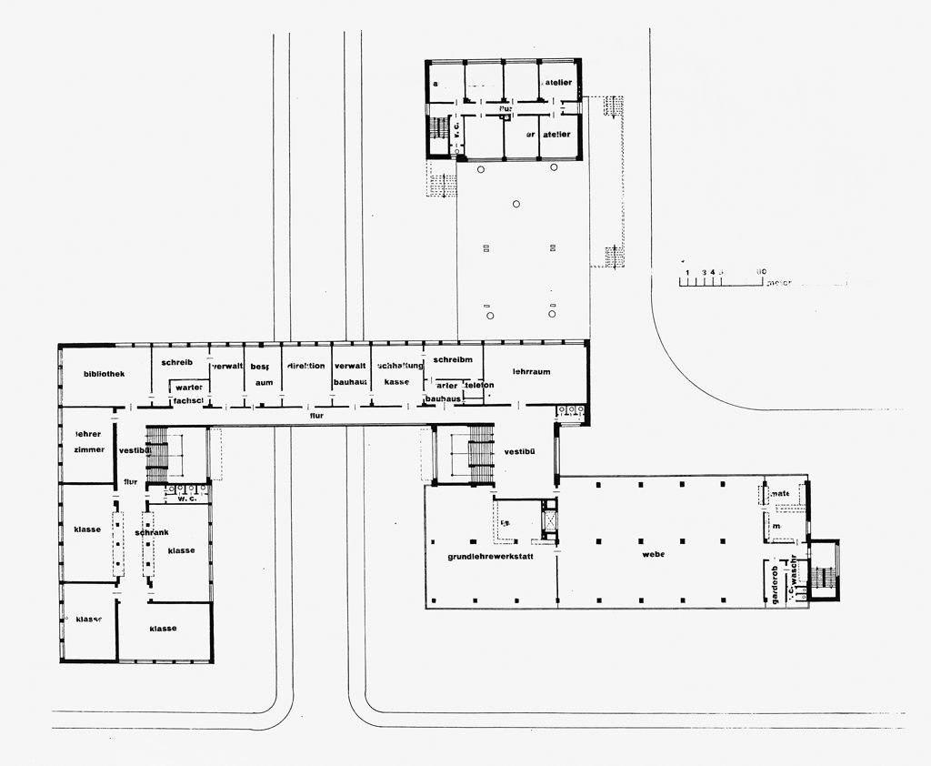
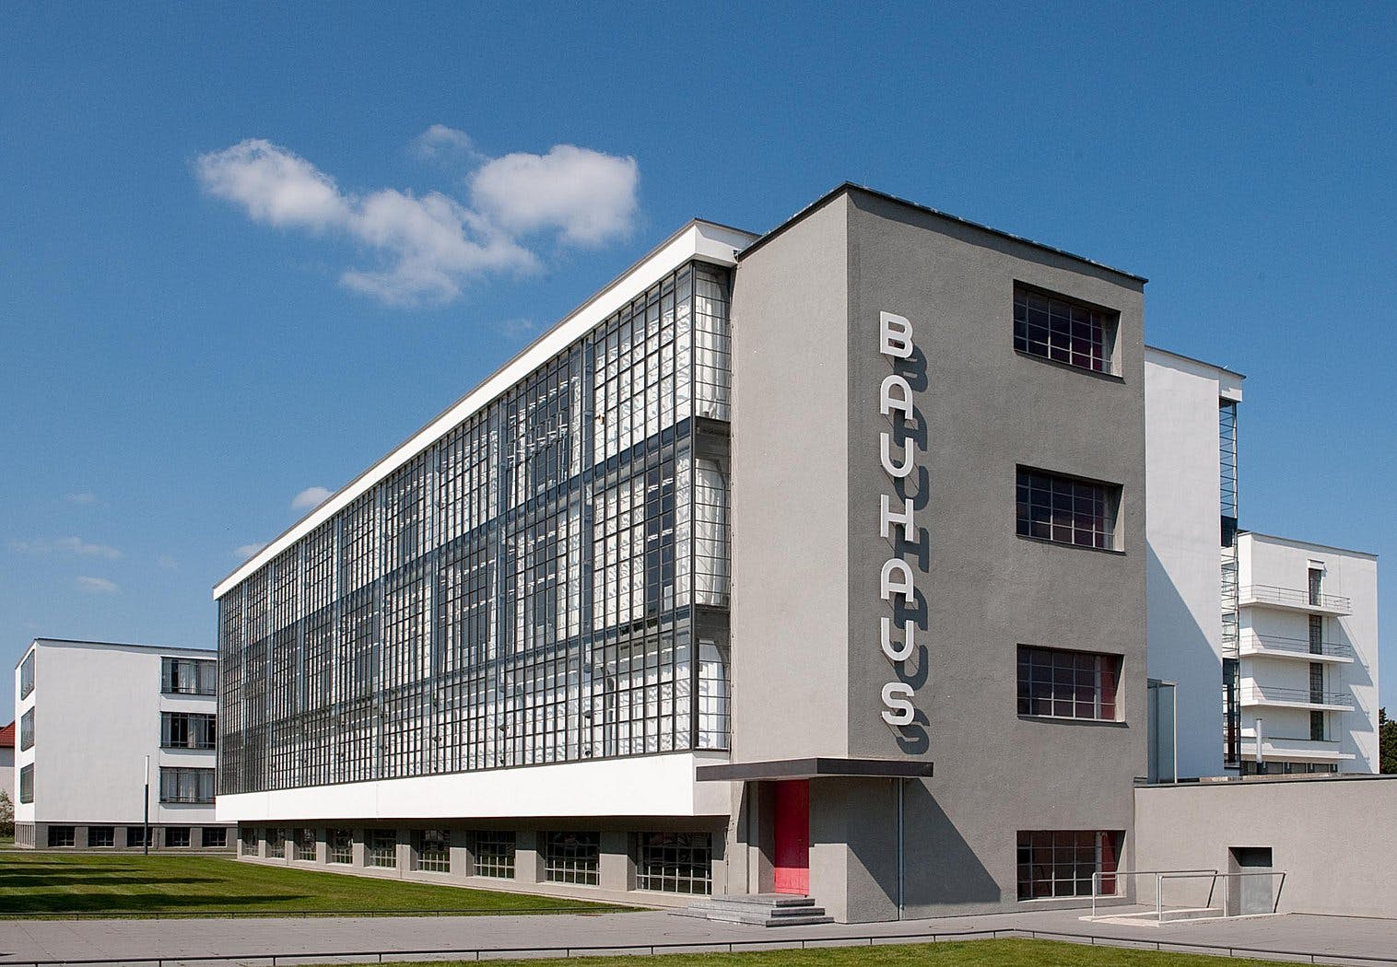
School of architecture and design, Germany, 1919 - 1933
All art forms should be designed as a unit
Technology embraced
Economy in the use of space, materials, time, and money
Avoid Romantic embellishments
Bauhaus

Slide 3
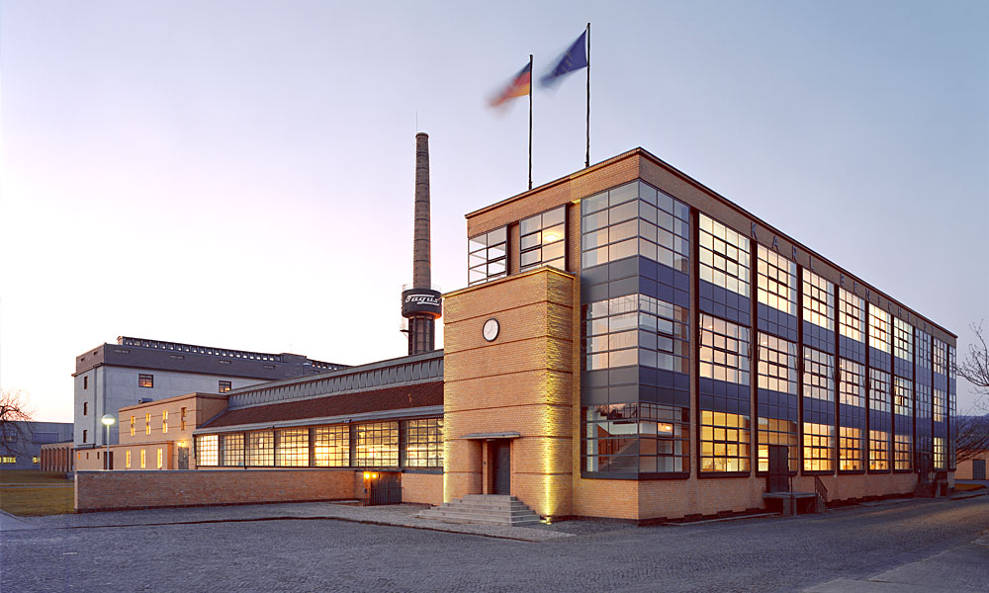
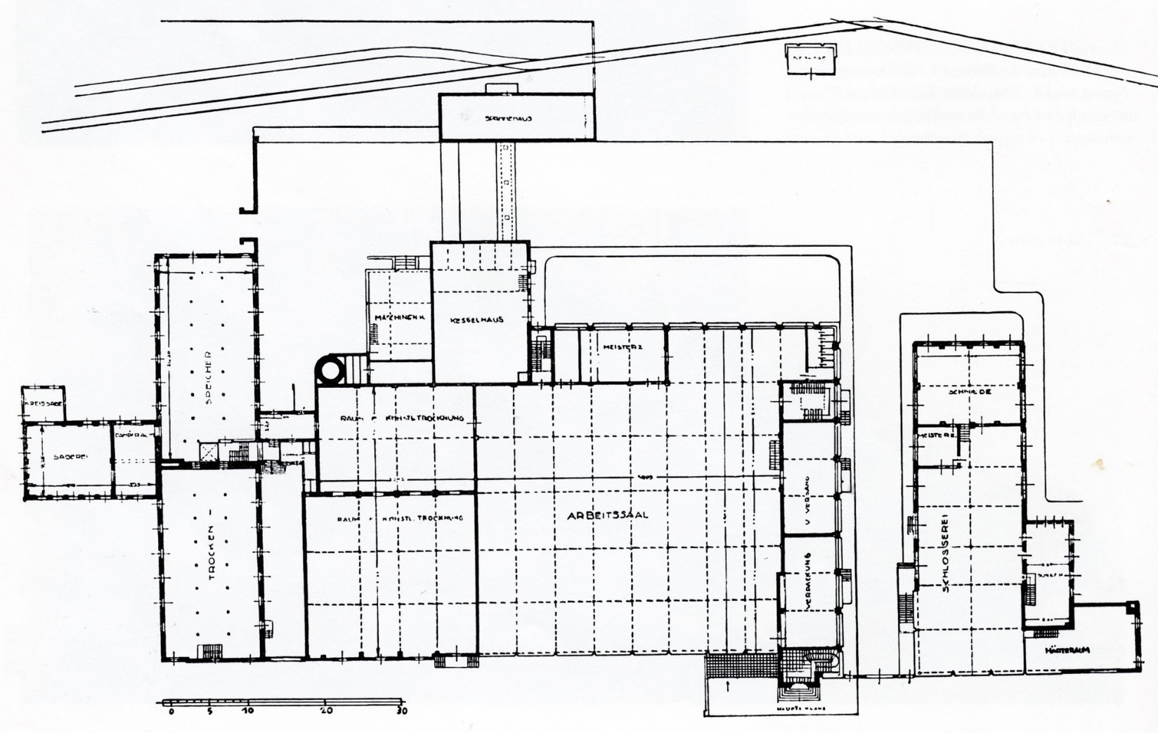
Fagus Factory
The Fagus Factory is today considered as one of the most important industrial structures of modern architecture.
It is considered as a blue-print of the functional design style that later became later associated with the Bauhaus.
Factory Alfeld an der Leine, Lower Saxony, Germany
The facade is articulated with narrow brick pillars, slightly recessed, which were placed between the iron frames sticking out of the building and housed the large windows creating a light curtain wall
It is particularly striking resolution of the corners of the block as they converge on two windows perpendicular to the unique presence in them of the light metal support bar.

Slide 4
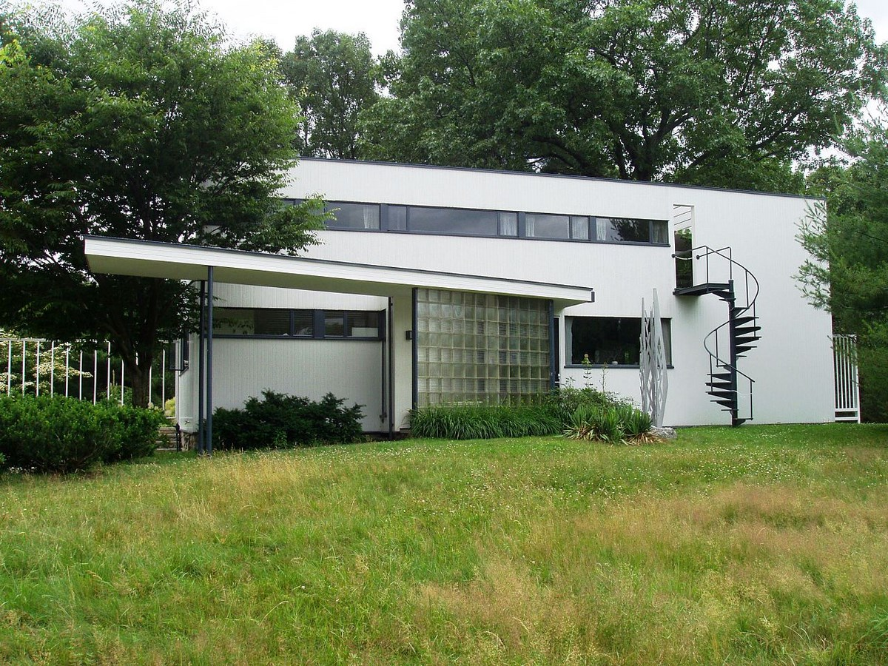
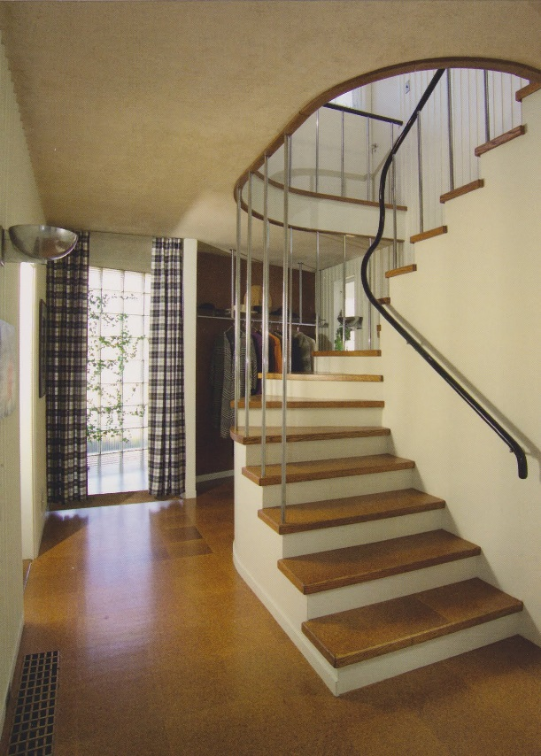
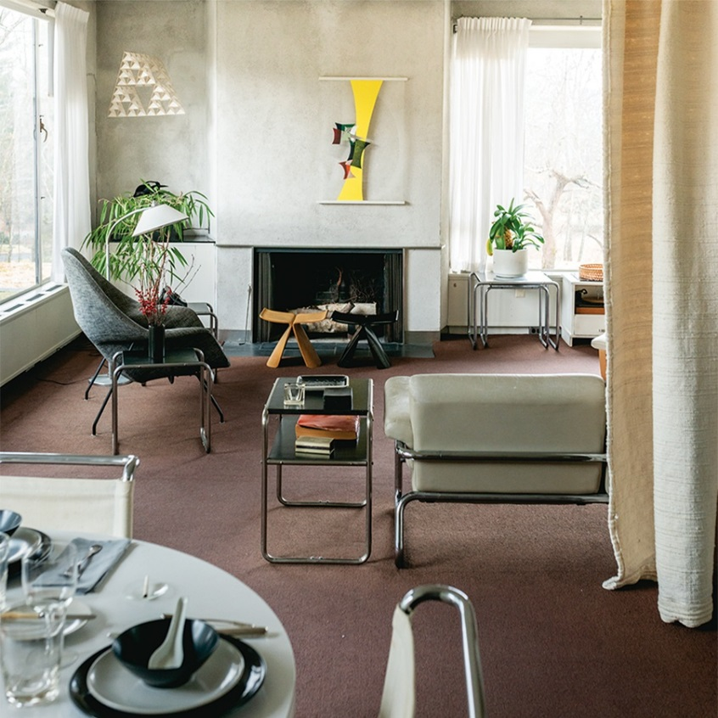
Gropius House
Gropius House combined traditional elements of New England architecture—wood, brick, and fieldstone—with innovative materials including glass block, acoustical plaster, chrome banisters, and the latest technology in fixtures.
It features furniture designed by Marcel Breuer and fabricated in Bauhaus workshops.
With the family’s possessions still in place, Gropius House has a sense of immediacy and intimacy.
In honor of the Bauhaus centennial in 2019, Historic New England launched a Gropius House app featuring photos, videos, and other archival materials related to the family and its social circle.

Slide 5
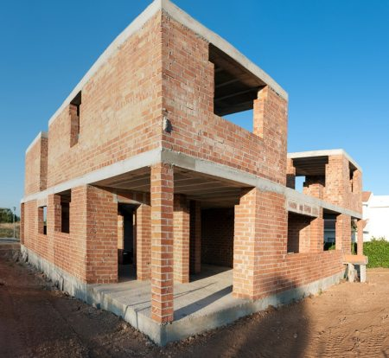
Load bearing structure:-
In load bearing structure walls are structural members and load of slab is carried by the walls and then walls transfer the load to foundation.
Hence, below each wall , a foundation of increasing thikness is provided due to this the load is spread over larger area at the foundation level.
Load Bearing Components of a Building:-
The main load-bearing structural elements are:
Beam
Columns
Walls
Braces
Trusses
A load bearing wall transfers the loads form slabs above it to the foundation.
These walls can be made of concrete, masonry or block materials.
Most of the exterior walls of a building structure are considered as load bearing.
Removal of load bearing wall as a part of renovation must be conducted only after providing alternative support for the above-supported structures.

Slide 6
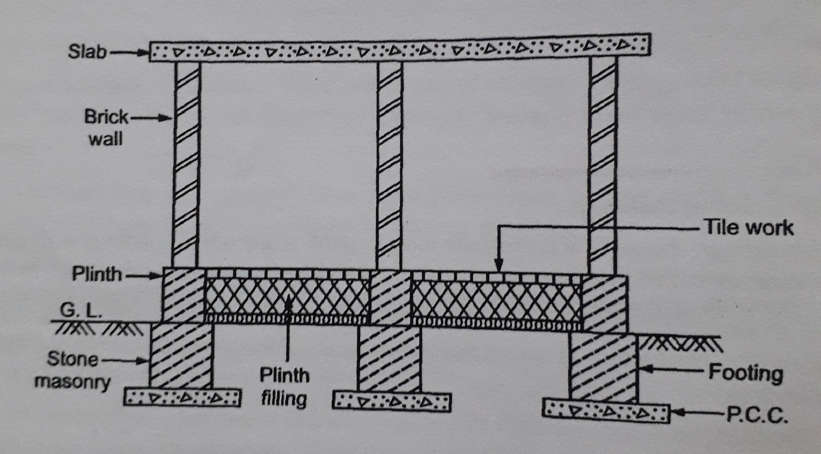
In case, of Load bearing, structural system the path followed is:-
Slabs >> Walls >> Foundation
Advantage:-
1.Low cost
Limitations of load bearing structure:-
1. Limited no. Of storey’s 3 to 4
2.Not suitable in earthquake prone areas
3.More thickness of wall so space is wasted
4.Takes more time for construction
5. Less durable

Slide 7
Charles jenks was born in 1939 in Massachusetts, USA.
Still lives in America
First become famous for his bubble diagram of architecture and for his explanation of what postmodernism really means within the field of architecture.
He borrowed the term “postmodern” from literature and applied it to architecture.
LAND FORMING
As well as writing, Charles jenks now spends much Of his time designing landscape and sculpture.
He calls his creative process “landforming”.
Charles Jencks has coined the term ‘landforming’ to describe the way he creates large-scale works of art in nature.
Jenks’ landforms are a combination of sculpture words and gardens.

Slide 8
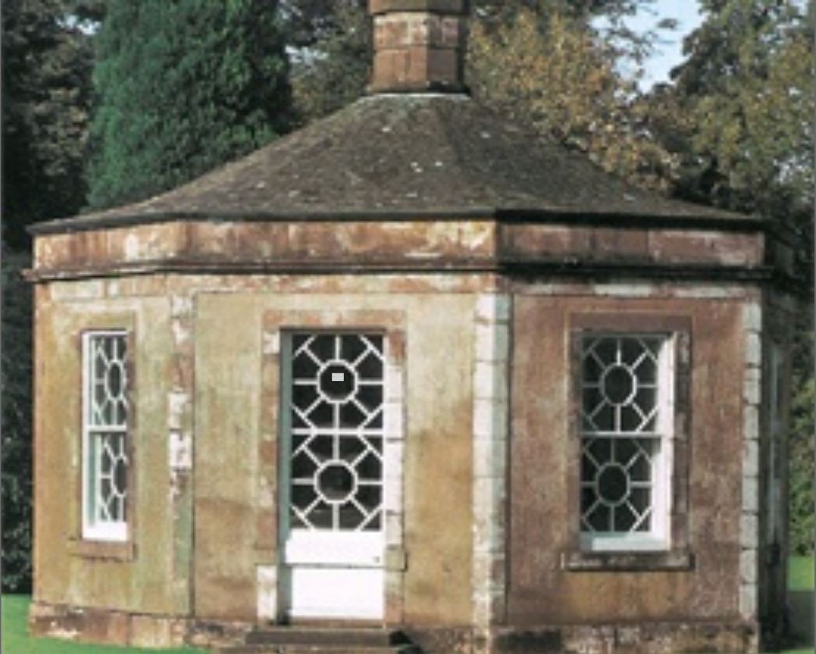
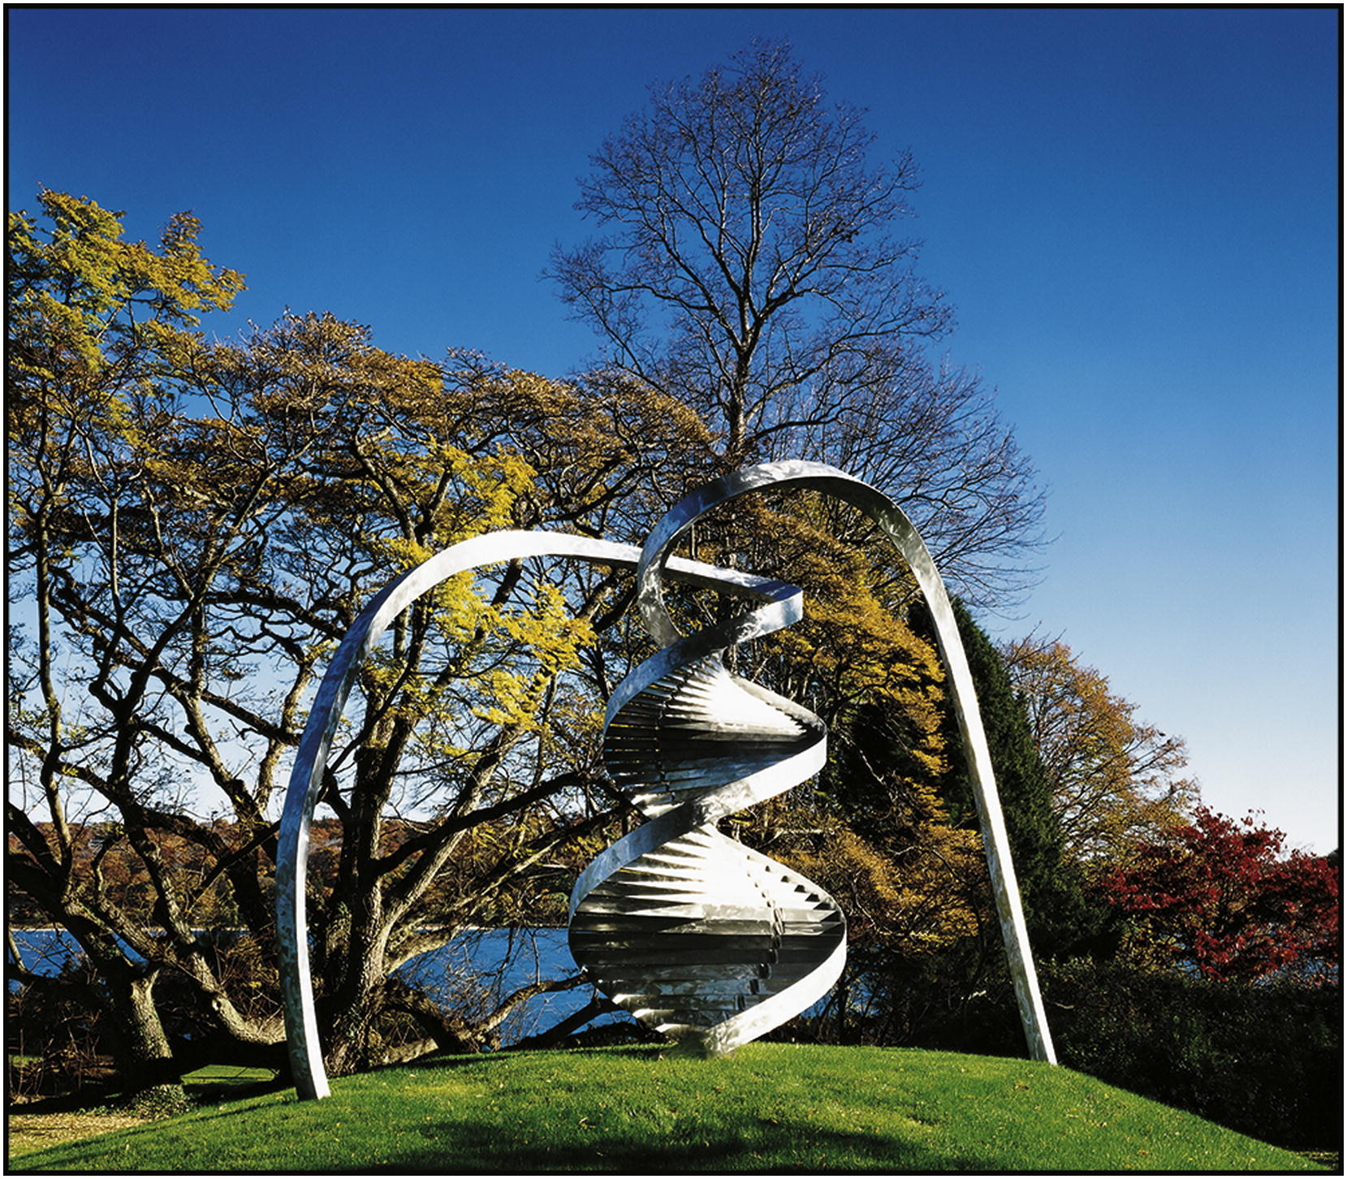
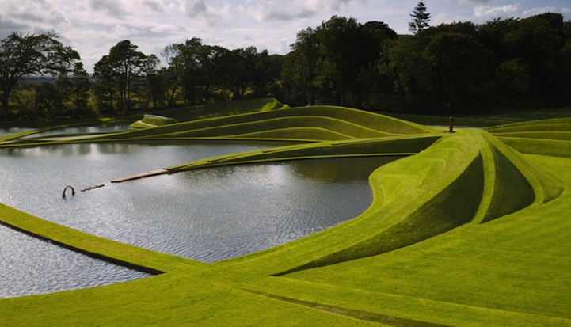
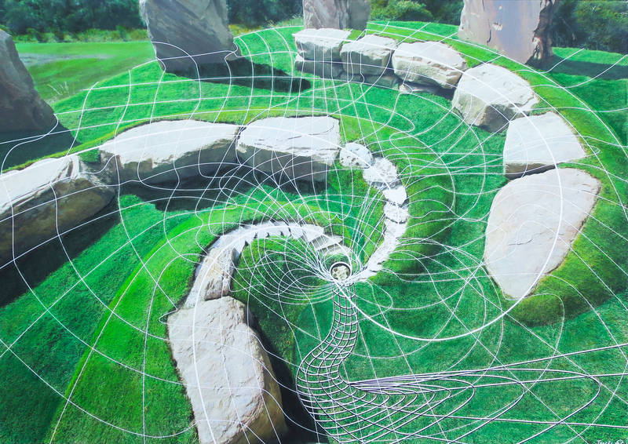
DESIGN PRINCIPLES
HUMAN CELLES
SCOTTISH DIASPORA
WAVEFORMS AND TWISTS
THE OCTAGON
MAPPA MUNDI

Slide 9
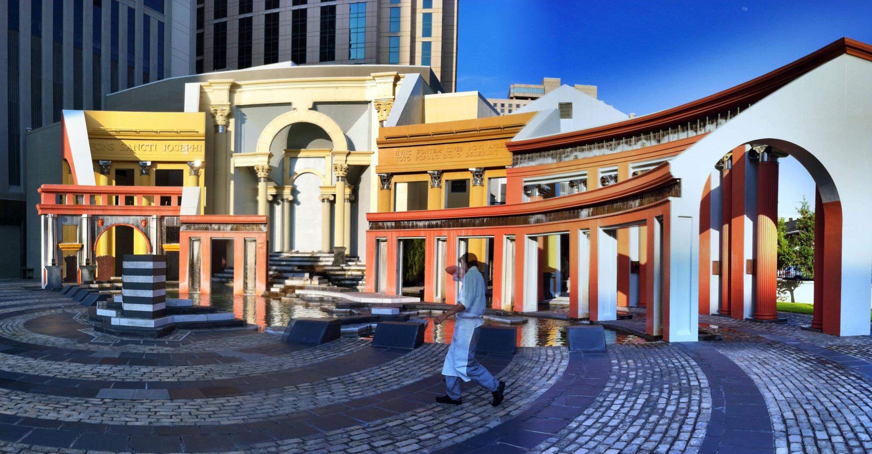
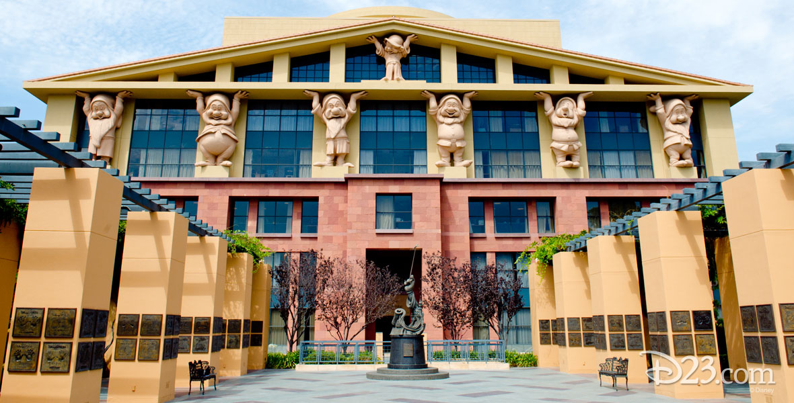
Postmodernism
International architectural movement that emerged in the 1960s, became prominent in the late 1970s and 80s, and remained a dominant force in the 1990s.
Postmodernist movement is often seen as an American movement, starting in USA around the 1960s–1970s and then spreading to Europe and the rest of the world.
The movement largely has been a reaction against the austerity, simplicity and functional design approach of the modern architecture/international style Portland Public Services Building, 1982. Michael Graves,
Rejection of strict rules set by the early modernists and seeks high spirits in the use of building techniques, angles, and stylistic references
MODULE
M22
TOPIC:-
Postmodernism
SHEET NO.
3
Piazza d’ Italia, New Orleans, 1976-1980 Charles Moore
SCALE
SUBBMITTED BY:-
MAYANK SHARMA
19BAC05
SUBMITTED TO:-
Ar. VIVEK
Team Disney –The Eisner Building, 1991 Michael Graves
LINGAYAS VIDYAPEETH

Slide 10
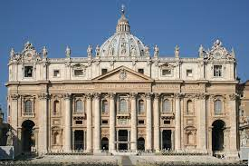
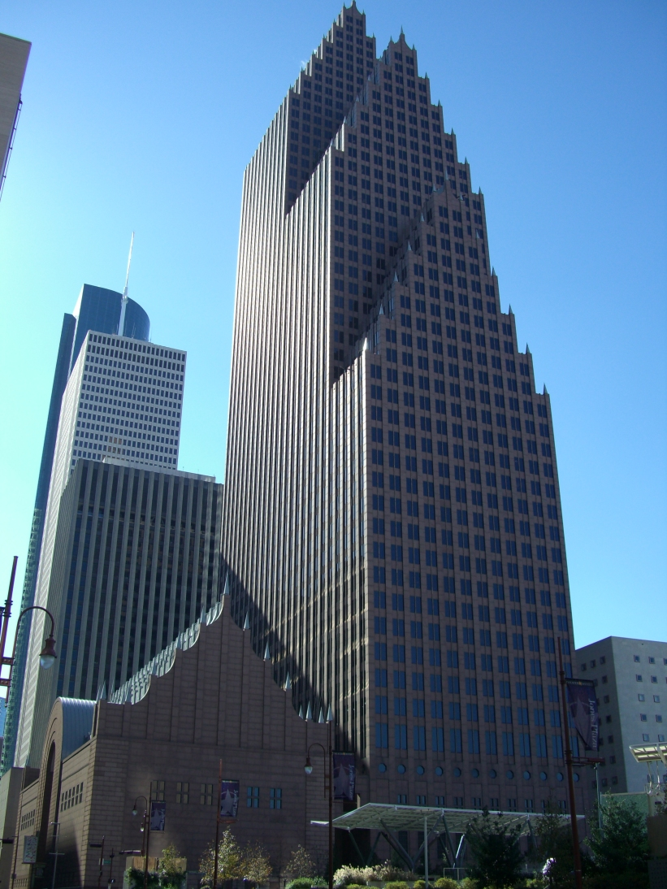
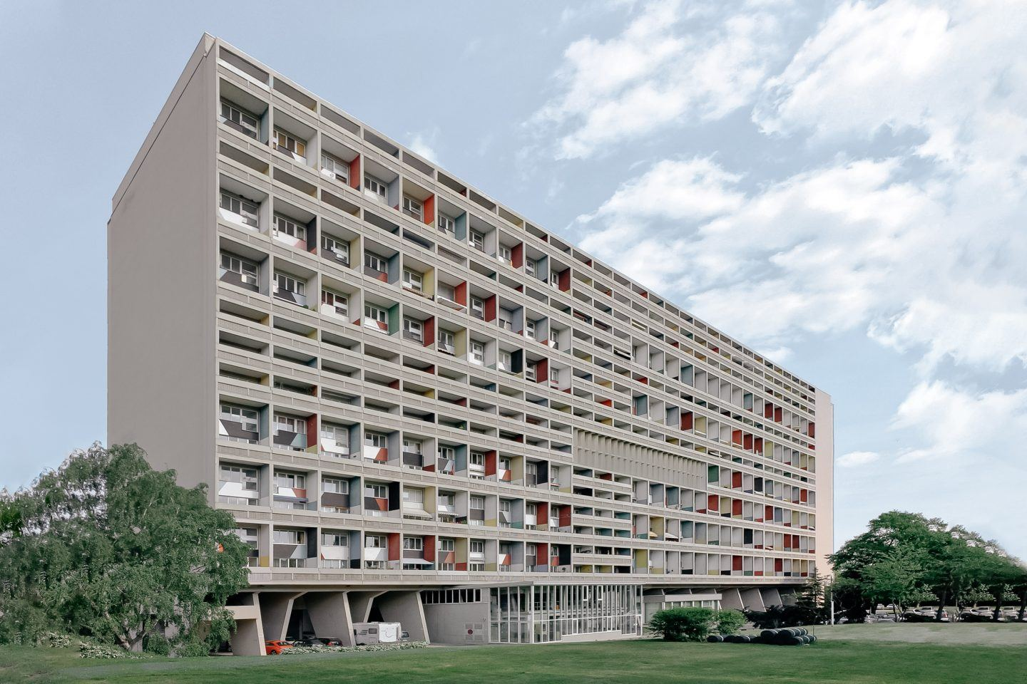
Pre- modern architecture
Modern architecture
Post-modernism
Bank of America Center in Houston, by John Burgee and Philip Johnson
CHARACTERISTICS OF POSTMODERNISM
Postmodern Architecture rejects the notion of “pure” or “perfect” form, instead it draws from: all methods, materials, forms, & colours available to architects.
Moves away from the neutral white colours seen in modernism the return of "wit, ornament and reference" to architecture Team Disney –The Eisner Building, 1991 Michael Graves, Took past components of different styles and melded them together to create new means of design.
It is known for the re-emergence of surface ornament, reference to its surrounding buildings, and historical references.
Used classical styles in new combinations: pillars, arches, domes, curtain wall facades, sculptures and roman conventions

