Slide 1
Architectural Graphic - III
Topic – Philospher’s Work
Presented by:-Hiba Gul

Slide 2
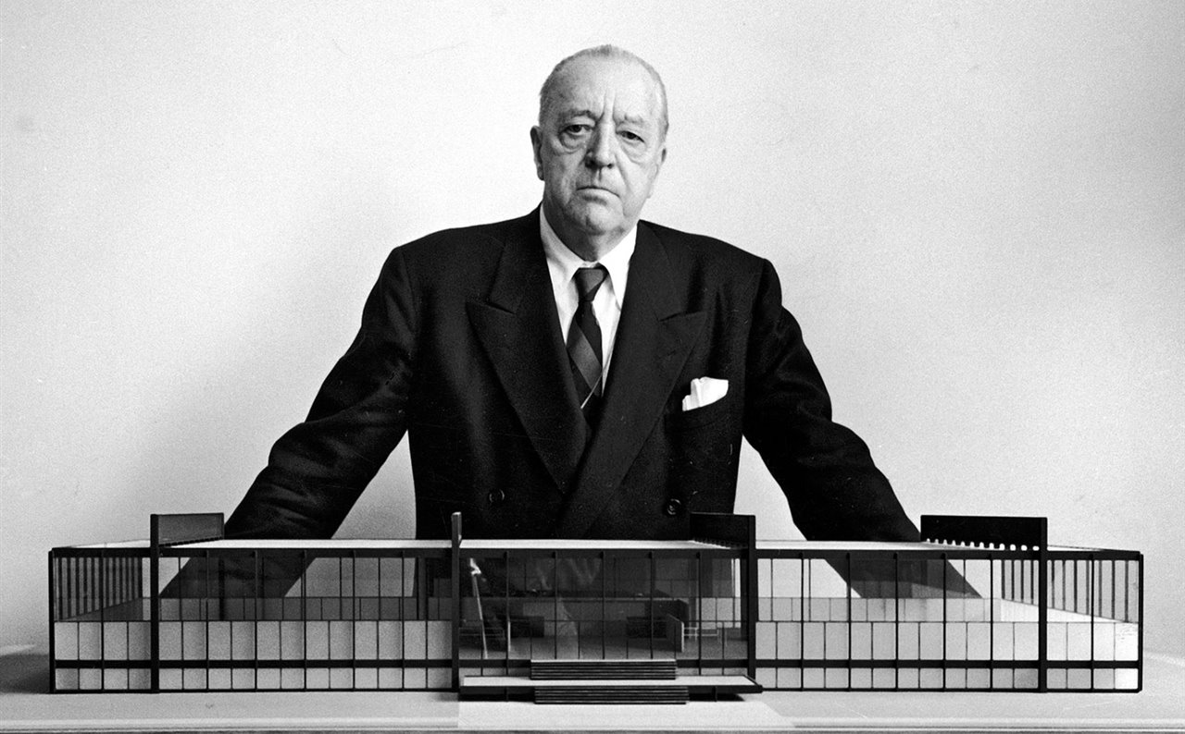
Ludwig Mies was born in Aachen, Nordhein Westfalen ,Germany, on March 27 1886. No formal training in architecture
Worked under Peter Behrens ,Succeeded Gropius as Bauhaus Director
Migrated to US and taught architecture at the Illinois Institute of Technology
Designed Skyscrapers Of Steel And Glass which became models of skyscraper design throughout the world.
LUDWIG MIES VAN DER ROHE
27 March 1886-17 August 1969

Slide 3
Simple rectangular forms
Open, flexible plans and multi-functional spaces
Widespread use of glass to bring the outside in
Mastered steel and glass construction
Exposed and very refined structural details
“Less is more.” -van der Rohe

Slide 4
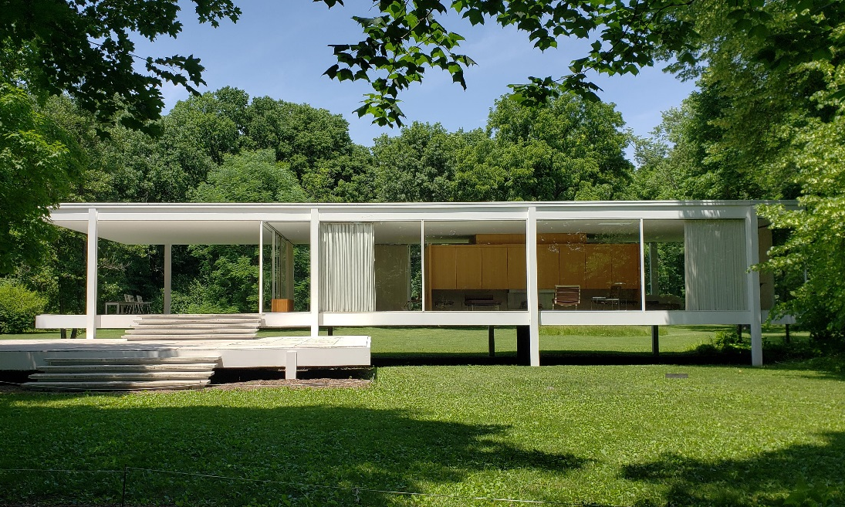
FARNSWORTH HOUSE
In 1946 he began work on the Farnsworth House a weekend retreat for doctor Edith Farnsworth.
It’s one of the most minimalist houses ever designed being composed of a transparent box framed by eight exterior steel columns with a single room subdivided by partitions and completely enclosed in glass.
It—two parallel planes held in suspension between the earth and sky by only eight steel columns—seems simple, but Mies worked through 167 drawings to come to his final, fearless design.

Slide 5
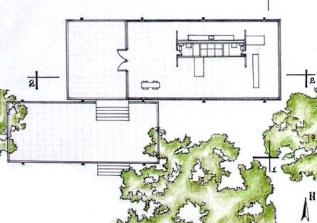
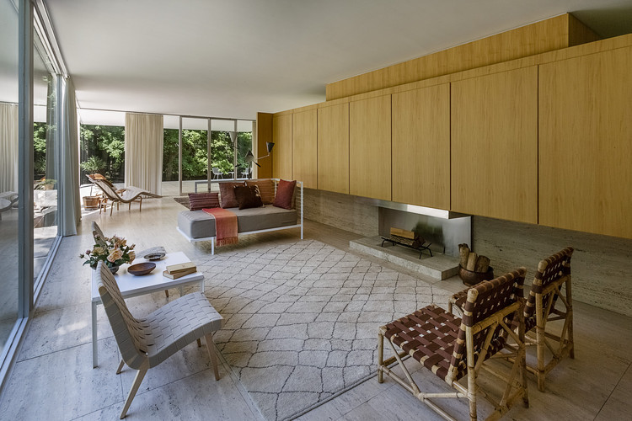

Slide 6
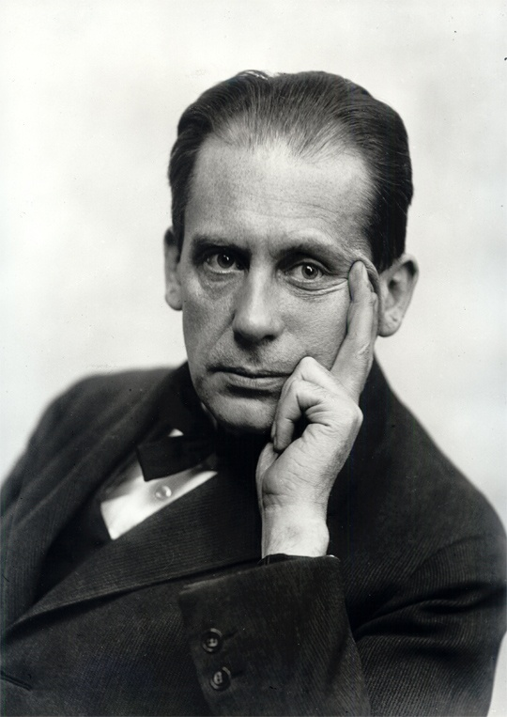
German Architect
Worked under Peter Behrens
Influenced by Frank Lloyd Wright
Founded the Bauhaus
Migrated to US and taught at the Harvard School of Architecture
Walter Adolph Georg Gropius (May 18, 1883 – July 5, 1969)

Slide 7
CHARACTER OF WORKS:
Simple geometry, often rectangular
Use of modern materials like steel and glass
Smooth surfaces
Primary colors
Linear and horizontal elements

Slide 8
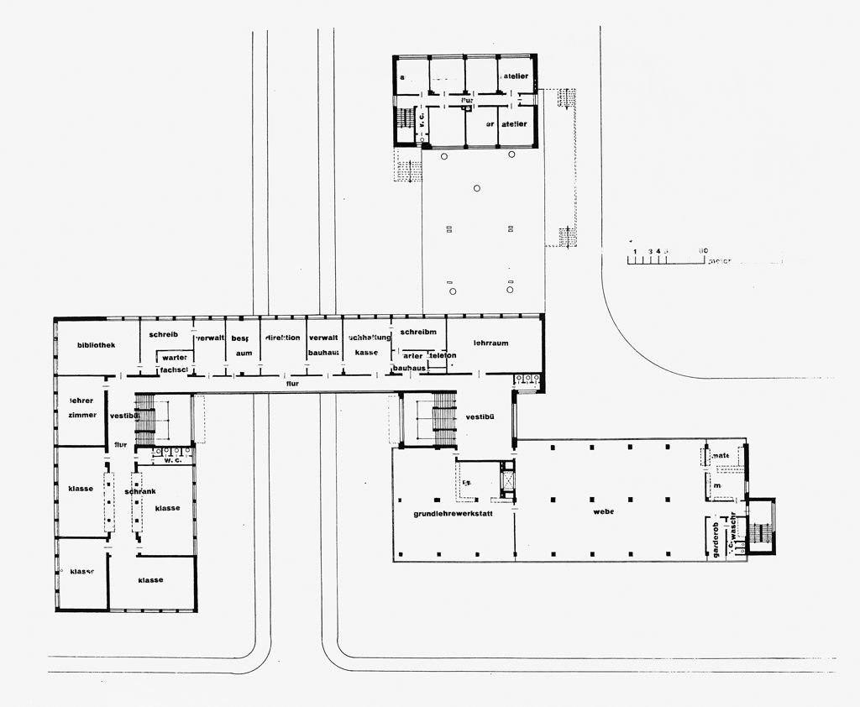
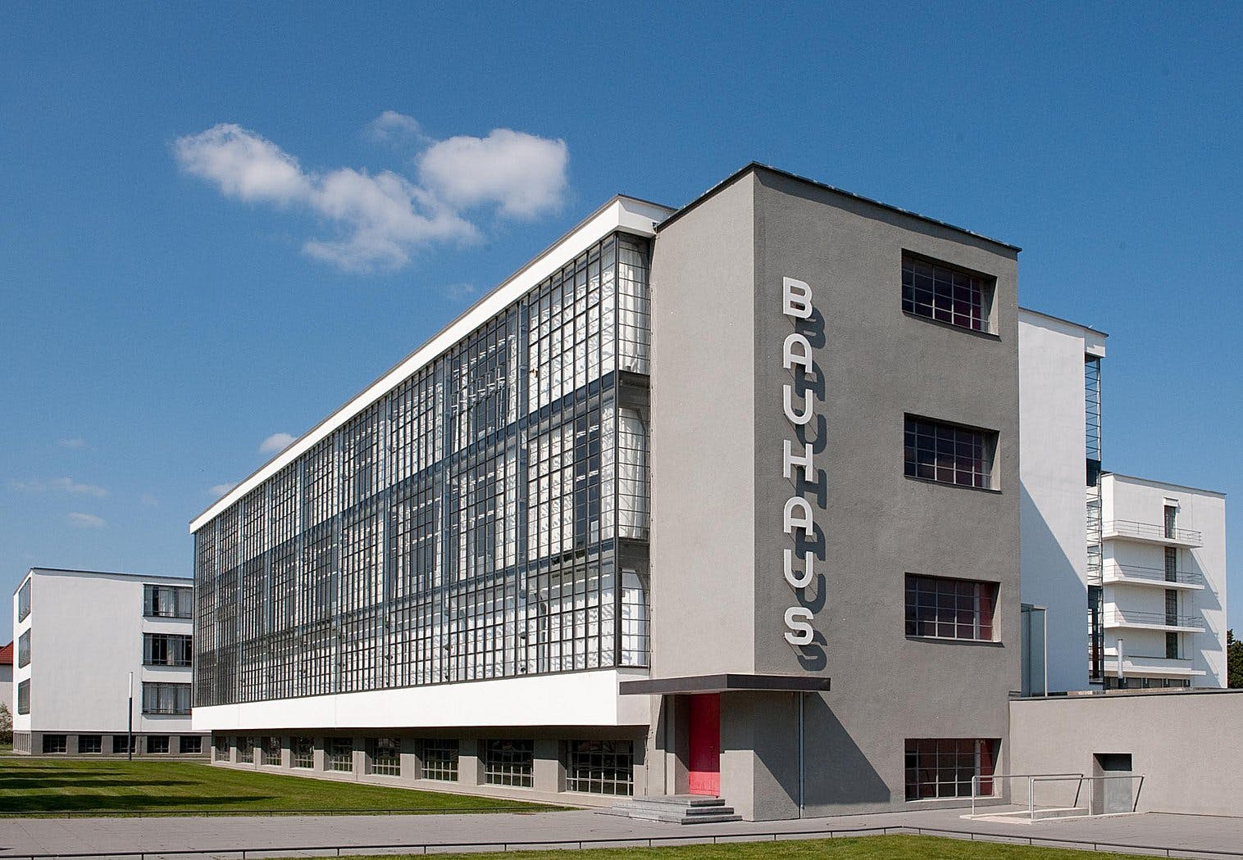
Bauhaus
School of architecture and design, Germany, 1919 - 1933
All art forms should be designed as a unit
Technology embraced
Economy in the use of space, materials, time, and money
Avoid Romantic embellishments

Slide 9
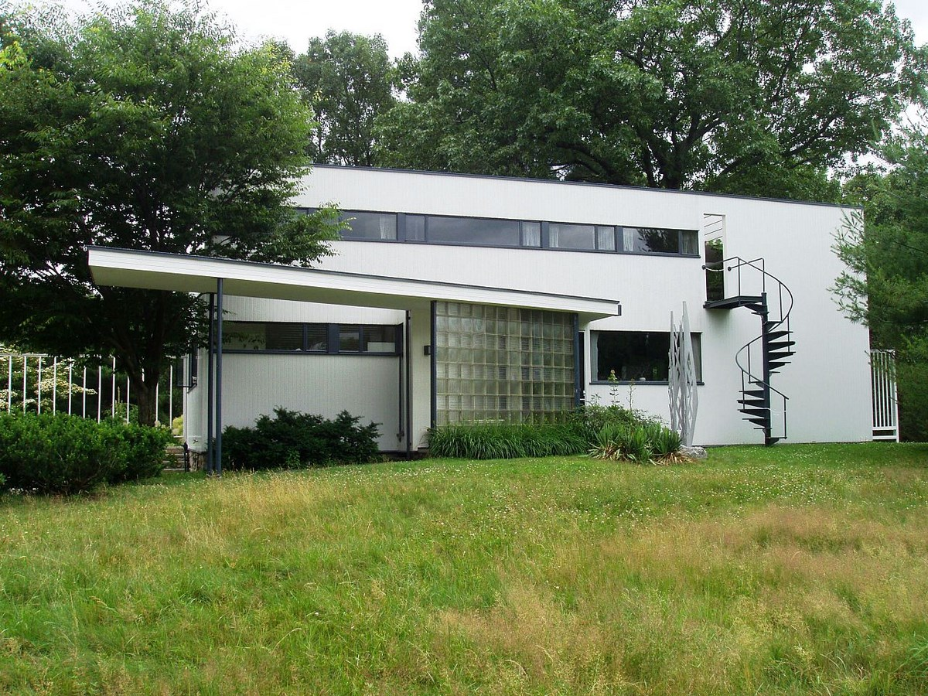
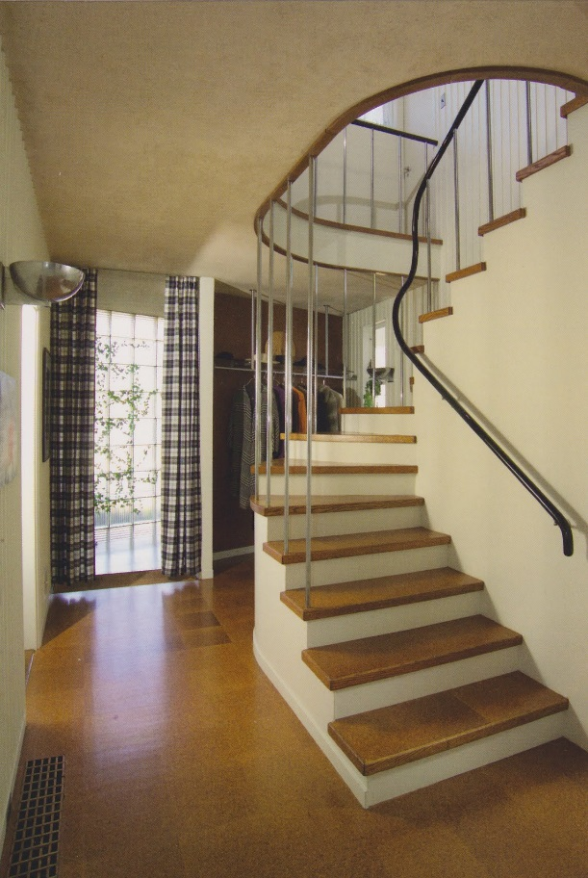
Gropius House
Gropius House combined traditional elements of New England architecture—wood, brick, and fieldstone—with innovative materials including glass block, acoustical plaster, chrome banisters, and the latest technology in fixtures.
It features furniture designed by Marcel Breuer and fabricated in Bauhaus workshops.
With the family’s possessions still in place, Gropius House has a sense of immediacy and intimacy.

Slide 10
THANKS

