Slide 1
Architectural Graphic - III
Topic – Philospher’s Work
Presented by:-Hiba Gul

Slide 2
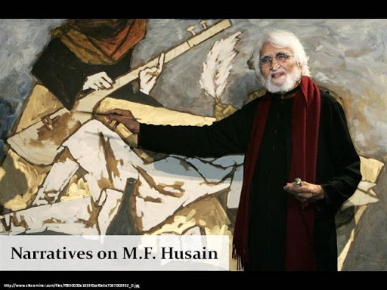
M.F.HUSAIN
Maqbool Fida Husain, known as M.F. Husain (1915-2011), was one of India’s most eminent artists.
Born in Pandharpur, his early years were spent in Indore.
Husain began his career as a painter of cinema hoardings after attending art school in Bombay (now Mumbai).
Using freehand drawing and vibrant colour, he depicted Indian subject matter in the style of contemporary European art movements, particularly Cubism.

Slide 3
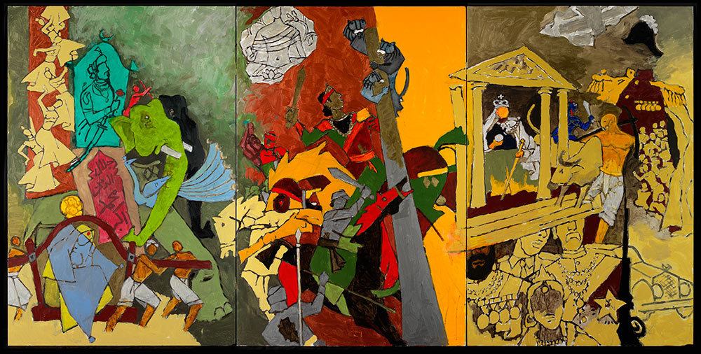
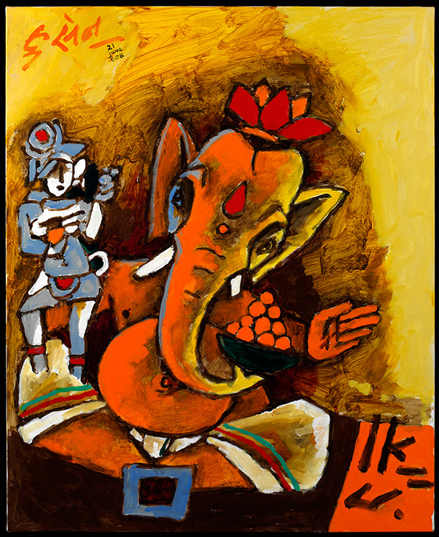
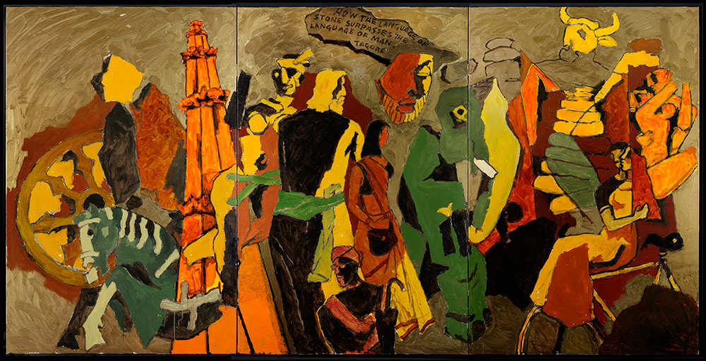

Slide 4
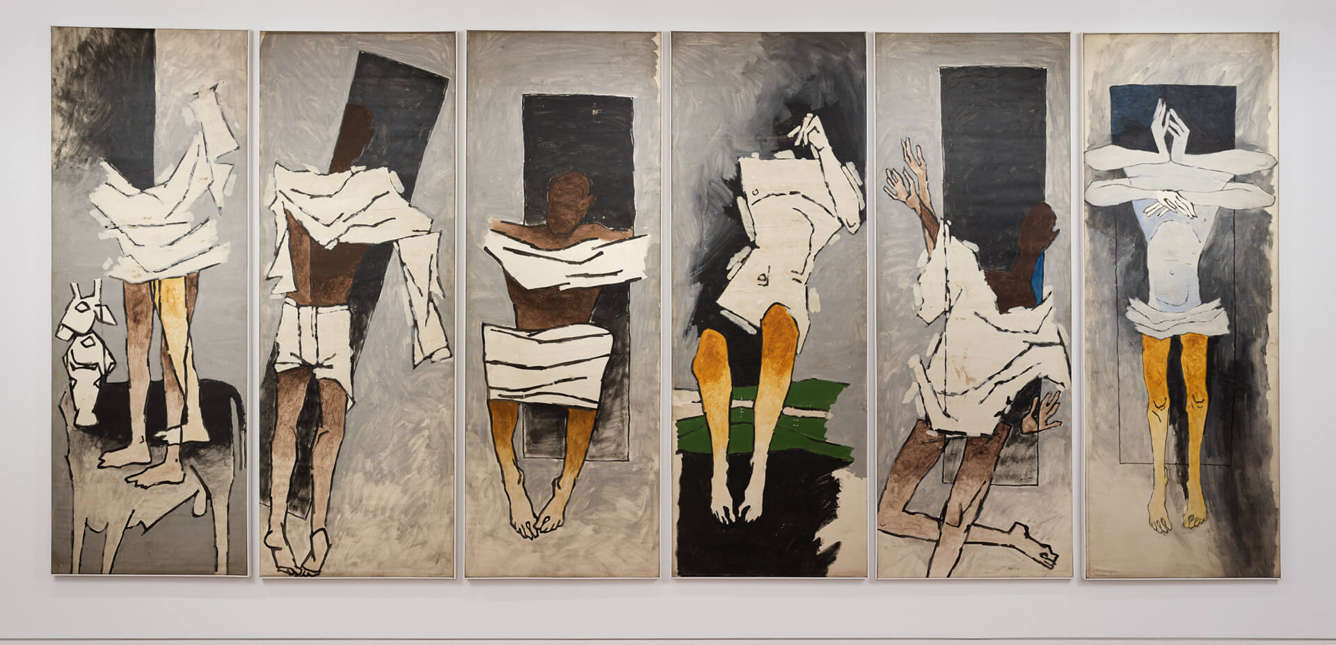
Often created art in a series with themes of Gandhi, Mother Teresa, Ramayana,Mahabharata, British raj, and motifs of Indian urban and rural life.
He tookdifferent perspectives which were caustic and funny or serious and somber.Husain was Moslem, painted Hindu symbols and themes often naked whileleaving Muslims themes clothed. Self exile in 1990’s because of 1970’s paintings.

Slide 5
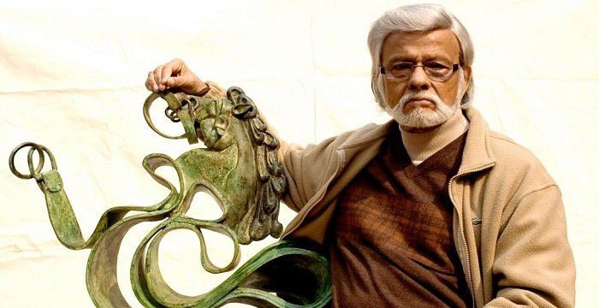
SATISH GUJRAL
Satish Gujral was an internationally acclaimed artist, muralist, sculptor, architect and writer.
In his quest for a unique Indian artistic identity, free of European influences, Gujral came to be known as one of the pioneers of modernism in post-Independent India.
In 1952, Gujral received a scholarship to study at the Palacio de Bellas Artes in Mexico City, where he served as an apprentice to renowned artists Diego Rivera and David Alfaro Siqueiros, who were pioneers of the muralist movement at the time.
.

Slide 6
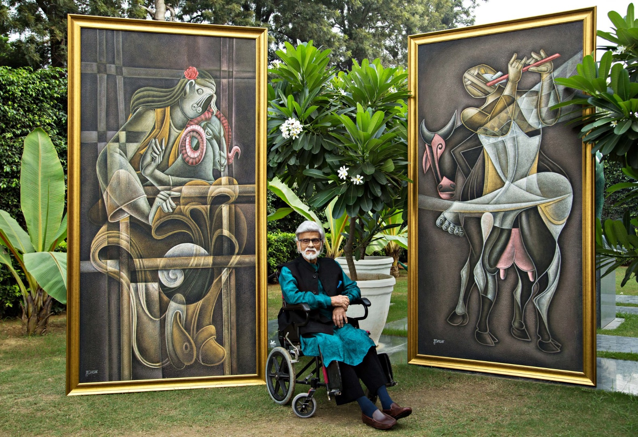
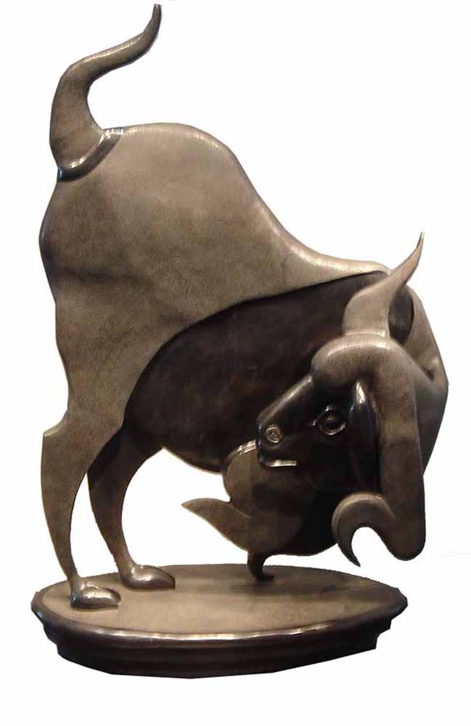
Inspired by them, Gujral similarly explored painting large fresco murals himself, and was frequently commissioned to paint them in India and abroad

Slide 7
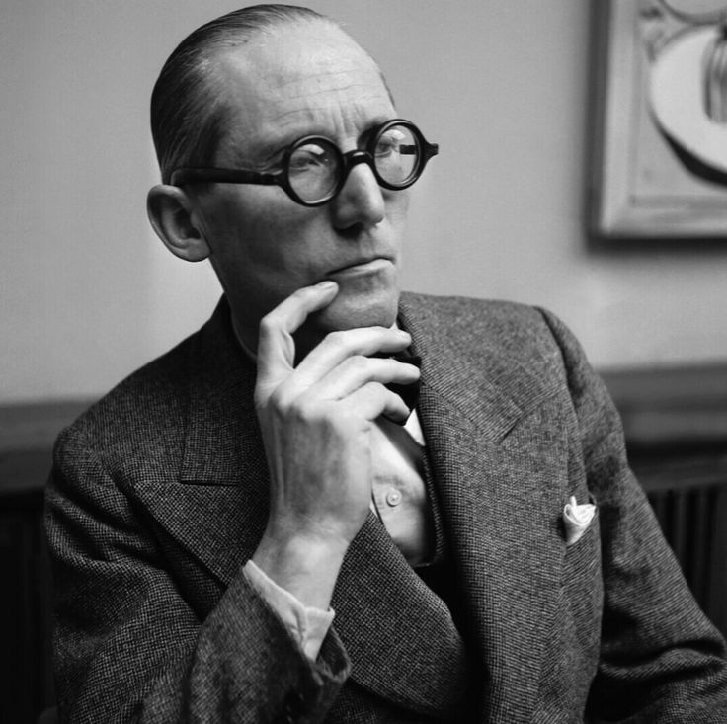
LE CORBUSIER
[DESIGN
PHILOSOPHY]
Le Corbusier was a Swiss-French architect, designer, painter, urban planner, writer.
They are used modern architecture.
FIVE POINTS OF ARCHITECTURE:
PILOTIS I.E. REINFORCED CONCRETE STILTS.
FREE FECADE
OPEN FLOOR PLAN
LONG HORIZONTAL RIBBON WINDOWS
ROOF GARDEN

Slide 8
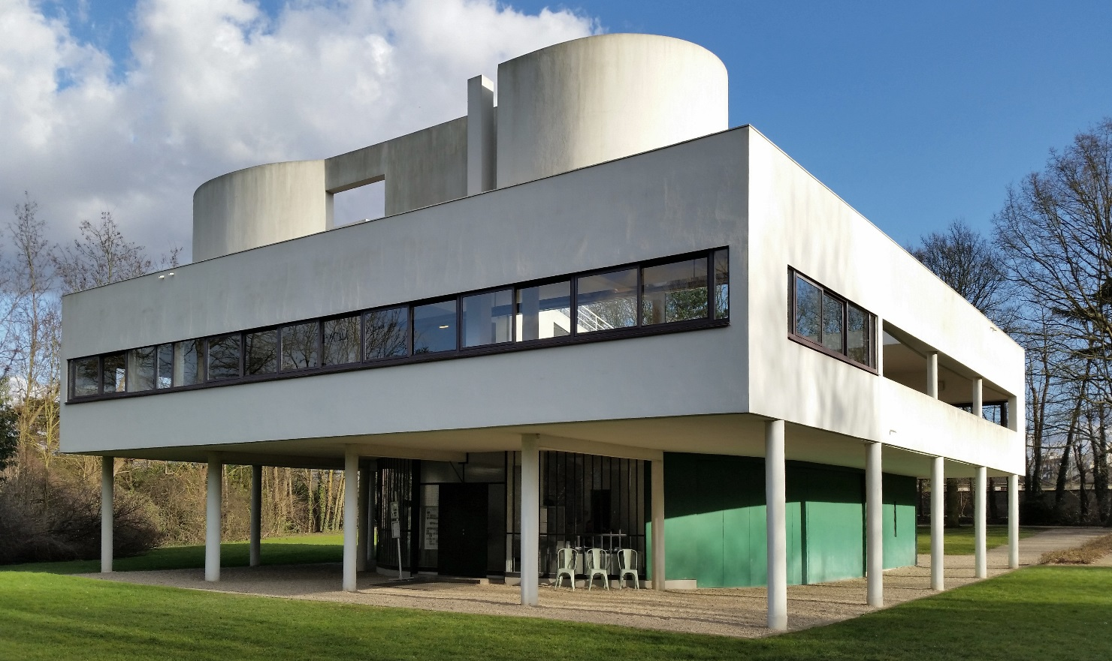
THEIR WORKS:
1.VILLA SAVOYE 2.CHANDIGARH
VILLA SAVOYE
GROUND FLOOR

Slide 9
FIRST FLOOR
TERRRACE FLOOR

Slide 10
CHANDIGARH
Chandigarh was the first planned city post independence. It is known internationally for its Architecture, Landscape and Urban Design.
In 1951 it was given to le Corbusier.
All the houses open up inside.
Grid planning is done.
7v,s road system is used.
The road are classified as v1, v2, v3, …………..v7
V1 connects chandigarh to other cities.

Slide 11
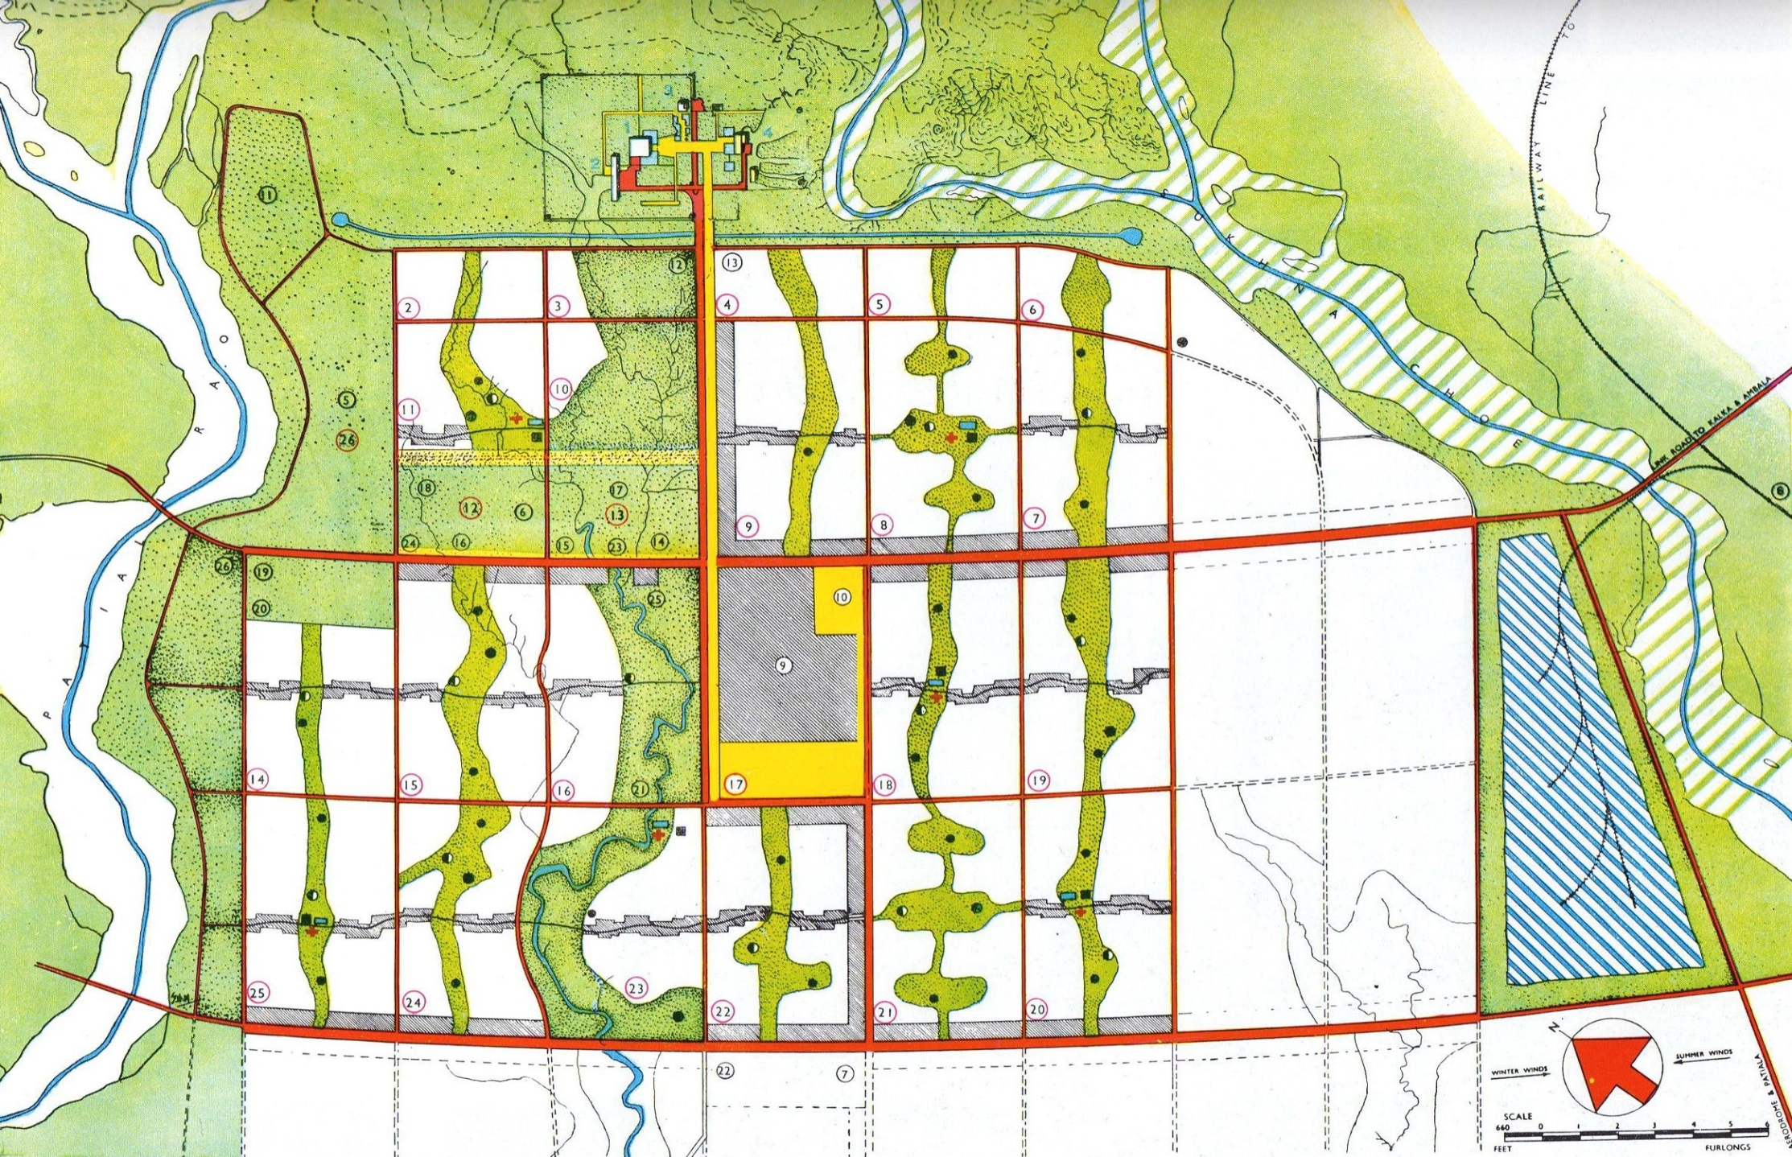
MASTER PLAN OF CHANDIGARH

Slide 12
IDEA OF LE CORBUSIER
THE CITY OF CHANDIGARH IS PLANNED TO HUMAN SCALE:
HEAD - CAPITAL[PLACE OF POWER]
HEART – THE CITY CENTRE.
STOMACH – THE COMMERCIAL AREA.
ARMS – UNIVERSITY AND INDUSTRIAL ZONE.
LUNGS – LEISURE VALLEY , OPEN SPACES.
ARTERIES – NETWORK OF ROADS.

Slide 13
GEOGRAPHICAL AND DEMOGRAPHICAL PROFILE:
AREA
LONGITUDE
LATITUDE
TOTAL POPULATION
DENSITY OF POPULATION / S.Q. KM. 7,900
114 S.Q. KMS.
76 47’ 14E
30 44’ 14N
10.55 LACS

Slide 14
THE ROADS OF THE CITY WERE CLASSIFIED INTO
SEVEN CATEGORIES KNOWN AS THE SYSTEM OF 7VS.
V1 FAST ROAD CONNECTING CHANDIGARH TO OTHER TOWNS.
V2 ARTERIAL ROADS.
V3 FAST VEHICULAR ROADS.
V4 FREE FLOWING SHOPPING STREETS.
V5 SECTOR CIRCULATION ROADS.
V6 ACCESS ROADS TO HOUSES.
V7 FOOTPATHS AND CYCLE TRACKS.

Slide 15
CONCLUSION:
POSITIVE
EACH SECTORS SATISFIES THE NECESSITIES OF HUMAN NEEDS.
SEPARATE ROADS FOR PEDESTRIAN,BICYCLE AND HEAVY VEHICLES.
SHOPS ON GROUND FLOOR, RESIDENCE ON UPPER FLOOR.
SHOP PROTECTED FROM RAIN AND SUN, AS A COVERED WALKWAY
FOR CUSTOMERS.
NEGATIVE
ROADS BEING SIMILAR TO EACH OTHER CREATES CONFUSION.
BRUTAL CONCRETE GIVES A ROUGH LOOK.
CITY NOT PLANNED FOR LOWER INCOME PEOPLE.
EXISTENCE OF SLUMS AROUND THE CITY.

Slide 16
THANKS

