Slide 1
Architectural Graphic - III
Topic – Patterns
Presented by:-Hiba Gul

Slide 2
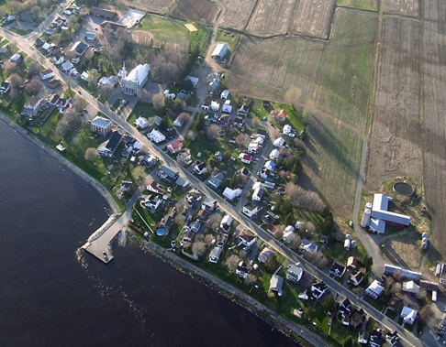
LINEAR SETTLEMENTS
are settlements where the buildings are constructed in lines, often next to a geographical feature like a lake shore, a river or following a road.

Slide 3
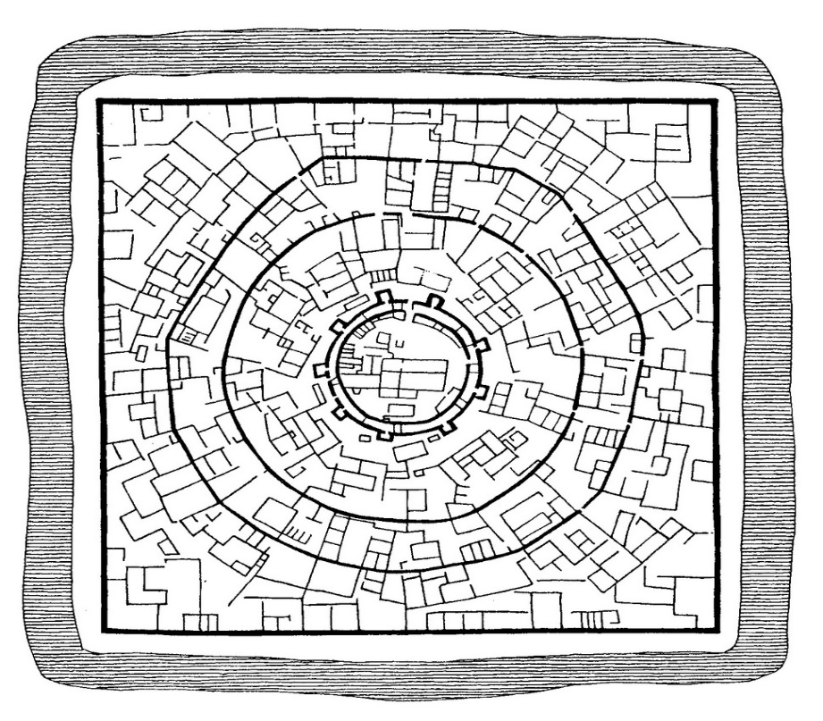
(b) Rectangular pattern:
Such patterns of rural settlements are found in plain areas or wide inter montane valleys. The roads are rectangular and cut each other at right angles

Slide 4
Circular settlement:
The settlements in which houses are constructed in a circular shape is known as Circular Pattern. Such kind of settlements is found around lakes, tanks, or a planned village. ... Such kind of settlements is found around the points where several roads cross each other (making star shape)

Slide 5
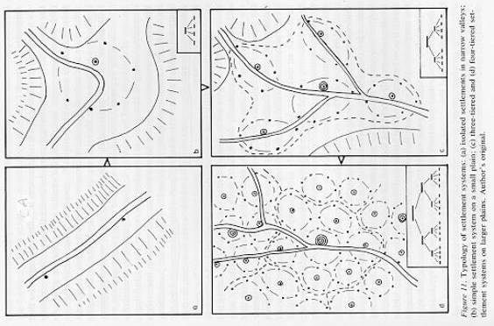
HUMAN SETTLEMENT PATTERNS

Slide 6
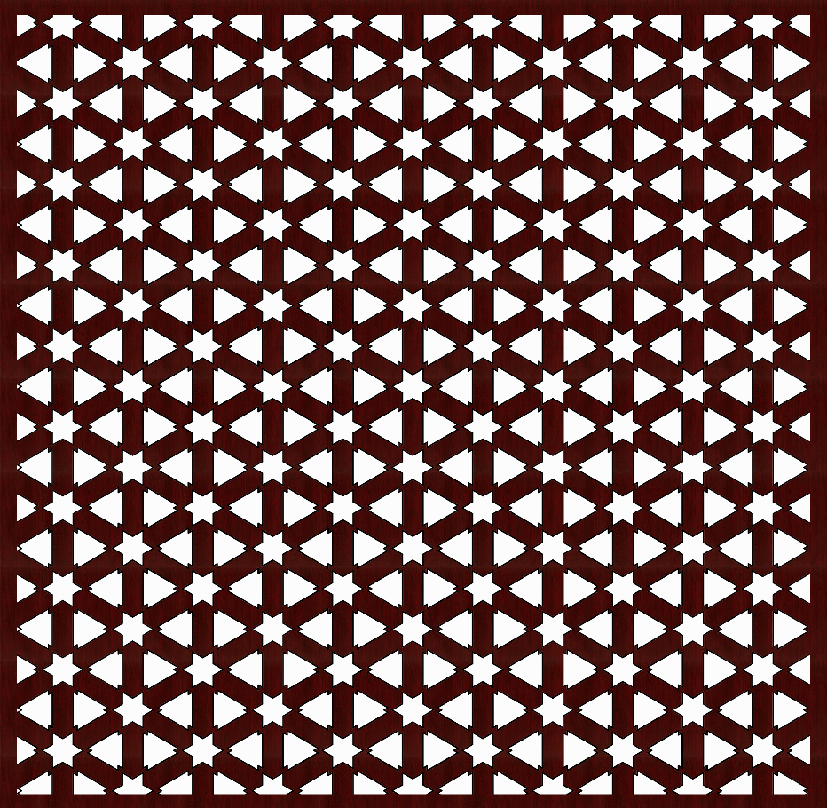
JALI PATTERN
THIS JALI PATTERN IS INSPIRED BY ISLAMIC ARCHITECTURE.
WE USED THEIR MOST OF THE USED SHAPE IS STAR AND TRIANGLE TO MADE THIS JALI PATTERN.
ONLY THESE TWO SHAPED ARE FIXED EACH OTHER PROPERLY BECAUSE STAR IS IS MADE BY COMBINATION OF TRIANLE.
THE JALI PATTERN SIZE IS 600MMX600MM.

Slide 7
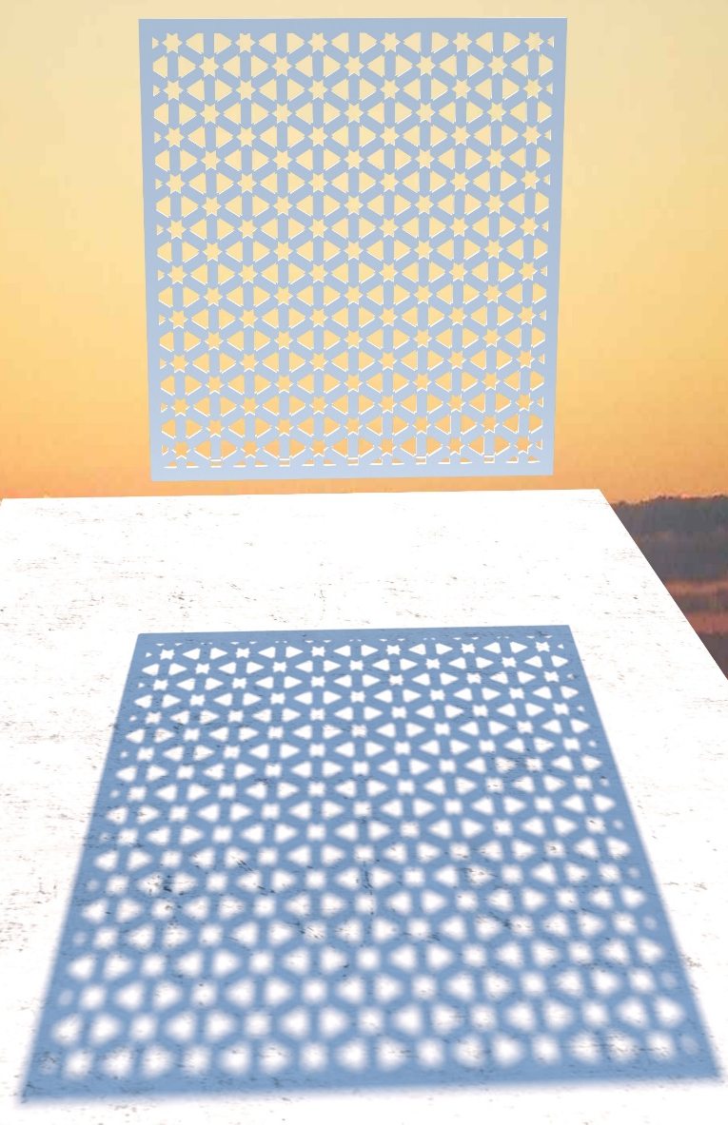
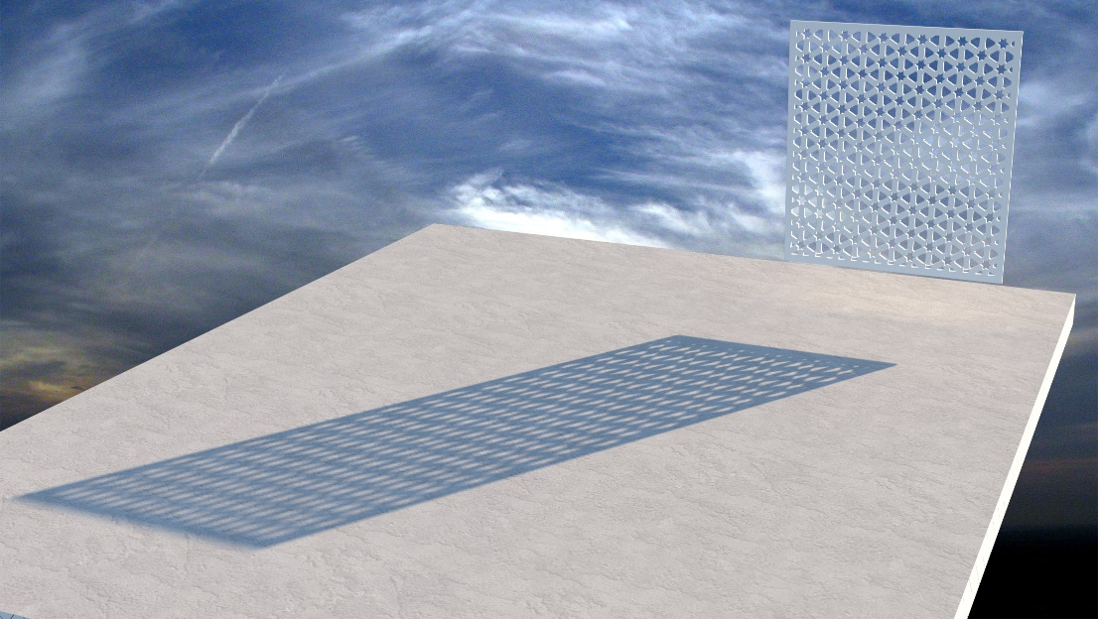
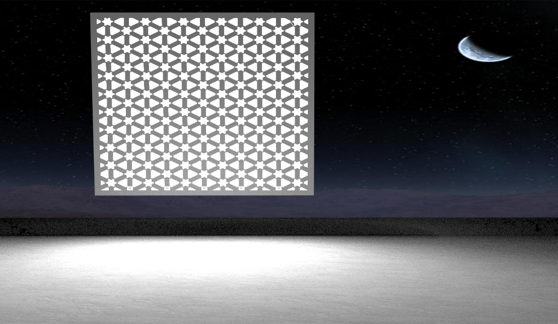
JALI PATTERN SHADOW FROM DIFFERENT ANGLES.

Slide 8
Thanks

