Slide 1
Architectural Graphic - III
Topic – Patterns
Presented by:-Hiba Gul

Slide 2
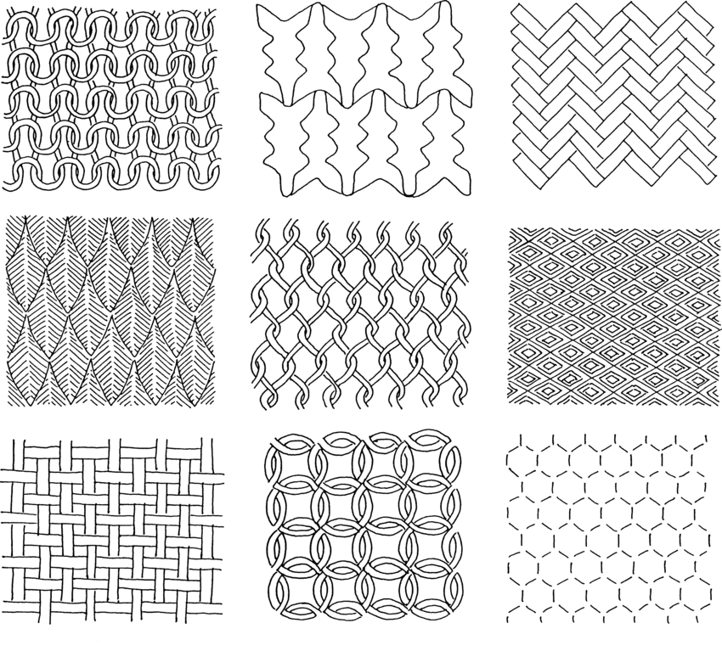
Meaning of patterns
A pattern is the repeated or regular way in which something happens or is done. ... A pattern is an arrangement of lines or shapes, especially a design in which the same shape is repeated at regular intervals over a surface.

Slide 3
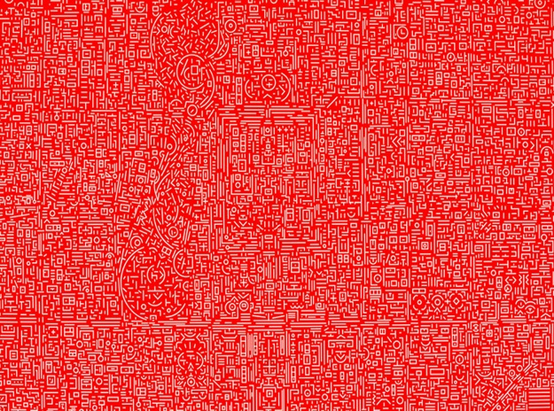
PATTERN
A repeating arrangement of numbers, colors and shapes.
A pattern is a regularity in the world, in human-made design, or in abstract ideas.
As such, the elements of a pattern repeat in a predictable manner.
A geometric pattern is a kind of pattern formed of geometric shapes and typically repeated like a wallpaper design. Any of the senses may directly observe patterns

Slide 4
Types of pattern
Symmetry.
Trees, fractals.
Spirals.
Flow, meanders.
Waves, dunes.
Bubbles, foam.
Tessellations.
Cracks.

Slide 5
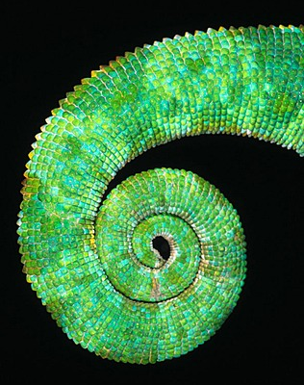
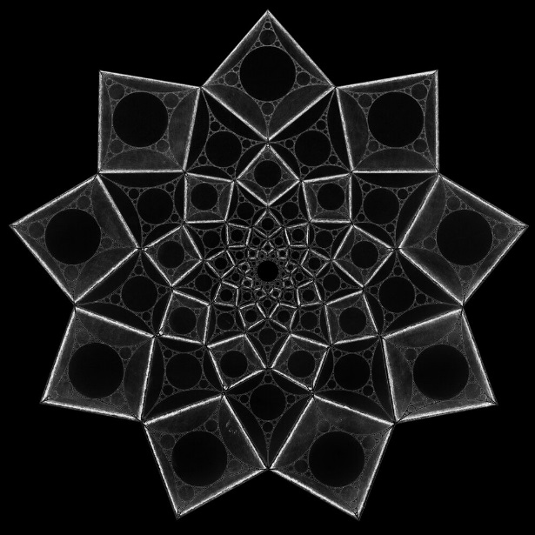
SYMMETRY
FLOW,MEANDERS
SPIRALS
FACTALS

Slide 6
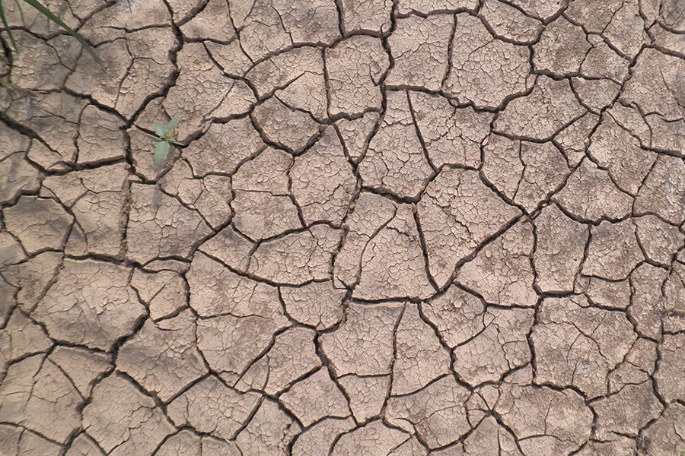
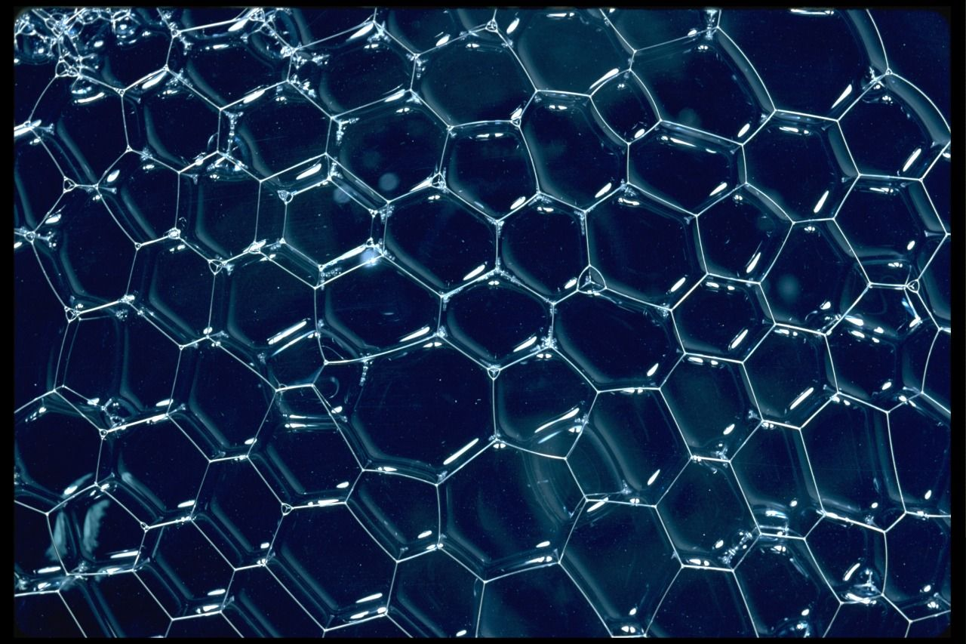
BUBBLES
CRACKS
TESSELLATIONS
WAVES

Slide 7
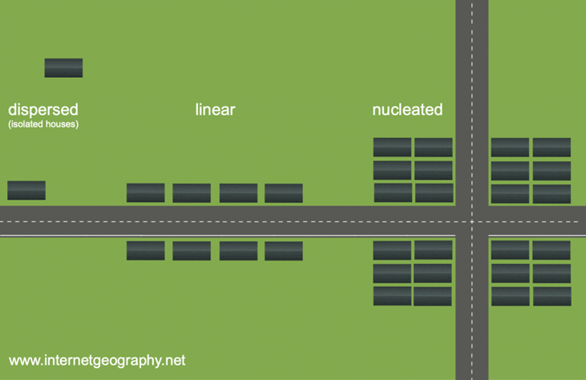
PATTERNS OF SETTLEMENT
Settlements take on a range of shapes when they form. Dispersed, linear and nucleated are the most common.

Slide 8
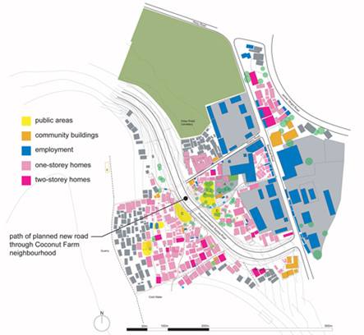
SETTLEMENT PATTERN
A settlement pattern refers to the shape of the settlement.
The shapes of early settlements were influenced by the surrounding landscape.
They were also shaped by other factors such as who owned the land and whether the land was good for building on or not.
Some examples of settlement patterns include, nucleated settlements, linear settlements and dispersed settlements.

Slide 9
DISPERSED SETTLEMENTS are ones where the houses are spread out over a wide area. They are often the homes of farmers and can be found in rural areas.

Slide 10
Thanks

