Slide 1
GIS & REMOTE SENSING
Subject: GIS Studio
Topic: Applications of GIS in Urban Planning
Presented by: Pallavi Tiwari

Slide 2
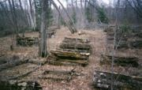
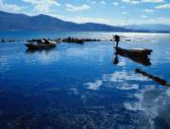
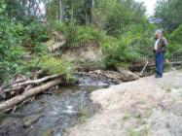
Natural Resources Management
-Resource assessment
-Change detection
-Suitability analysis
-Scenario study
-Impact assessment

Slide 3
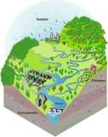
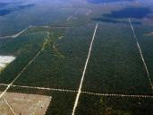
Natural Resources Management Applications
Water Resources assessment
Land-use planning
Soil erosion potential evaluation
Watershed planning
Vegetation mapping
Ecosystem analysis
Conservation planning
Risk assessment
Coastal zone management and hazard mapping

Slide 4
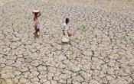
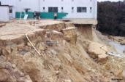
Disaster Management & Mitigation
•Earthquakes
•Drought
•Fire
•Flood & Cyclones
•Landslides & Erosion
•Volcano etc.

Slide 5
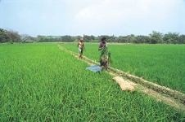
Agriculture
Crop water requirement prediction
Crop acreage & yield estimation
Crop condition assessment
Soil moisture evaluation
Suitability mapping

Slide 6
Business GIS
• Supply Chain Management
• Marketing
• Site Selection
• Consumer Management
• Logistics
• Intelligent Routing
• Demographic Analysis
Precisely GIS can be used for -
• For detection of potential market.
• For detection of dealer / distributor network.
• Zoning by market growth.
• For strategy planning in case of market analysis for launch of products

Slide 7
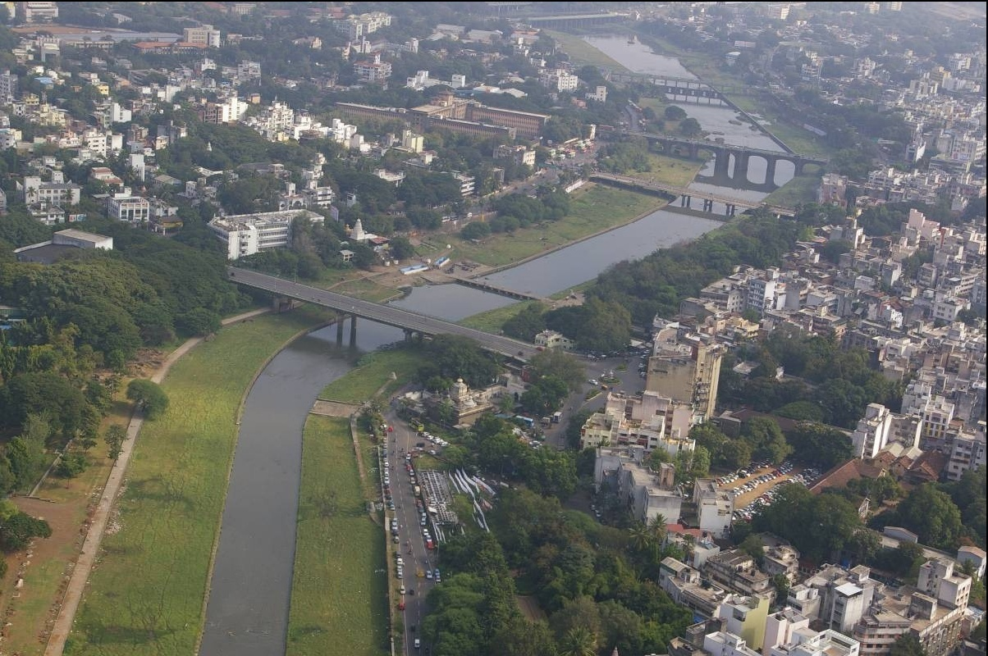
Urban Planning & Development
Urban sprawl analysis
Cadastral mapping & land management
Land use / land cover mapping & analysis
Site selection

Slide 8
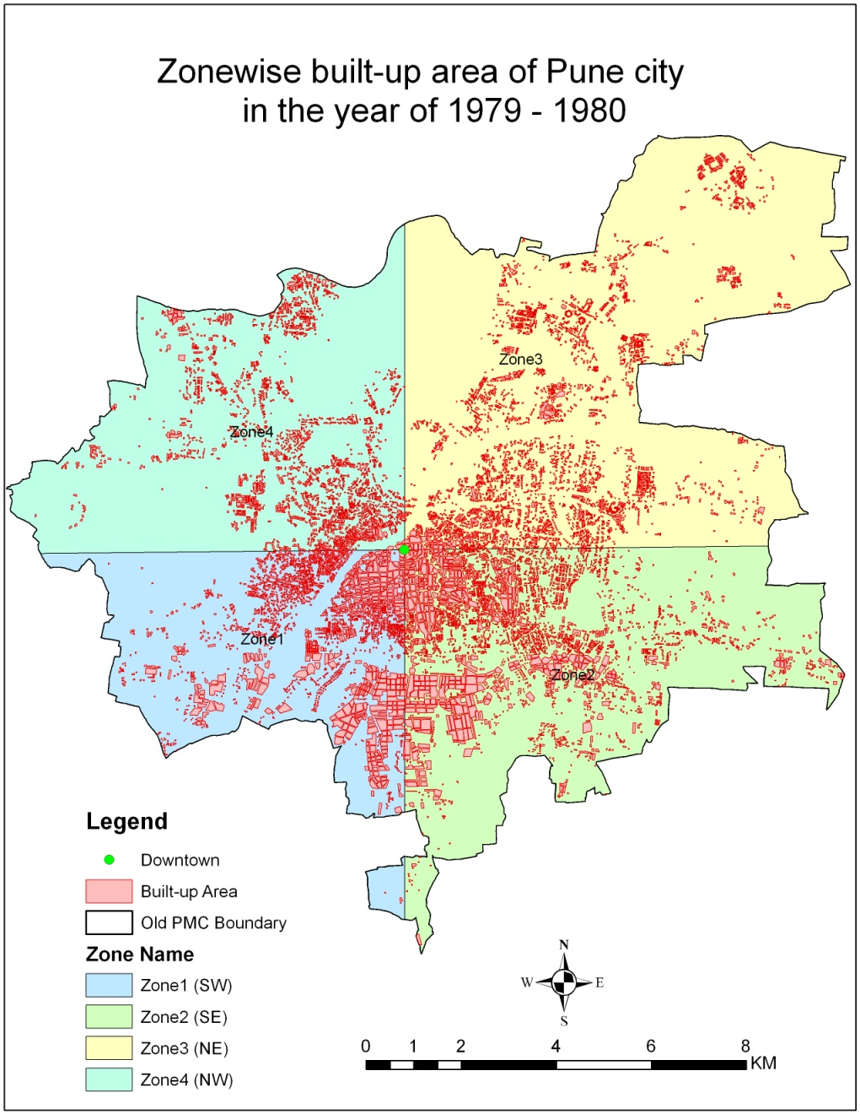
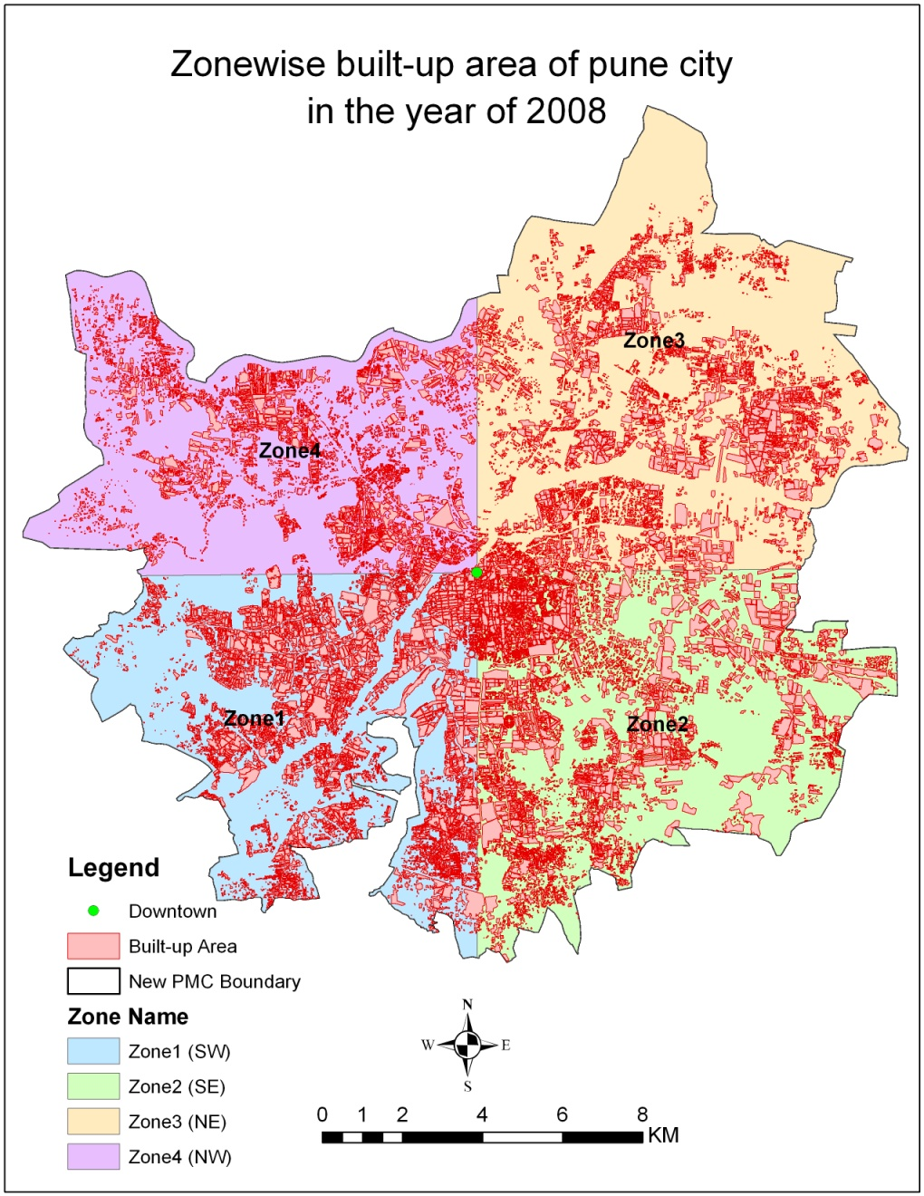

Slide 9
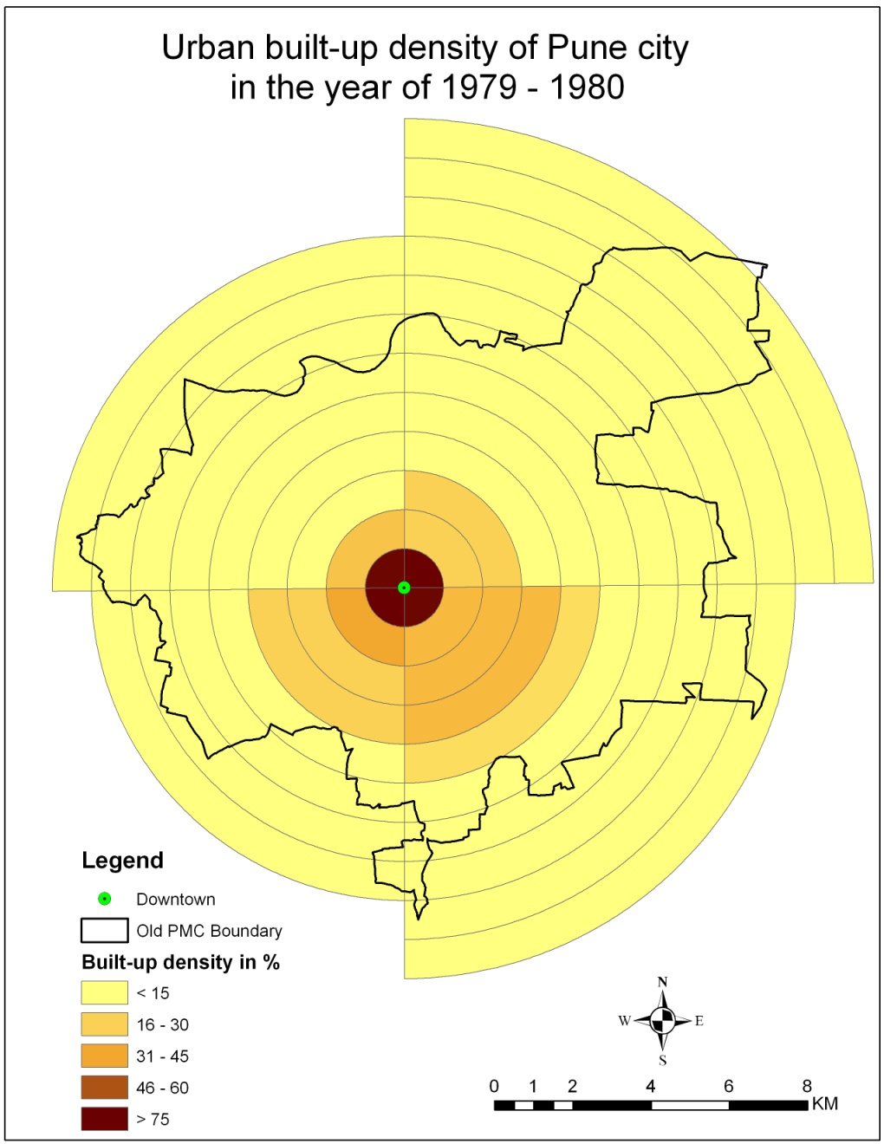
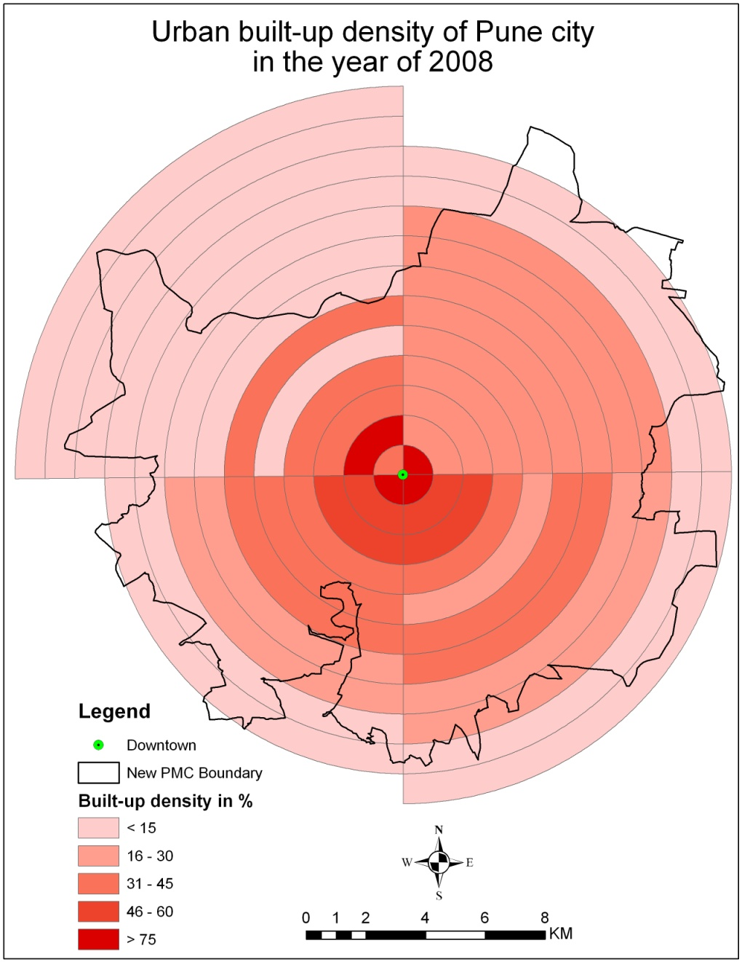
Growth of urban built-up density from 1979-80 to 2008.
The zone wise study is not sufficient to notice the urban sprawl, while the concentric circle of 1km interval approach is more appropriate for identifying the urban growth as well as its dispersion. There is lot of variation in urban development between the multiple buffer rings.

Slide 10
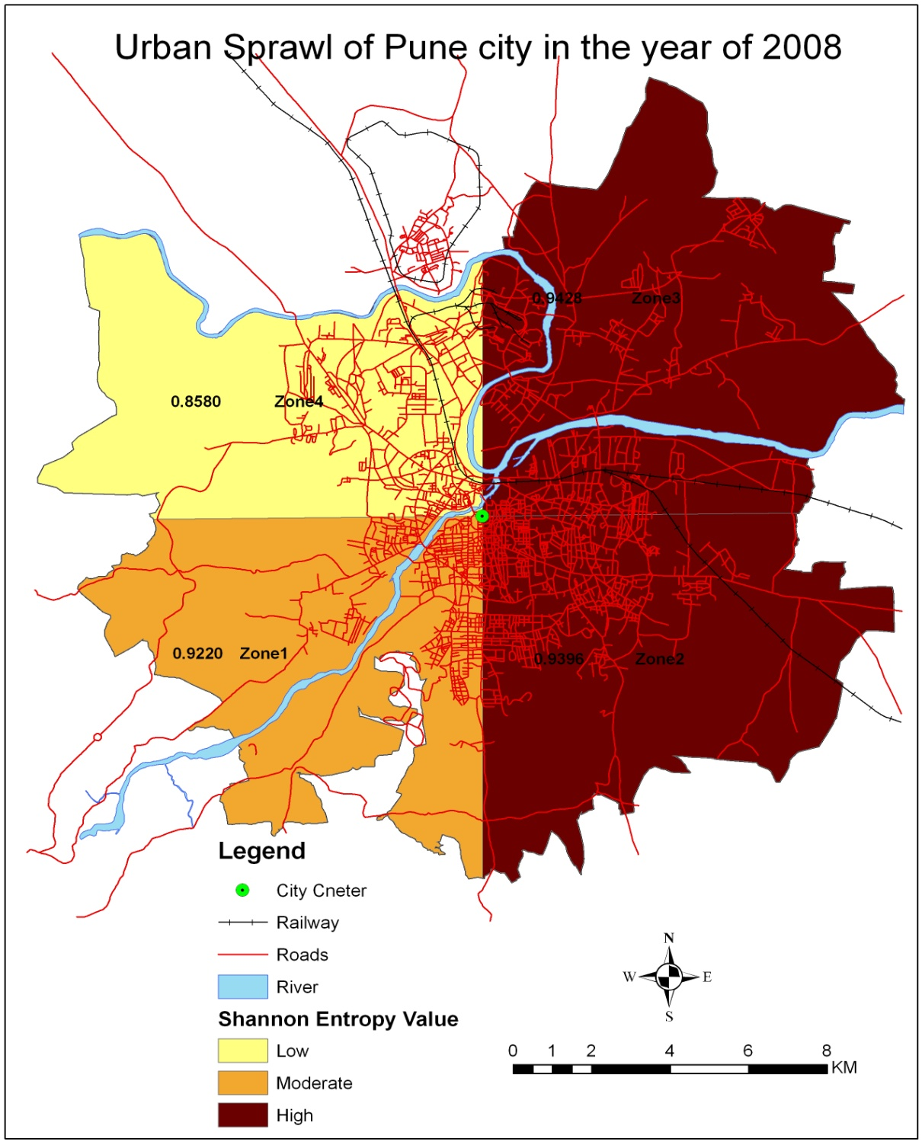
Zone wise urban sprawl of Pune city in 2008:

