Slide 1

GIS & REMOTE SENSING
Subject: GIS Studio
Topic: Applications of GIS in Urban Planning and spatial operations
Presented by: Pallavi Tiwari

Slide 2
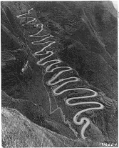
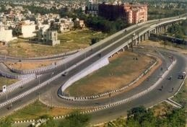
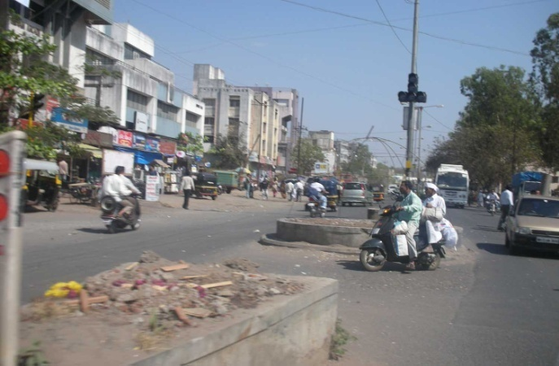
Transportation
Route planning for road & rail
Road network updating
Logistics management
• Analysis of highway crash data
• Intelligent crash location
• Traffic planning tools
• Route selection and evaluation

Slide 3



Utility Management
Creation of digital maps and asset maps of Electricity, Gas, Telecom, Power, Water Utilities etc. linking them to the relevant databases and developing systems for providing decision support information.

Slide 4
What is a Geographic Information System?
Geographic Information System (GIS) – A computer-based system for the collection, storage, organization, maintenance, and analysis of spatially-referenced data, and the output of spatially-referenced information.
  Data – Any collection of related facts; the basic elements of information.
  Information - Data that have been processed to be useful; provides answers to "who", "what", "where", and "when" questions
Information can only come from accurate data.

Slide 5
Applications of GIS
Urban Planning, Management & Policy
  Zoning, subdivision planning
  Land acquisition
  Economic development
  Code enforcement
  Housing renovation programs
  Emergency response
  Crime analysis
  Tax assessment
Environmental Sciences
  Monitoring environmental risk
  Modeling storm water runoff
  Management of watersheds, floodplains,
  wetlands, forests, aquifers
  Environmental Impact Analysis
  Hazardous or toxic facility siting
  Groundwater modeling and contamination
  tracking
Political Science
  Redistricting
  Analysis of election results
  Predictive modeling
Civil Engineering/Utility
  Locating underground facilities
  Designing alignment for freeways, transit
  Coordination of infrastructure maintenance
Business
  Demographic Analysis
  Market Penetration/ Share Analysis
  Site Selection
Education Administration
  Attendance Area Maintenance
  Enrollment Projections
  School Bus Routing
Real Estate
  Neighborhood land prices
  Traffic Impact Analysis
  Determination of Highest and Best Use
Health Care
  Epidemiology
  Needs Analysis
  Service Inventory

Slide 6

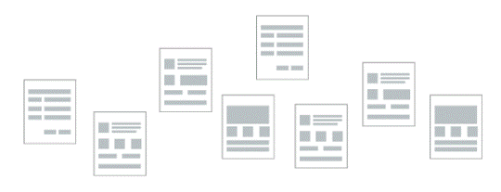
How do we describe geographical features?
By recognizing two types of data:
  Spatial data which describes location (where)
  Attribute data which specifies characteristics at that location
  (what, how much, and when)
SPATIAL DATA
NON - SPATIAL DATA OR ATTRIBUTES

Slide 7
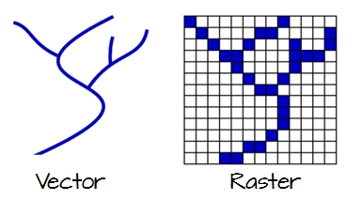
How do we represent these digitally in a GIS?
By grouping into layers based on similar characteristics (e.g hydrography, elevation, water lines, sewer lines, grocery sales) and using either:
  vector data model
  raster data

Slide 8
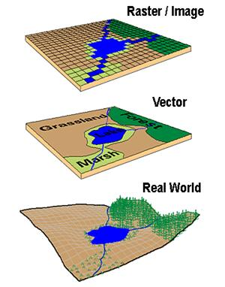
Raster vs. Vector Data Model

Slide 9
Data Model Concepts
Vector data model and Raster data model can represent same phenomena
    E.g. Elevation represented as surface (continuous field) using raster grid or as lines representing contours of equal elevation (discrete objects), or as points of height (Z values).
Data can be converted from one conceptual view to another
    E.g. raster data layer can be derived from contour lines, point cloud
Selection of raster or vector model depends on the application or type of operations to be performed
    E.g. Elevation represented as surface (continuous field) in raster - to easily determine slope, or
    as discrete contours if printed maps of topography

Slide 10
There are three basic types of vector objects: points, lines and polygons
Vector data model uses sets of coordinates and associated attribute data to define discrete objects
Point objects in spatial database represent location of entities considered to have no dimension. Simplest type of spatial objects
    E.g. wells, sampling points, poles, telephone towers, etc.
Line objects are used to represent linear features using ordered set of coordinate pairs
    E.g. infrastructure networks (transport networks: highways, railroads, etc.) ; utility networks: (gas, electric, telephone, water, etc. ); airline networks: hubs and routes, etc.); natural networks such as river channels

Slide 11
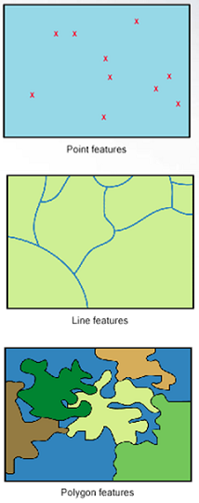
Polygon objects in spatial database represent entities which covers an area
    E.g. lakes, Buildings, parcels, etc.
Boundaries may be defined by natural phenomena (e.g. lake), or by man made features (e.g census tracts, neighborhoods)
    E.g. Land cover data: forest, wetlands, urban areas, etc.
    Soil data – soil types

Slide 12
Raster Data Model defines the world as a regular set of cells in a uniform grid pattern
Cells are square and evenly spaced in the x and y directions
Each cell represent attribute values and cell location of phenomena or entities
Cell dimension specifies the length and width of the cell in surface units
Raster data models represent continuous phenomena or spatial features
    E.g. Elevation/DEM, bathymetry, precipitation, slope, etc.
Raster data model may also be used to represent discrete data
    E.g. Land cover: forest, wetlands, urban areas
Rasters are digital aerial photographs, imagery from satellites, digital pictures, or even scanned maps

Slide 13
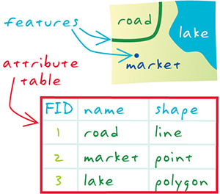
Attribute Tables
Non-spatial information associated with a spatial feature is referred to as an attribute. A feature on a GIS map is linked to its record in the attribute table by a unique numerical identifier (ID). Every feature in a layer has an identifier.

Slide 14
Attribute data can be broken down into four measurement levels:
Nominal data which have no implied order, size or quantitative information (e.g. paved and unpaved roads)
Ordinal data have an implied order (e.g. ranked scores), however, we cannot quantify the difference since a linear scale is not implied.
Interval data are numeric and have a linear scale, however they do not have a true zero and can therefore not be used to measure relative magnitudes. For example, one cannot say that 60°F is twice as warm as 30°F since when presented in degrees °C the temperature values are 15.5°C and -1.1°C respectively (and 15.5 is clearly not twice as big as -1.1).
Ratio scale data are interval data with a true zero such as monetary value (e.g. $1, $20, $100).

Slide 15
Spatial Operations
Spatial operations use geometry functions to take spatial data as input, analyze the data, then produce output data that is the derivative of the analysis performed on the input data
E.g. Buffer, clip, intersection, union, dissolve, merge, etc.

Slide 16
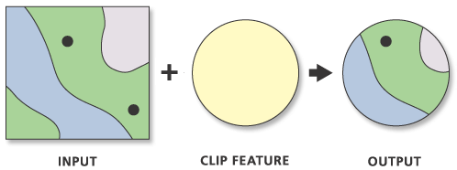
Spatial Operations
Clip (Analysis)
Clip: Extracts input features that overlay the clip features
Creating a new feature class: Area of Interest (AOI), or study area
The Output Feature Class will contain all the attributes of the Input Features

Slide 17
Spatial Operations
Clip (Data Management )
Cuts out a portion of a raster dataset, mosaic dataset, or image service layer.
Allows you to extract a portion of a raster dataset based on a template extent
The clipped area is specified either by a rectangular envelope using minimum and maximum x- and y-coordinates or by using an output extent file

Slide 18
Spatial Operations
Intersect (Analysis)
Computes a geometric intersection of the input features.
Features or portions of features which overlap in all layers and/or feature classes will be written to the output feature class.
Input Features must be simple features: point, multipoint, line, or polygon

Slide 19
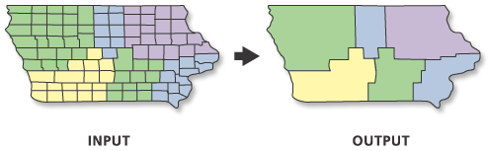
Spatial Operations
Dissolve (Data Management)
Aggregates features based on specified attributes

