Slide 1
Subject: Principles Of Human Settlements-I
Topic: Ancient India Town Planning
Presented by: Pallavi Tiwari

Slide 2
TIMELINE - (9000BC TO 550AD )
STONE AGE(PRE HISTORIC PERIOD) --- 9000BC - 3300 BC
PALEOLITHIC
MESOLITHIC
NEOLITHIC
BRONZE AGE --- 2800 BC - 500 BC
MANASARA SILPA SASTRA-TYPICAL PLANNING LAYOUTS
INDUS VALLEY CIVILIZATION ---- ---2800 BC – 1900BC
VEDIC ERA(ARYAN &DRAVIDIAN )---1500BC - 500 BC
IRON AGE ----- 1000 BC – 350 BC
ANCIENT INDIA ------ 500 BC - 550 AD
MAURAYAN PERIOD ----------- -320 BC – 185 BC
SATAVAHANA PERIOD ---- ------- 230 BC - 220 AD
GUPTA PERIOD ----- ------- 240 AD – 550 AD

Slide 3
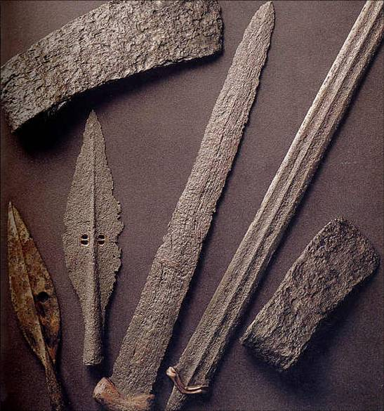
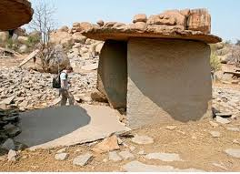
PRE HISTORIC PERIOD - 9000 BC TO 3300 BC
Stone Age The primitive man made use of stones and stone tools for every day chores. Thus, the era was termed as Stone Age. The Stone Age is broadly divided into three parts on the basis of specialization of stone tools utilized by the primitive man; namely, the Old Stone Age or the Paleolithic age dating from approximately 2000000 BC to 8000 BC, the Middle Stone Age or the Mesolithic Age dating from 8000 BC to 4000 BC and the New Stone Age or Neolithic age from 4000 BC to 3300 BC.
Paleolithic Age In this age, man was essentially a food gatherer. He learnt to make weapons out of stones . The crude weapons were slowly carved properly and were made sharp and pointed. Man also learnt how to create fire and make use of it.

Slide 4
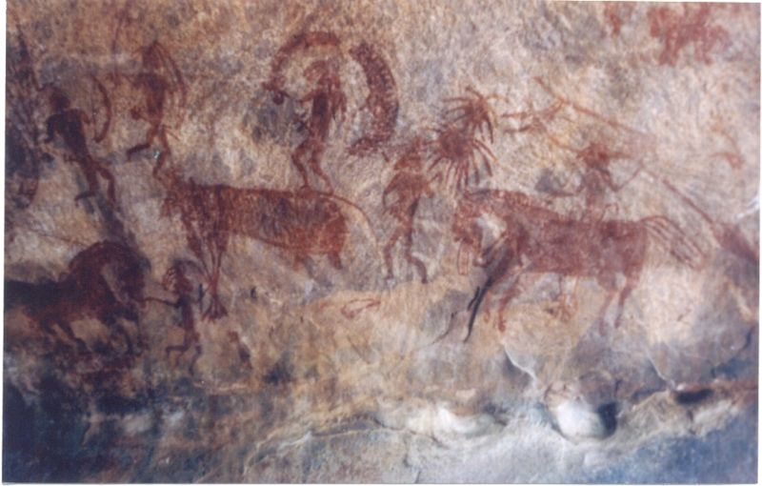
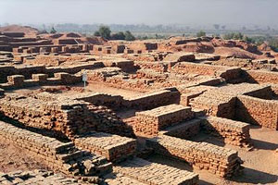
Mesolithic Age
In this age the size of the groups grew to form small communities. The number of mouths to feed increased . The tools improved and became more refined and sharp. There was a drastic change in the food and clothing of man. Apart from hunting, farming techniques were developed and man began to grow crops. Man also learnt to draw and paint and the evidence is found in the form of cave paintings found in India. Examples like Gujarat, some places of Rajasthan, Bihar, Utter Pradesh and Adamgarh in Madhya Pradesh.
Neolithic Age It is known as the last stage of the Stone Age era. The main features of this age were the finely flaked weapons and small tools made of stone that were used for day to day work. This age also saw domestication of cows, horses and other poultry and farm animals.The wheel, which was a very important invention during this age.
Rock painting

Slide 5
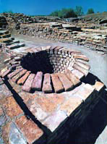
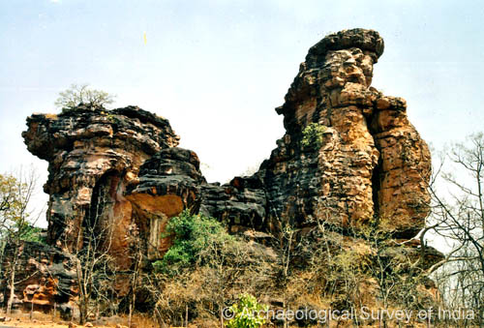
BRONZE AGE - 2800 BC TO 500 BC
The Bronze Age is the era when metals were used and improved for making tools and other weapons. This age came immediately after the Neolithic Age and aided in the development of the metallurgy industry. It almost coincided with the beginning of the Indus Valley Civilization. People living in Indus Valley produced bronze, copper and tin thus developing new techniques of metallurgy.
IRON AGE - 1000 BC TO 350 BC
The Iron Age is the last principal period in the three-age system for classifying ancient societies, preceded by the Bronze Age and the Stone Age. Its dates and context vary depending on the geographical region. The Iron Age in each area ends with the beginning of the historical period, i.e. the local production of ample written sources.
In this age ,there came up 16 powerful kingdoms or states in the Gangetic Plains of North India.
Rock shelters

Slide 6
MANASARA –SILPA – SASTRA
The following typical planning are mentioned :-
Dandaka
Sarvatobhadra
Nandyavarta
Padmaka
Swastika
Prastara
karmuka
chathumukha
Dandaka layout
The name itself indicate that it is a long layout like a ‘Danda’ or long pole.
The main features of this Layout describes that streets are straight and cross each other at right angles at the centre running east to west and south .
The main street should have on either side buildings and footpaths...
Here a tendency is noticed to locate the temples away from the centre of the town. The temples were away from centre of the village and at the outskirts are even now an important feature of the country side.
when two or more temples are constructed they are often put at further ends of village or town.

Slide 7
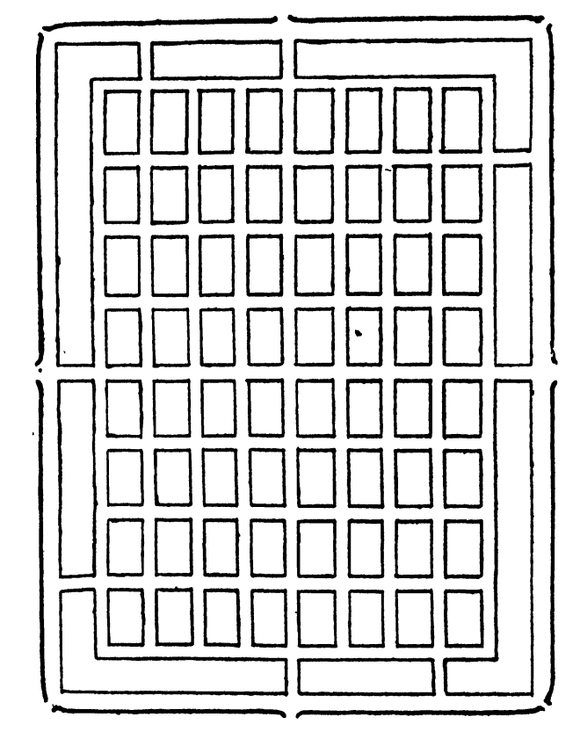
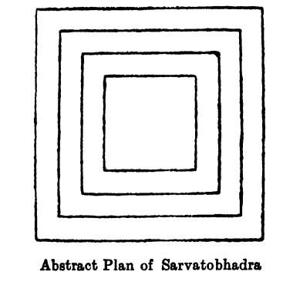
Another feature of the layout is that the length of the town should be twice its breadth.
Out of the eight layouts mentioned in manasara ,all except two are specified to have this proportion ,the two exceptions are padmaka and swastika layouts whose lengths should be equal to breadths.
Sarvatobhadra Layout
The layout is square one. It has one to five carriage roads or main streets together with a surrounding streets
At the four corners there should be a monastery, temples or guest house. Other public houses in quarters as are required.
At the four directions, there should be main gates.
By allotting different plots for different trades and professions a kind of zone system has been introduced.
Approach towards centre are to become less and less populated, until it reaches the centre ,where there should be no building at all. This is a practice diametrically opposite to the present system where the centre is intensely built and the intensity reduces further and further away from the centre.

Slide 8
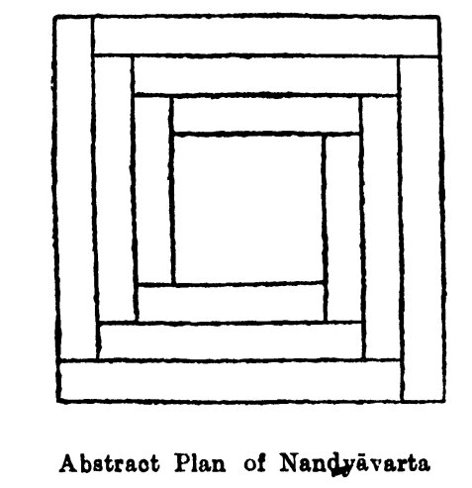
One thing to which they appear to have given a great deal of stress was the provision of less important roads or lanes between two important streets ,preferably with one pavement on one side.
In dandaka layout it is apparent that trade and professions are concentrated towards the centre ,while the residential quarters receded to the periphery of the town. Concentration of trade and profession at periphery of town has a great advantage; when they increase ,outlying areas can be tacked on towns and developed without inconveniencing the inhabitants and remodelling the entire town at tremendous expense.
Nandyavarta layout
The name its tells that nandyavarta is a thick white flower that grows on a bush. The main peculiarity of the flower is the overlapping of the petals. This characteristic of the petal is adopted in the layout of the streets in nandyavarta layout .
The length of the town should be twice the breadth.
The centre of the town should be kept open or pavilion or shrine may be constructed there probably to form a feature of the layout.
The nandyavarta layouts is an improvement on the sarvatobhadra layout.

Slide 9
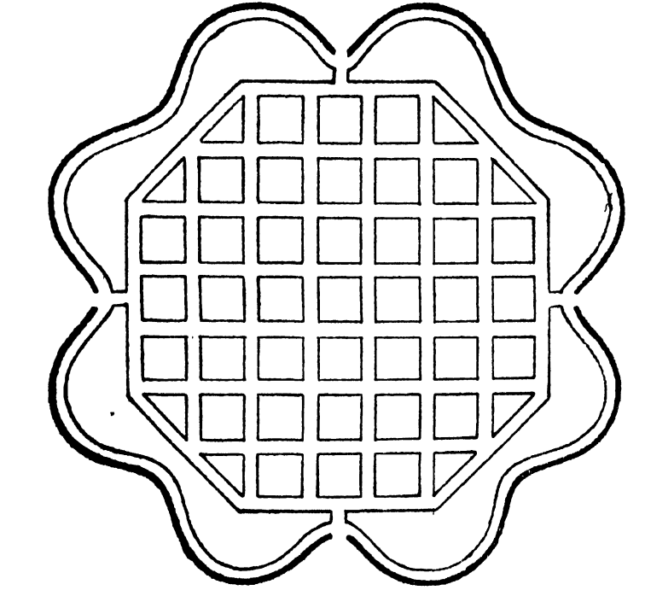
Padmaka layout
In this layout there should be four to eight streets. All carriage roads in the exterior as well as in the surrounding ones should be furnished with footpaths. Across the middle there should not be any street ,the gates should be made towards the four directions.
The chief characteristics of the layout can be determined from its name padmaka ,which means like a lotus and from the statement that the residential buildings should be built in the six plots each divided by an oblique line. It is on either side of these diagonal streets that the most important residential quarters are to be built.
The four streets that radiate to the east ,west ,south and north are apparently to contain the important public buildings.
In this layout ,half of the layout is modification of the same ,in which the connecting streets through the periphery and the three rounds are made straight ,instead of segmental ,thereby giving an octagonal shape to the entire layout.

Slide 10
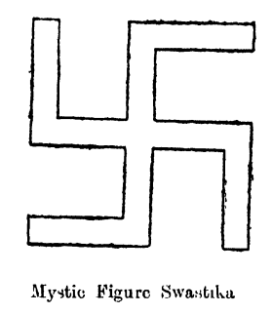
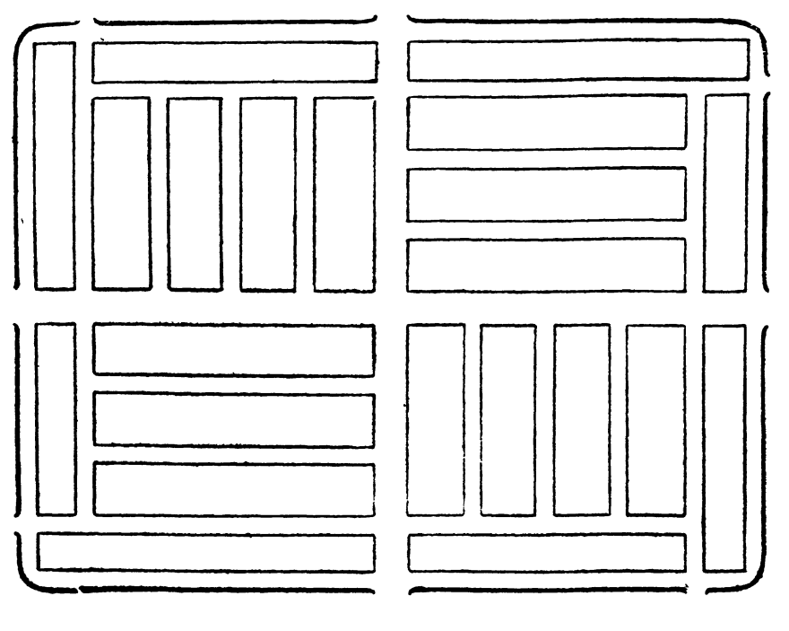
Swastika layout
Swastika is one of the two mystic crosses of the Hindus .In this layout ,the length and breadth should be equal and ground should divided into 81 divisions.
There should be a street running straight from east to west in the middle and another running straight from south to north crossing the former in the centre. The other streets running towards the east extend from north to north-east ; those running towards the east extend from north to north –east ;those running towards the south extend from east to south –east ,those running towards the west extend from south to south –west and those running towards the north extend from west to north –west . This completes the swastika portion of the layout.

Slide 11
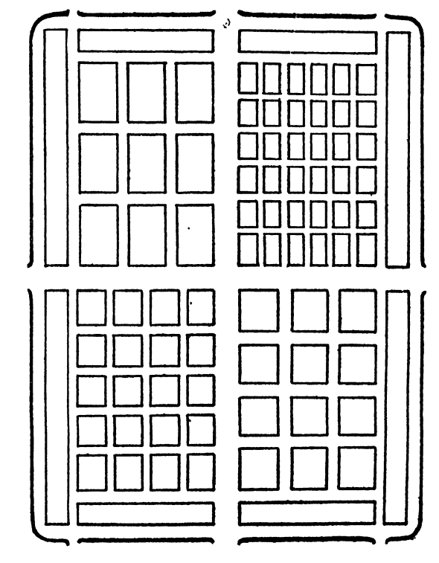
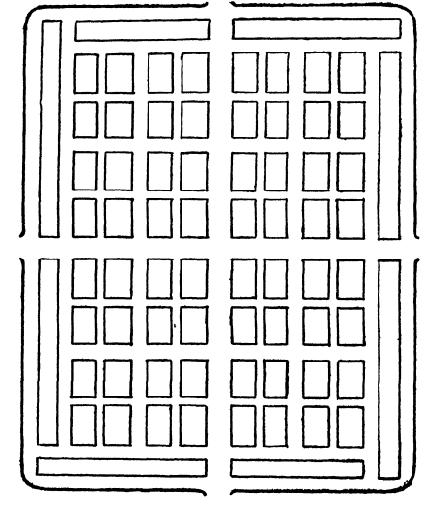
Basically prastara is square or rectangular layout. In prastara ground divided into 16 square blocks, and the roads are laid along the boundaries of these blocks. There are three streets east to west and three streets south to north.
Prastara layout
Chaturmukha layout
This town can be a square or rectangle in shape. A large street should be made around it and this street be furnished with two footpaths. From the four plot block in the centre ,should be four gates or openings at the head of these streets.

Slide 12
Karamuka layout
This layout is suited for a town on the river bank or sea and the outside part of a pair of the roads should be like a karamuka.karamuka is a bow and based on that meaning the town is laid out by some writers in the shape of a bow ,with modifications of their own. Karamuka means the face of the bank or shore.kara and muka are south Indian words ,the former denotes the bank of a river or the shore of the sea and latter means the face.
Its length should be a equal the breadth or length may be greater.
There should be a junction at the head of the streets.
This layout is admirable for an open town; but for a fortified town so many openings to river banks is a potential source of attack by the enemy , and cannot be recommended.

