Slide 1
Subject: Principles Of Human Settlements-I
Topic: Ancient Greece Town Planning
Presented by: Pallavi Tiwari

Slide 2
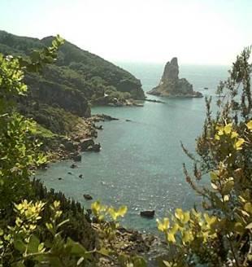
ANCIENT GREECE
Region of isolated valleys, hills, small plains, peninsulas, and islands
Sea formed its focal point
Nothing more than barbarous fringe area to older civilizations of the Middle East
Tiny, unimportant, and poor in natural resources

Slide 3
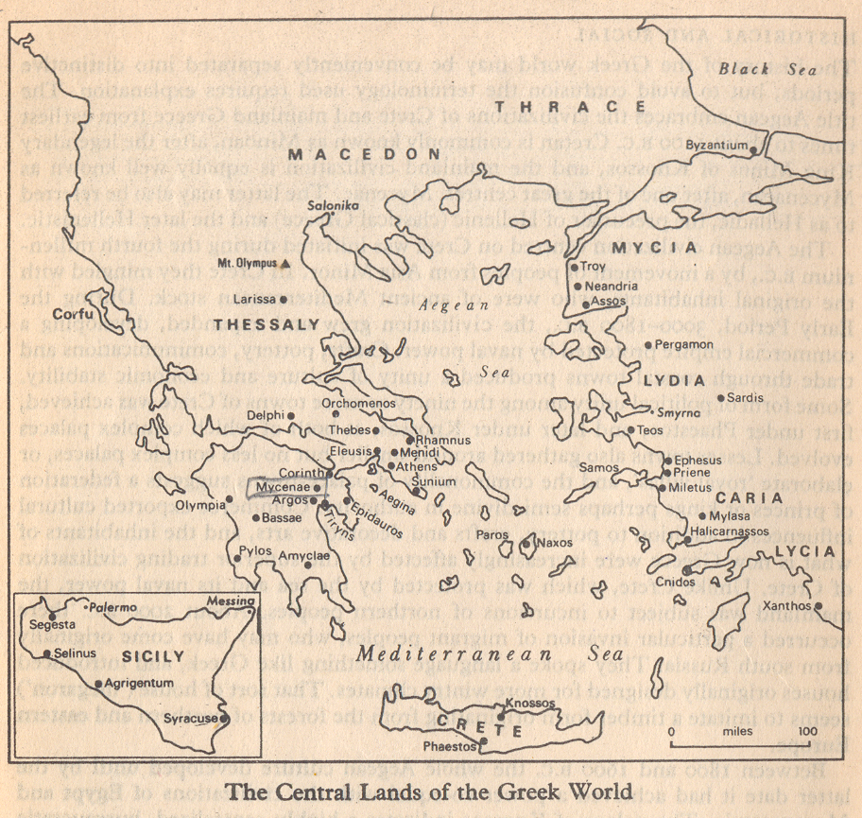
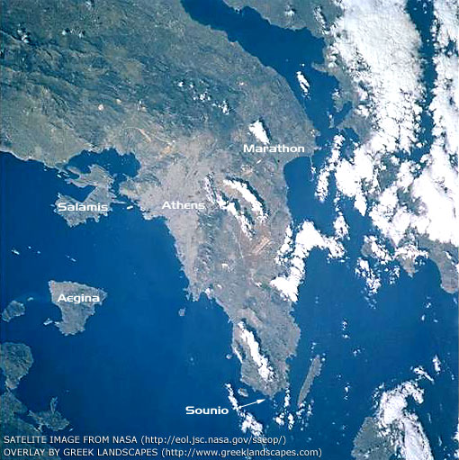

Slide 4
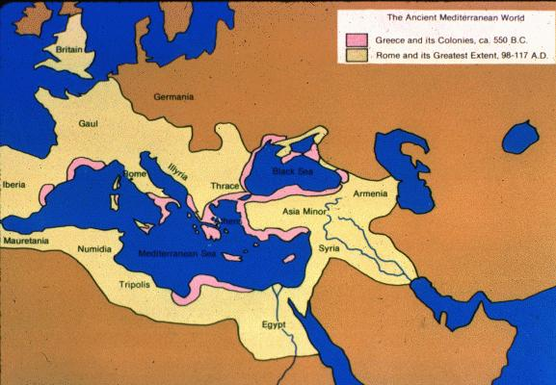
Greece also benefited from its position on the edge of the civilized world
Far enough away to escape domination by the various Middle Eastern Empires but close enough to absorb the rich culture of its eastern neighbors

Slide 5
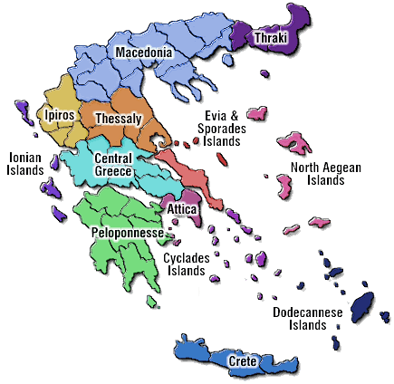
FIRST GREEKS (2000-1400 BC)
Either were Neolithic farmers who migrated from Asia Minor around 3000 BC
Or were an Indo-European tribe from southern Russia who migrated into the region around 2300 BC
In either case, when people did arrive in the peninsula, they soon came into contact with an already civilized people who lived on the nearby island of Crete - The Minoans

Slide 6
END OF MINOAN CIVILIZATION
Civilization came to an end between 1450 and 1350 BC
All palaces destroyed and never rebuilt
Theory 1
Invaded by Mycenaeans in 1400 BC
Destroyed Crete to eliminate Minoans as trade rivals
Theory 2
Massive volcanic eruption on island of Thera showered Crete with debris, ash, and poison gas
Destroyed fleets with tidal waves
Mycenaeans arrived after catastrophe and destroyed what was left

Slide 7
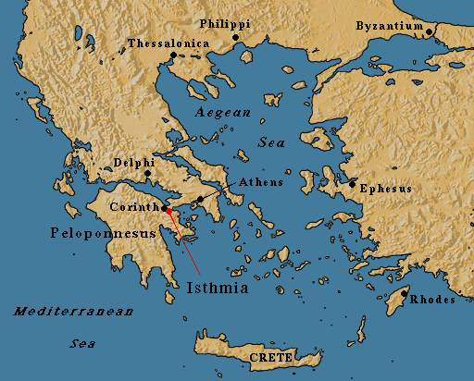
MYCENEAN AGE – 600-1400 BC
1600-1150 BC
Had some contact with Minoan civilization by at least 1600 BC
Typical of the very warlike, semi-barbarian cultures that extended over most of Europe
Only difference was that contact with Minoans gradually ameliorated some of their barbarism and allowed them to develop a more sophisticated culture

Slide 8
MYCENEAN CIVILIZATION EMERGES
Assimilation of Minoan culture was complete by 1400 BC
About the time that they invade and destroyed Crete
Took the place of Minoans as commercial middlemen between civilized Middle East and barbarian Europe
Began to build huge palaces at Mycenae, Tiryns, Athens, Thebes, and Pylos

Slide 9
DAWN OF THE “DARK AGE” – (1100-750BC)
All Mycenean palaces destroyed around 1250 BC
Except one at Athens
Survivors moved to Attica or moved overseas
Greece only contained 10% of its former population by 1200 BC
Trade network collapsed
Art and culture lost
Greece entered a period of severe economic, social, and technological backwardness
Dark Age (1200-800 BC)

Slide 10
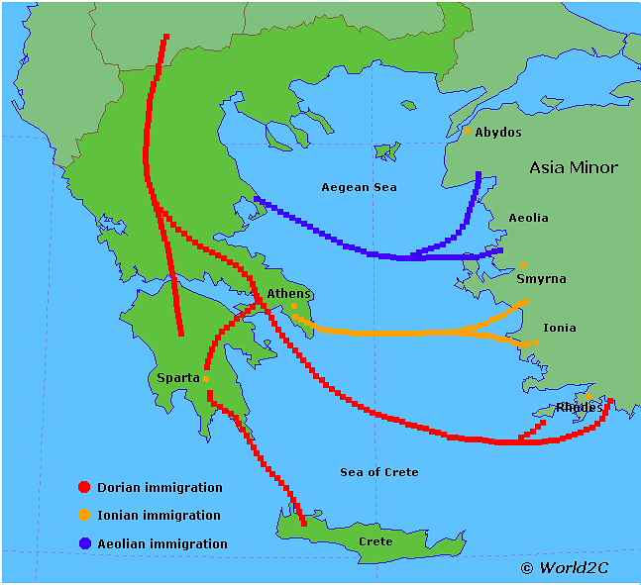
CAUSES
Period in which Mycenean kingdoms fell was one of general unrest
Lybians and Sea Peoples attacked Egypt
Sea Peoples destroyed Hittite Empire
Pirates roamed the eastern Mediterranean
Mycenean palaces came under tremendous pressure
Palaces destroyed over a long period
Perhaps victims of different groups of invaders arriving at different times
Small, vicious groups of raiding parties brought about downfall of Mycenean civilization
Not a single, massive migration of new people

Slide 11
THE DARK AGE
Although generally isolated and backward, the Dark Age did see some technological and cultural innovations that would create foundation for future Greek civilization
People who fled Greece settled on Aegean Islands, coast of Asia Minor, and elsewhere, forming base for prosperous city-states that would develop there

Slide 12
Stimulated another wave of migration and Greek migrants from the peninsula and other settlements founded hundreds of new sites along Black Sea, the Adriatic, and western Mediterranean
Population of Greek world began to grow rapidly around 800 BC

Slide 13
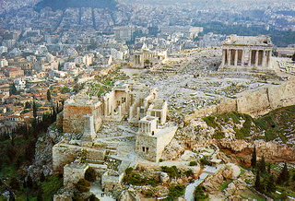
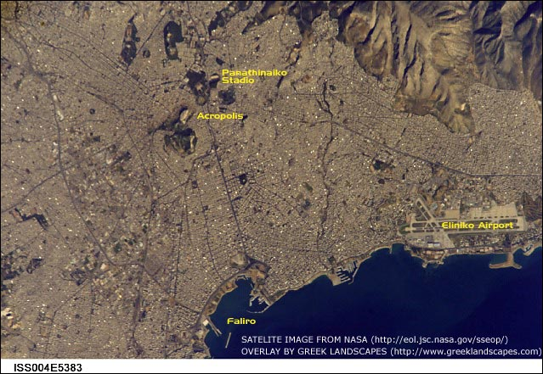

Slide 14
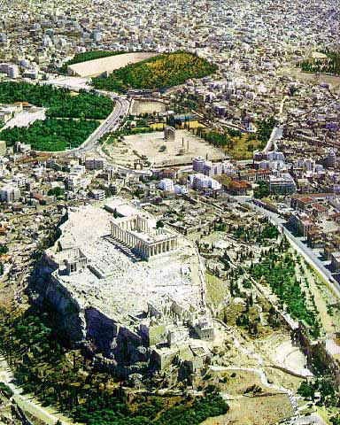
GREEK CITY – STATES (700 - 338 BC)
Polis (city)
City surrounding a fort
Absolutely independent and self-sufficient
Based on 3 ideas:
-Geographical territory
-Community it represented
-Economic independence it produced

Slide 15
GREEK CITY - STATES

Slide 16
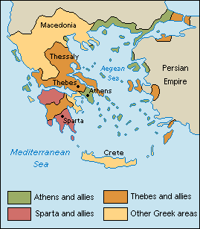
Athens, the city which by itself means Greece
Athens was an almost Oriental mixture of splendid public buildings with mean and ill-grouped houses.
The streets of Athens as narrow and tortuous, unpaved, unlighted, and more like a chaos of mud and sewage than even the usual Greek road
Sparta, the rival of Athens, remained wholly untouched by it
There neither public nor private buildings were admirable,

Slide 17
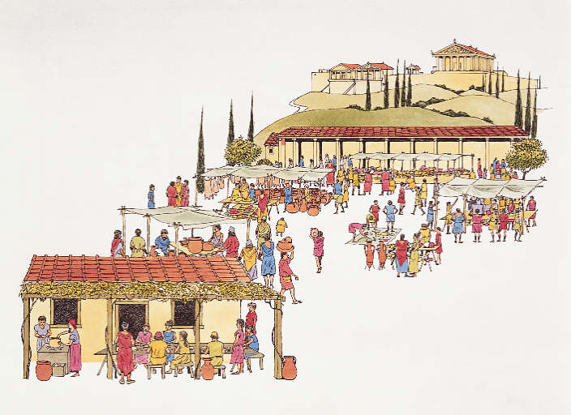
GREEK CITY - STATES
More similarities
Original forts created on an acropolis (hill)
Each city-state had an agora (marketplace)
Served as a meeting place for the people

Slide 18
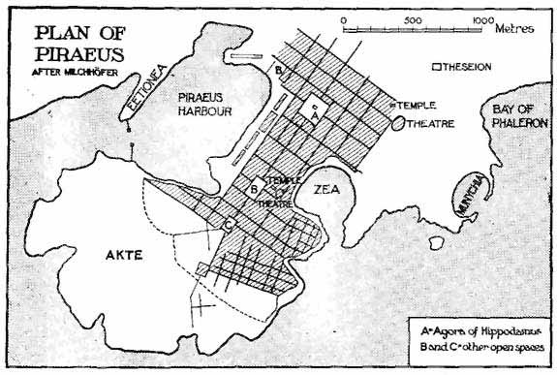
PLAN OF PIAEUS
The art of town-planning in Greece probably began in Athens.
The architect Hippodamus—have worked in Athens and in connection with Athenian cities, under the auspices of Pericles.
He introduced the principle of straight wide streets, made provision for the proper grouping of dwelling-houses and also paid special heed to the combination of the different parts of a town in a harmonious whole, centred round the market-place.
Cities named as laid out by Hippodamus-Piraeus, the port of Athens, with broad straight streets,running parallel or at right angles to one another and rectangular blocks of houses; the longer and more important streets ran parallel to the shore, while shorter streets ran at right angles to them

Slide 19
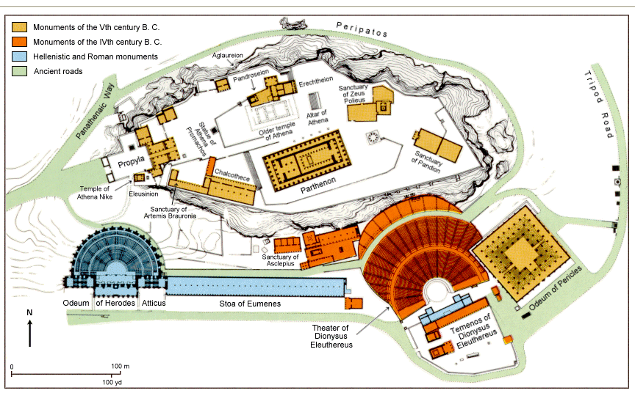
ACROPOLIS
Acropolis, a town of irregular, rudely pear-shaped outline with a distinct though not yet fully excavated town-plan.
Two main thoroughfares ran straight from end to end and crossed at right angles the longer of these thoroughfares being just a quarter of a mile long and 30 ft. wide.
From these two main streets other narrower streets (12-18 ft. wide) ran off at right angles; the result, though not chess-board pattern, is a rectangular town-plan.

Slide 20
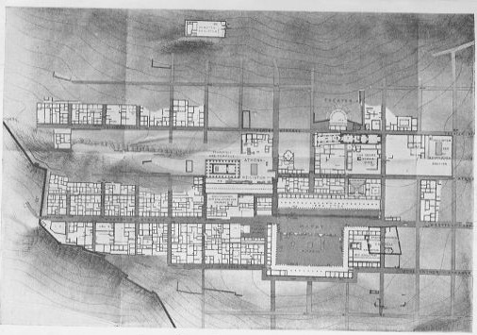
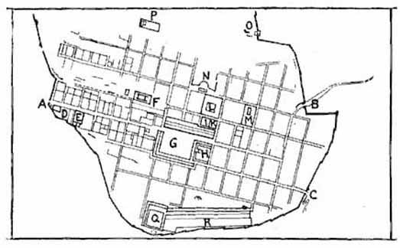
THE MACEDONIAN AGE, 330-130 B.C.
The more systematic, method of town-planning.
These towns were laid out with a regular 'chess-board' street-plan.
Priene was a little town on the east coast of the Aegean and in the Macedonian age it was refounded.
The old Acropolis was given up.
Instead, a broad sloping terrace, or more exactly a series of terraces, nearer the foot of the hill, was laid out with public buildings—Agora, Theatre, Stoa, Gymnasium, Temples, and so forth—and with private houses. The whole covered an area of about 750 yds. in length and 500 yds. in width.

Slide 21
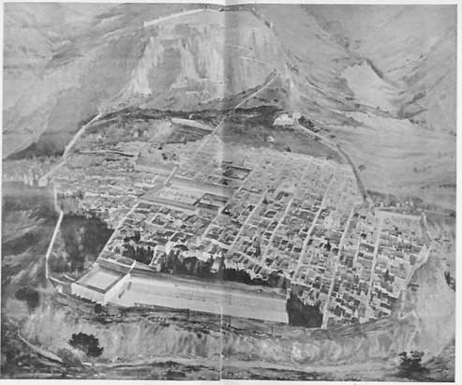
In the centre was the Agora or market-place, with a temple and other large buildings facing on to it;
Round them were other public buildings and some eighty blocks of private houses, each block measuring on an average 40 x 50 yds.
The broader streets, rarely more than 23 ft. wide, ran level along the terraces and parallel to one another.
Other narrower streets, generally about 10 ft. wide, ran at right angles up the slopes,

