Slide 1
Advanced Construction Material
Presented by: Ar. Balraj Marjara

Slide 2
1. Translucent Concrete
Concrete buildings are known more for their stability than their great lighting. That was until translucent concrete started to make its way on to the market.
Translucent concrete is mixed with glass fiber optical strands, which create a solid but sheer block. LitraCon, as the concrete is known, can be used in flooring and pavement.
According to the concretes manufacturers, the optical fibers make up only 4 percent of the mixture. Meaning that blocks made from this material still have the ability to support load-bearing walls.

Slide 3
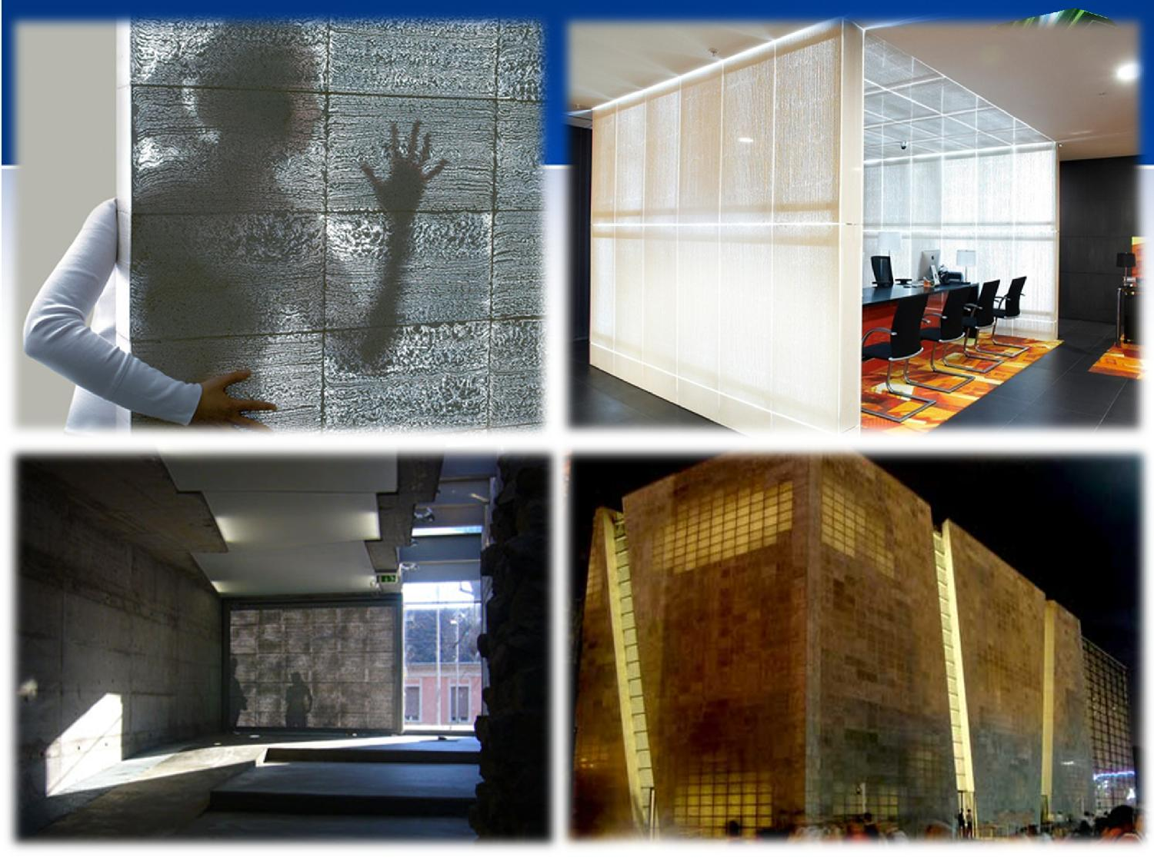

Slide 4
2. SensiTile
As you walk across your kitchen floor to get something from the refrigerator, the floor twinkles with lighted path that guides your way through the dark room. At least it would, if you had SensiTiles.
The concrete of the tiles is embedded with acrylic fiber- optic channels that transfer light from one point to another. As shadows move across Terrazzo's surface, the light channels flicker with a randomized, twinkling effect.
Their tiles are available for use as flooring, in bathrooms and even ceilings, so you can have twinkling lights follow you all over the house.

Slide 5
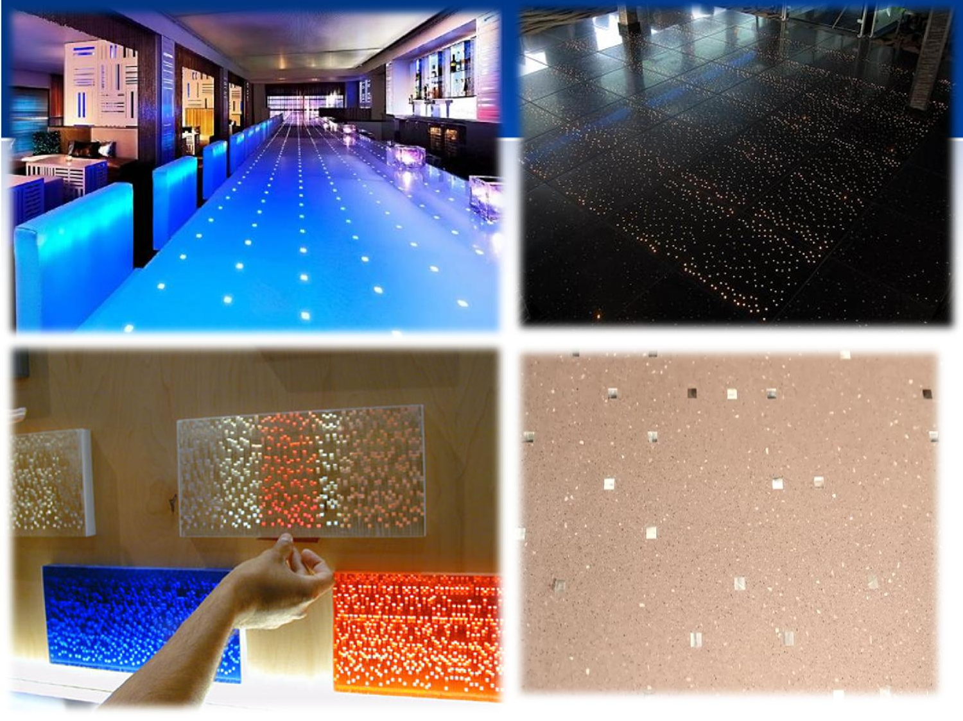

Slide 6
3. Electrified Wood
You may never have to deal with the tangle of wires again thanks to “Wood.E.” This European-designed material incorporates a source of electricity directly into tables and chairs.
Two metal layers are pressed between the wood of the furniture, making it possible to pass an electrical current through the whole thing. The 12-volt power is fed to the metal layers via one connector, and lamps, and other devices can be connected via the other.
Not sure if this furniture will work with all electrical outlets, but we're for any piece of furniture that means we don't have to find a way to tie all our wires together.

Slide 7
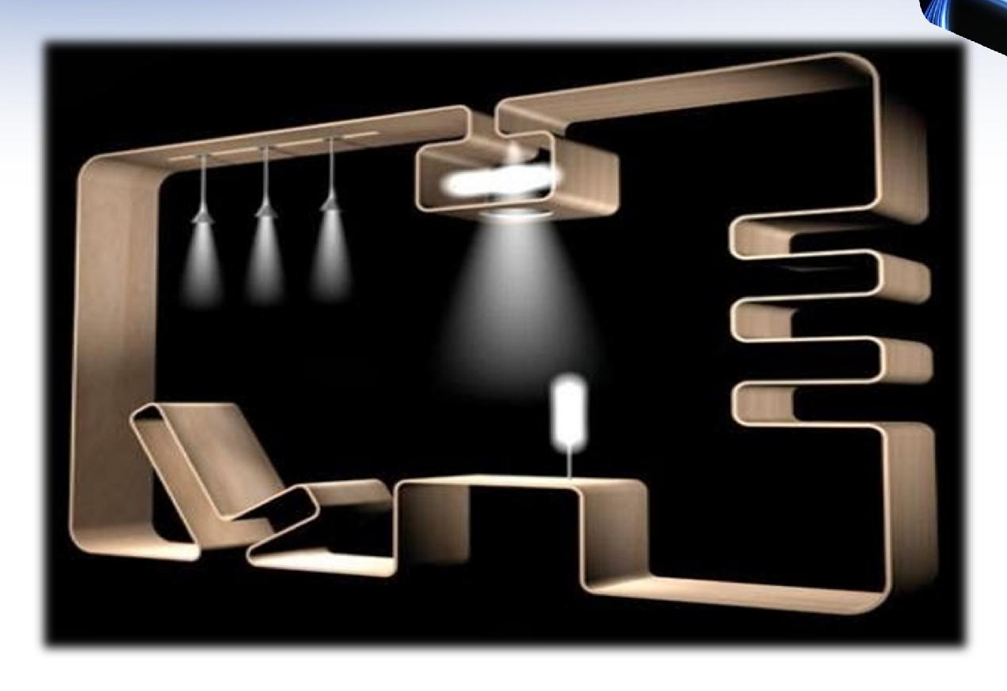
Wood-E

Slide 8
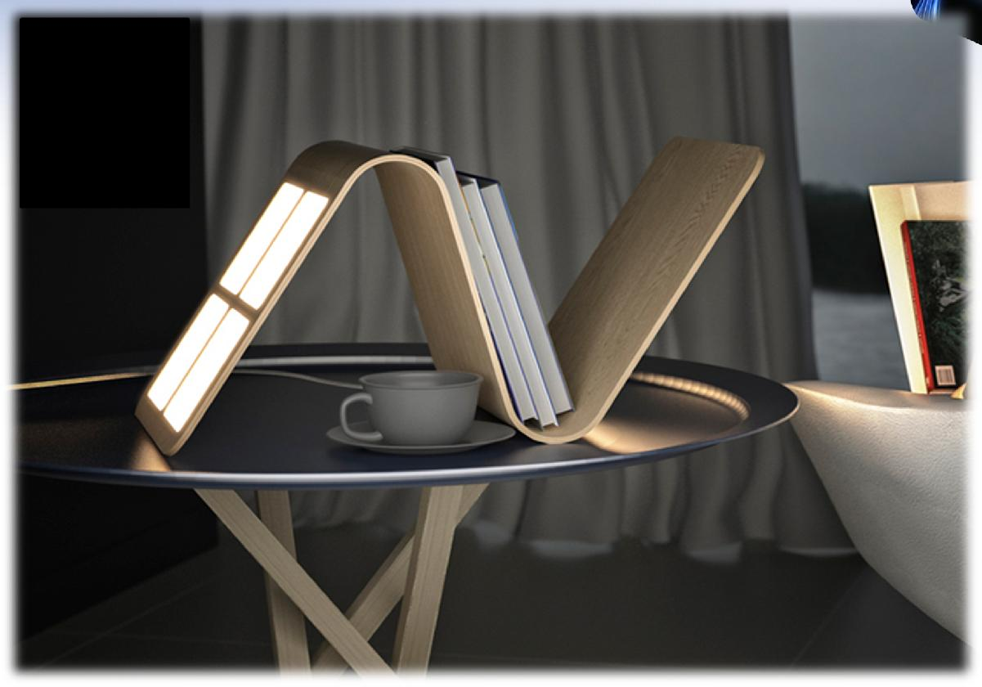
Wood-E (Cont’d)

Slide 9
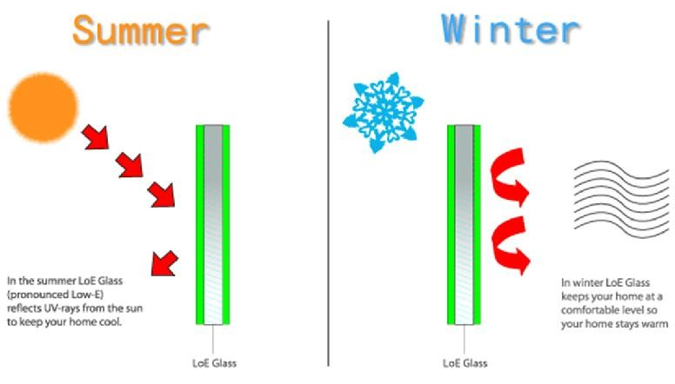
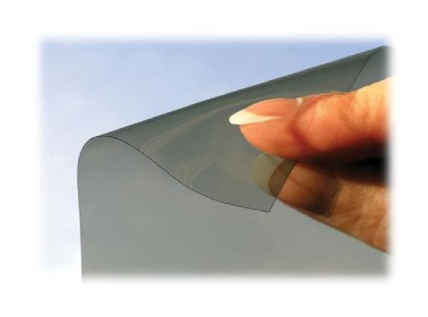
11. Low-E Glass / Films
Low-emissive (Low-E) glass is window glass that has been treated with an invisible metal or metallic oxide coating, creating a surface that reflects heat, while allowing light to pass
through. Windows treated with Low-E coatings are proven to reduce energy consumption, decrease fading of fabrics, such as
window treatments, and increase overall comfort in your home.

Slide 10
Low-E Glass / Films

Slide 11
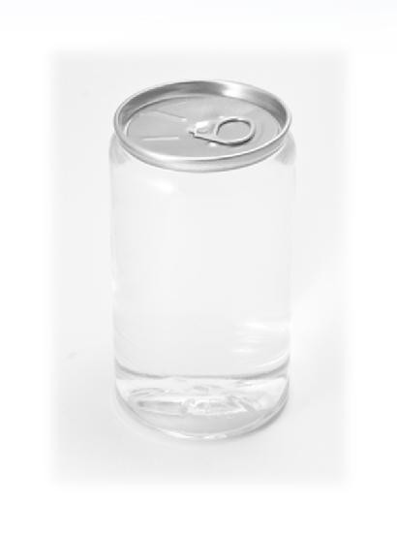
12. Transparent Aluminum
Extremely durable crystalline material with excellent optical transparency
To be used windows, domes, plates, rods and tubes in a wide range of sizes and thicknesses
Excellent clarity
Total absence of birefringence
Outstanding hardness and high strength
Available in a wide variety of sizes, shapes and thicknesses
Produced using proven ceramic forming processes
Readily scaled up to high volumes
Cost effective advanced material solution
Applicable to a wide variety of industries including aerospace, security, defense and Semiconductor, Energy and consumer products.

