Slide 1
Theory of Supply
MICROECONOMICS
Aditi Arora
Assistant Professor

Slide 2
Supply
Supply refers the amount of a good or service that the producers are willing and able to offer to the market at various prices
Implies, what firms offer for sale, not necessarily they succeed in selling

Slide 3
Determinants of Supply
Price of the good –
Price of related goods –
Price of the factors of production –
State of technology –
Government policy – taxes and subsidies

Slide 4
Law of Supply
Other things remaining constant, the quantity of a good produced and offered for sale will increase as the price of the good rises and decrease as the price falls
What about the supply of labour?
Drawing a supply curve for a firm
Market Supply Curve

Slide 5
Supply Curve
Shift of supply curve
Technology
Cost of factors of production
Government policy
Movements along the supply curve
Changes in the price of the commodity

Slide 6
Elasticity of Supply
Defined as the responsiveness of the quantity supplied of a good to a change in its price
Elasticity of supply = Ep = % change in quantity supplied
% change in price
Change in quantity supplied X 100
Original quantity supplied =
Change in price X 100
Original price

Slide 7
Supply Elasticity
Perfectly inelastic - tickets for sports or musical venues, SR agricultural produce – wheat rice
Relatively less-elastic supply
Relatively greater-elastic supply – vegetables production
Unit – elastic
Perfectly elastic – lemonades in a shop

Slide 8
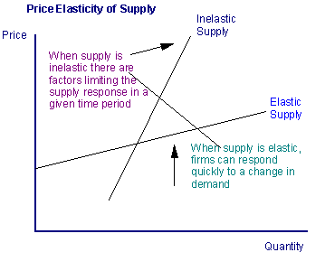

Slide 9
Factors affecting Elasticity of Supply
Nature of the commodity
Perishable vs durable
Time-factor
Technique of production
Future expectations

Slide 10
Market Equilibrium
At market equilibrium – the quantity that buyers are willing and able to buy exactly balances the quantity that sellers are willing and able to sell
At the equilibrium – everyone in the market is satisfied: buyers have bought what they wanted to buy and sellers have sold what they wanted to sell
Why is it the equilibrium?
What happens if demand curve shifts?
What happens if supply curve shifts?

