Slide 1
HEALTHCARE FACILITIES -SOCIAL INFRASTRUCTURE
Pallavi Tiwari
Assistant Professor

Slide 2
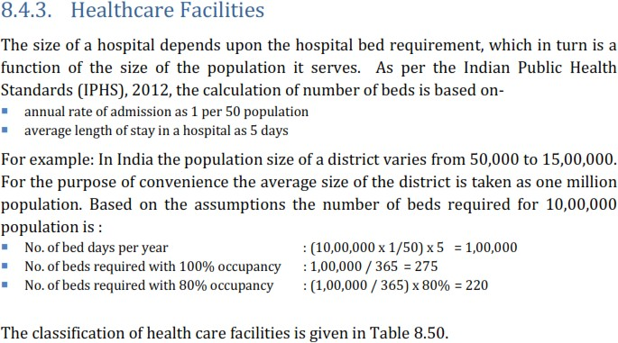
HEALTHCARE FACILITIES - URDPFI
Source - URDPFI Guidelines, 2014
Indian Public Health Standards(IPHS) are a set of standards envisaged to improve the quality of health care delivery in the country under the National Rural Health Mission.

Slide 3
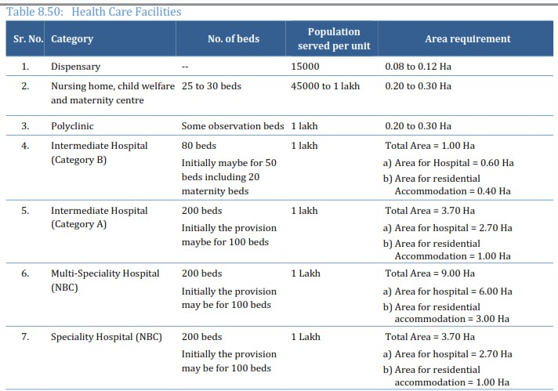
re
HEALTHCARE FACILITIES - URDPFI

Slide 4
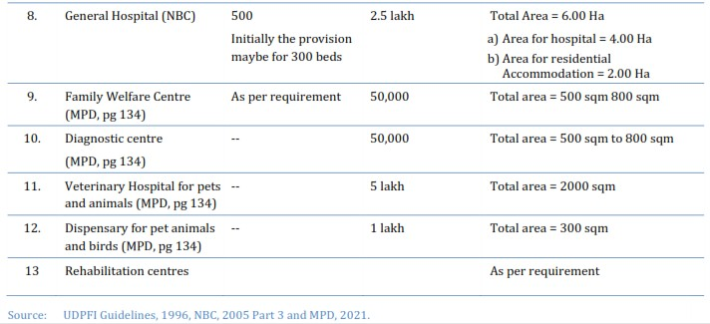
HEALTHCARE FACILITIES - URDPFI
The Department of Health and Family welfare suggests incorporation of Trauma Centres in the highways cutting across urban local authority jurisdiction. The trauma care centres should be suitably positioned along the highways with doctors trained in emergency medicine and trauma care, with adequate emergency management technicians, supported by efficient and efficient ambulance system.

Slide 5
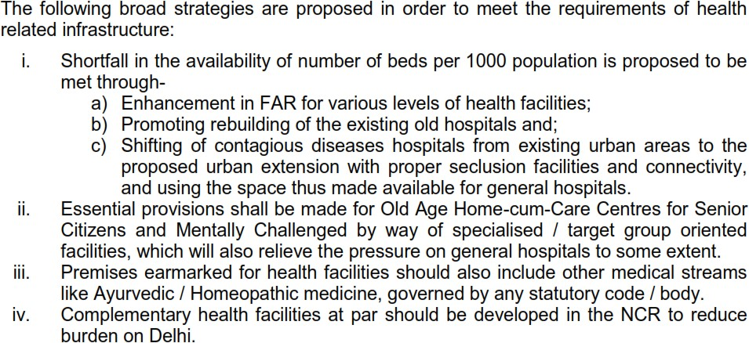
HEALTHCARE FACILITIES - URDPFI
STANDARDS ADOPTED AS PER WHO
- 5 beds per thousand population
- Floor Area per bed is 80 sqm.

Slide 6
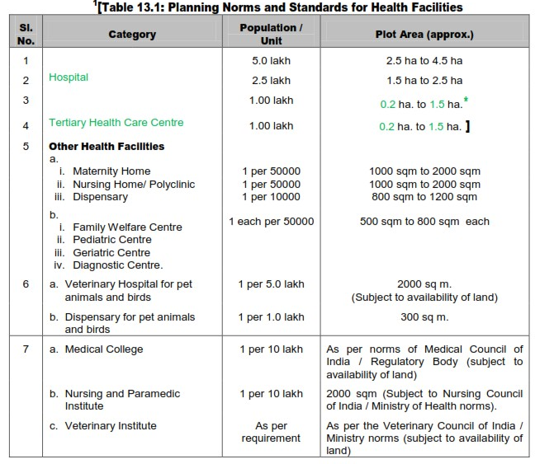
HEALTHCARE FACILITIES – MPD 2021

Slide 7
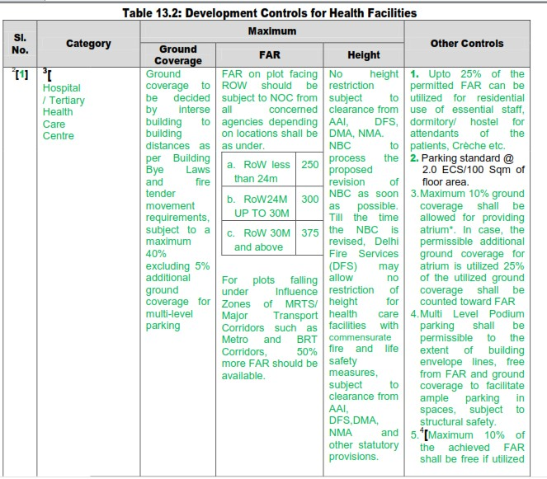
HEALTHCARE FACILITIES – MPD 2021

Slide 8
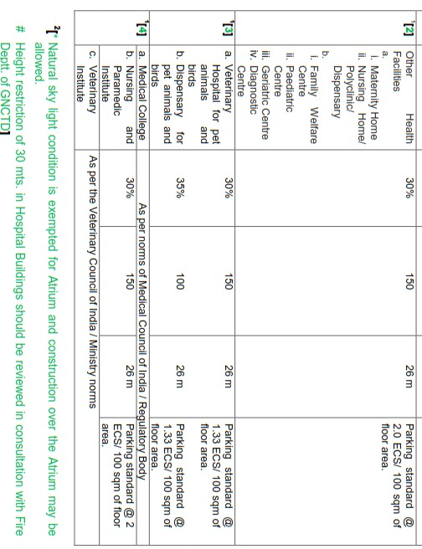
HEALTHCARE FACILITIES – MPD 2021

Slide 9
HEALTHCARE FACILITIES – MPD 2021

Slide 10
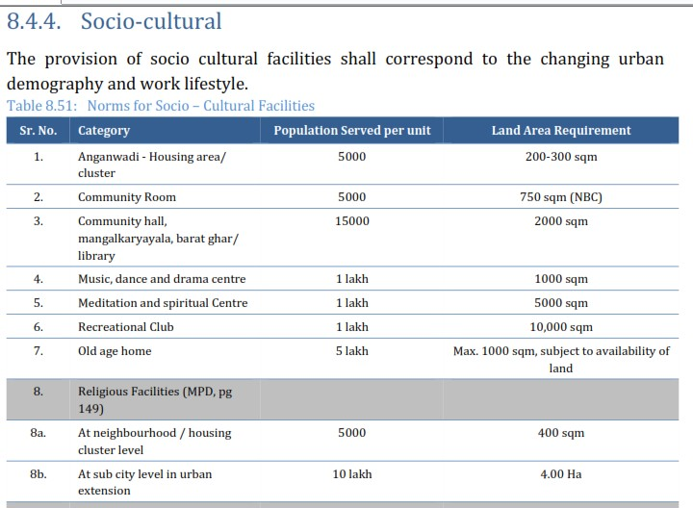
HEALTHCARE FACILITIES – MPD 2021

Slide 11
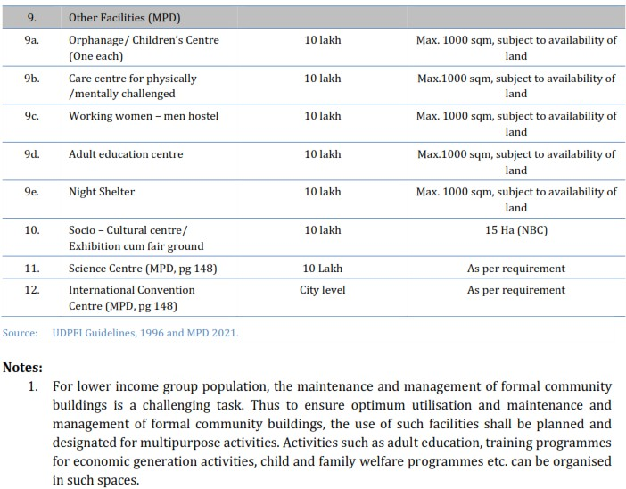
HEALTHCARE FACILITIES – MPD 2021

Slide 12
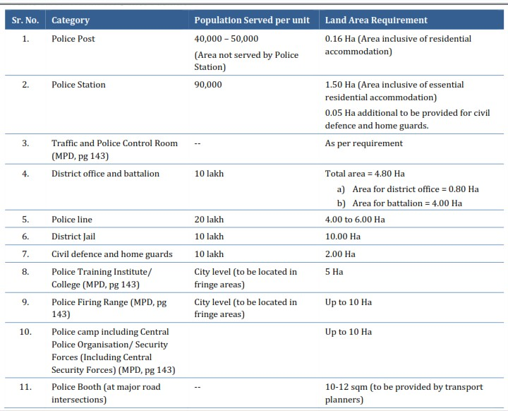
HEALTHCARE FACILITIES – MPD 2021

Slide 13
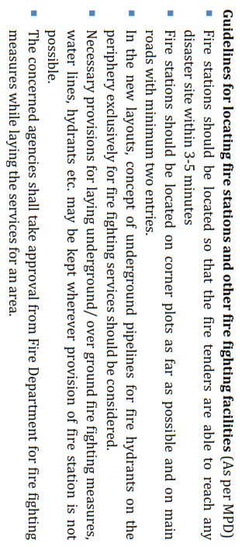
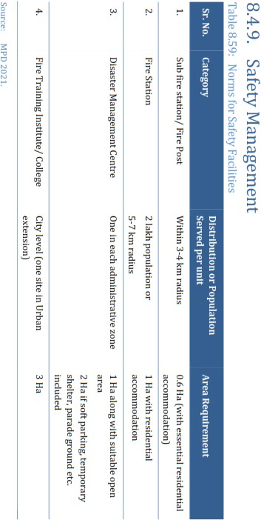
HEALTHCARE FACILITIES – MPD 2021

