Slide 1
PUBLIC FACILITIES -SOCIAL INFRASTRUCTURE
Pallavi Tiwari
Assistant Professor

Slide 2
Biodiversity Parks of Delhi
Owned and Developed by DDA , with technical inputs by the Centre for Environmental Management of Degraded Ecosystems (CEMDE), University of Delhi and DDA.
These parks are unique landscapes, designed in house by DDA the first of their kind in India and perhaps in the world, which, like nature reserves, harbour hundreds of vanishing species living together in the form of diverse communities and provide ecological, cultural and educational benefits to the urban society.

Slide 3
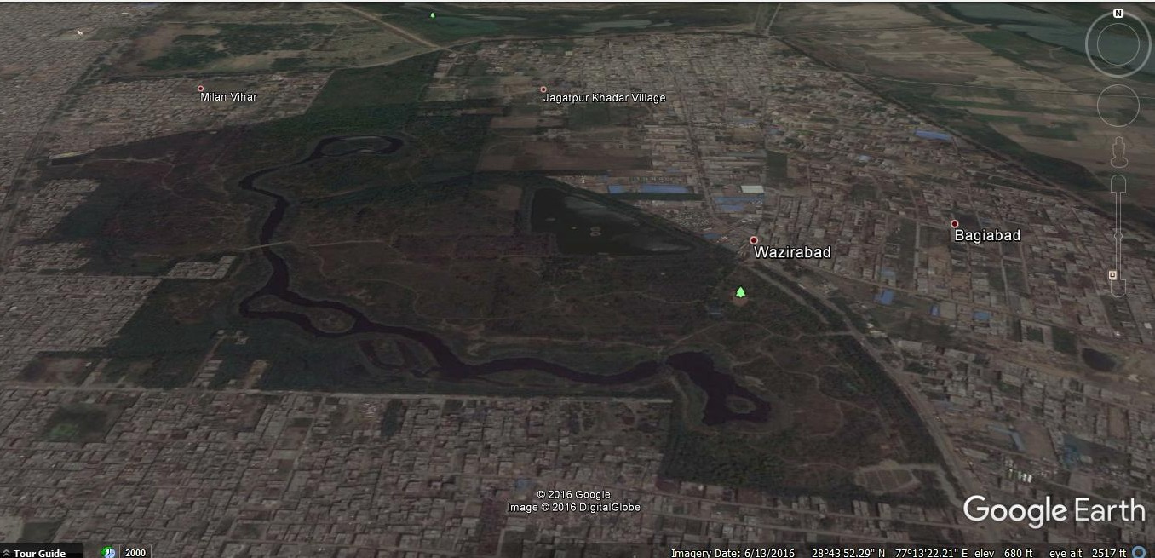
Biodiversity Parks of Delhi
Yamuna Biodiversity Park

Slide 4
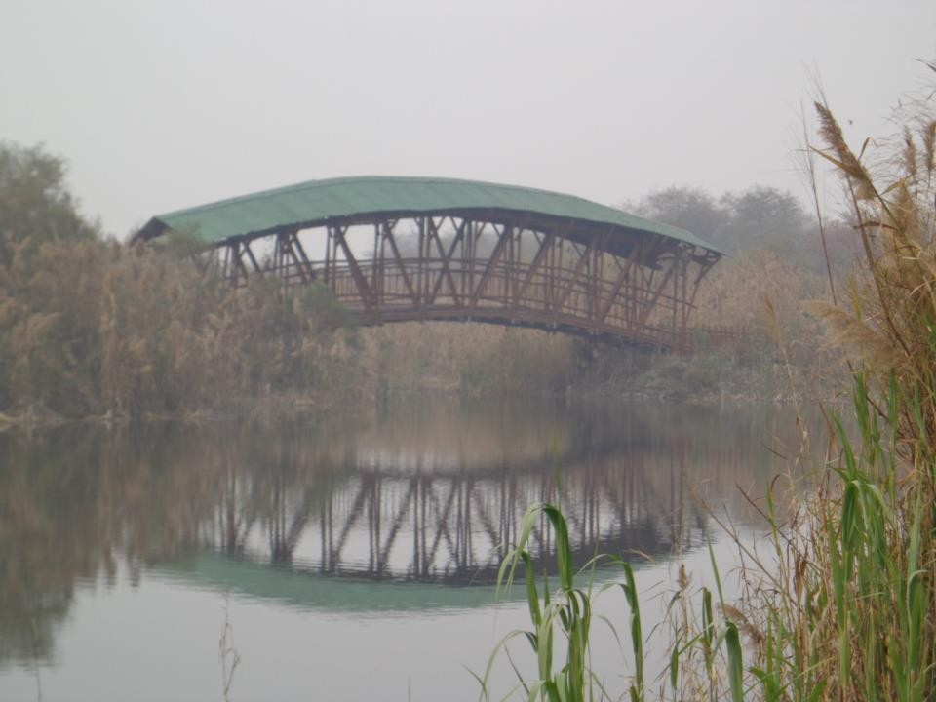
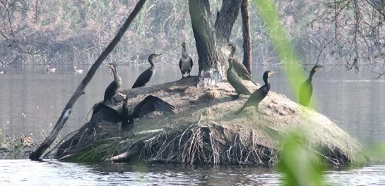
Biodiversity Parks of Delhi
Emerging as the capital's most visited public place and prominent center for learning and understanding the environment,
Home for biologically rich wetlands, grassland communities, a wide variety of fruit yielding species and an abundance of medicinal herbs.
Comprises a native flora and fauna which used to exist a 100 years ago and then became extinct locally.
Natural conservation site for specific group of endangered plants.
Yamuna Biodiversity Park

Slide 5
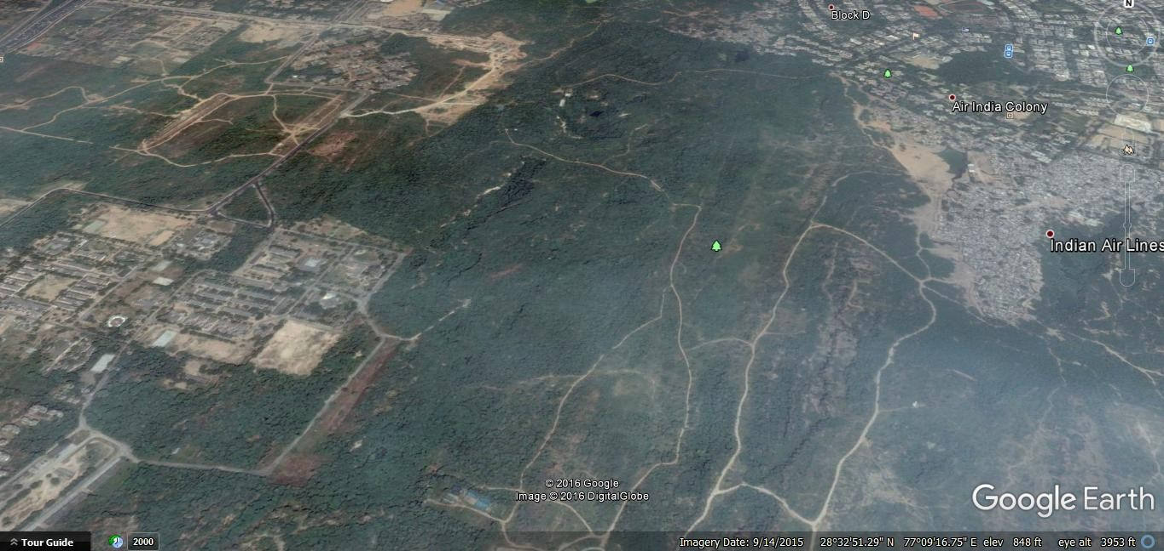
Aravalii Biodiversity Park
Biodiversity Parks of Delhi
The Aravalli Biodiversity Park is located on the South Central Ridge and spreads over an area of 692 acres.
Bounded by JNU (Nelson Mandela Marg), the Mehrauli - Mahipalpur road, NH-8 and the Palam road and the southern boundary of Vasant Vihar.

Slide 6
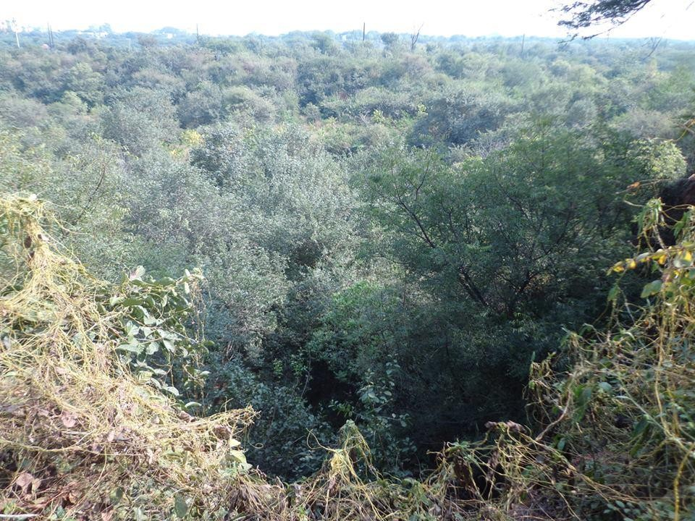
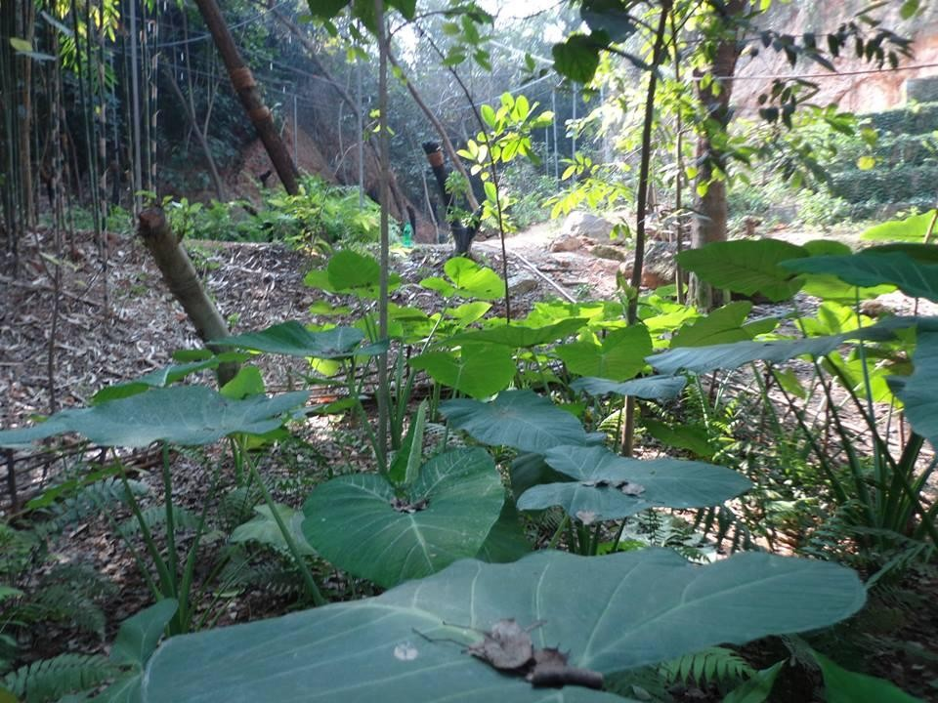
Aravalii Biodiversity Park
Biodiversity Parks of Delhi
The Aravallis are among the oldest mountain ranges having evolved about 1500 million years ago, and extend from Gujarat through Rajasthan to Haryana–Delhi.
The spurs of the Aravallis are popularly known as the Delhi Ridge in Delhi which is divided into the Northern.
The landscape is undulating with gentle slopes and dotted with numerous morrum and clay mined pits of different sizes, depths and shapes.

Slide 7
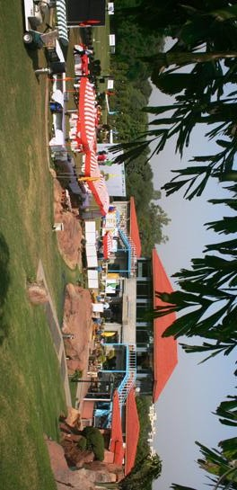
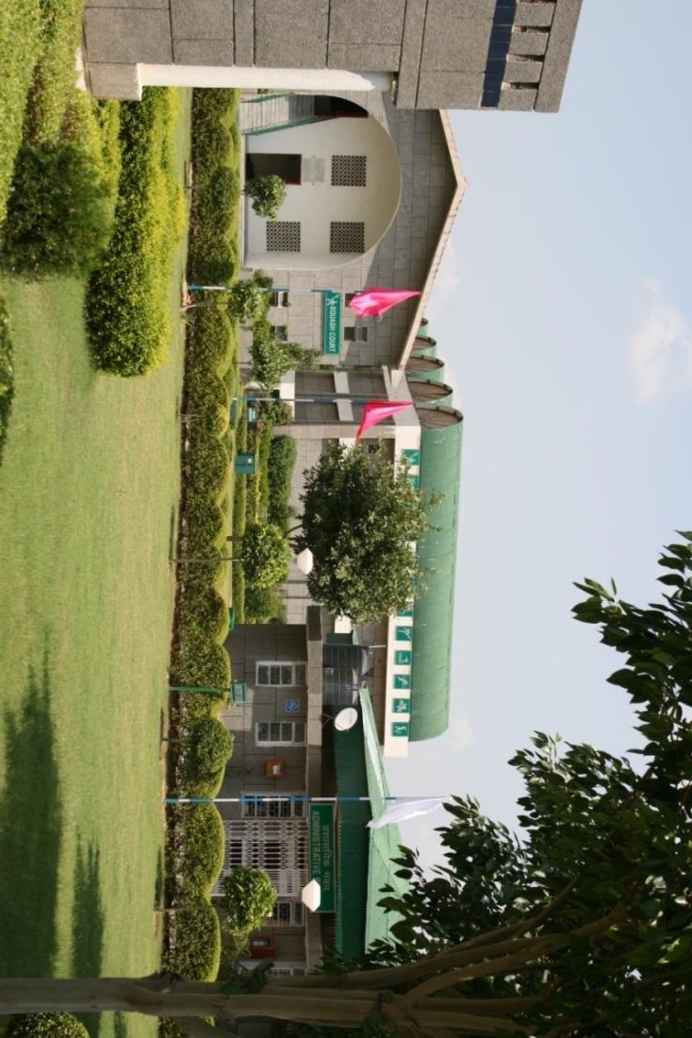
Biodiversity Parks of Delhi
LADO SARAI GOLF COURSE
SPORTS COMPLEX- DWARKA

Slide 8
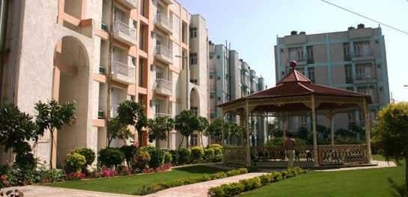
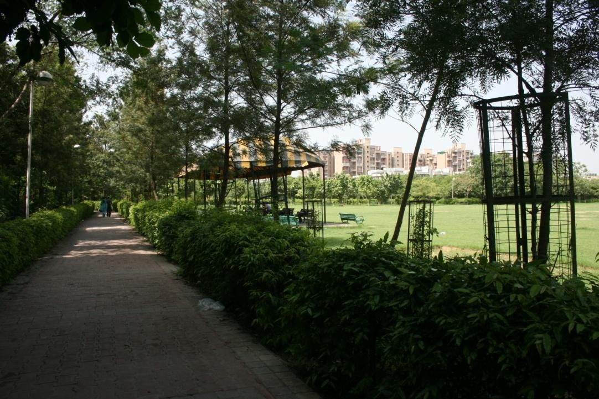
Biodiversity Parks of Delhi
PARK IN DDA HOUSING –
VASANT KUNJ
NEIGHBOURHOOD PARK - DWARKA

Slide 9
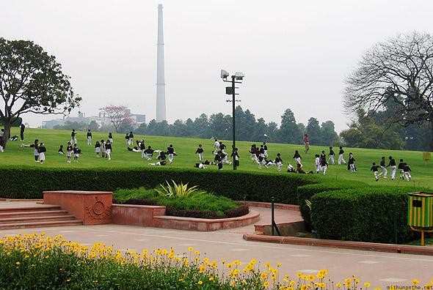
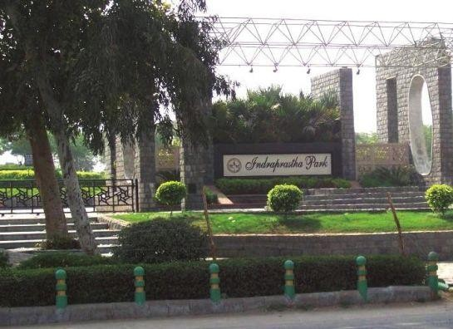
LAND FOR SOLID WASTE MANAGEMENT (SWM)
Biodiversity Parks of Delhi
CITY LEVEL MILLENIUM PARK, ON DISUSED LANDFILL SITE

Slide 10
Thank You

