Slide 1
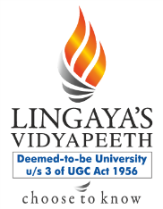
PUBLIC FACILITIES -SOCIAL INFRASTRUCTURE
Pallavi Tiwari
Assistant Professor

Slide 2
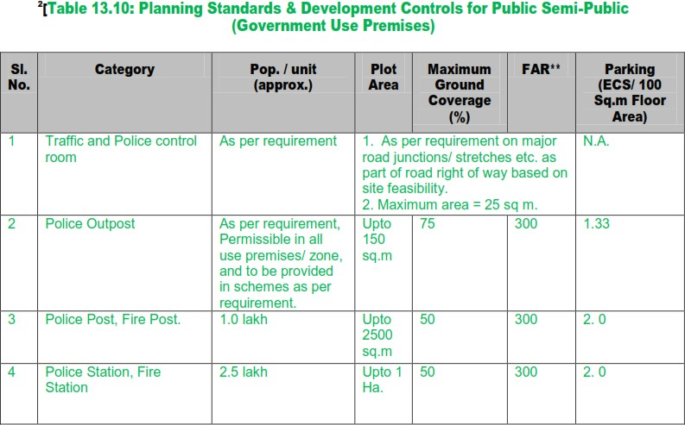
Planning Standards & Development Controls for Public Semi-Public (Government Use Premises)

Slide 3
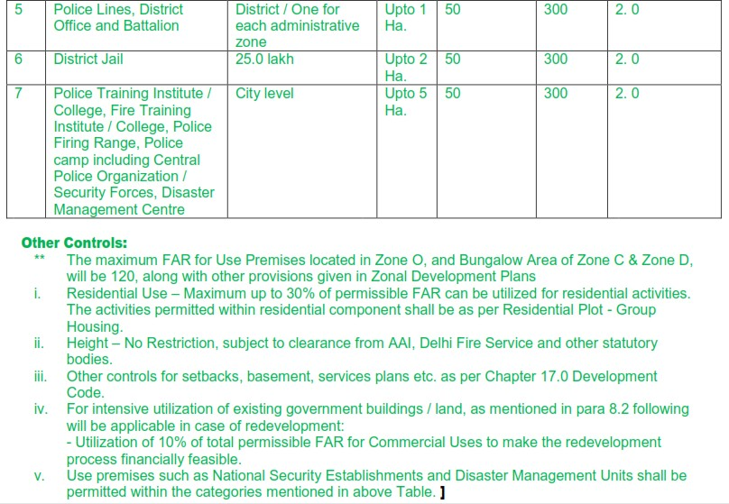
Planning Standards & Development Controls for Public Semi-Public (Government Use Premises)

Slide 4
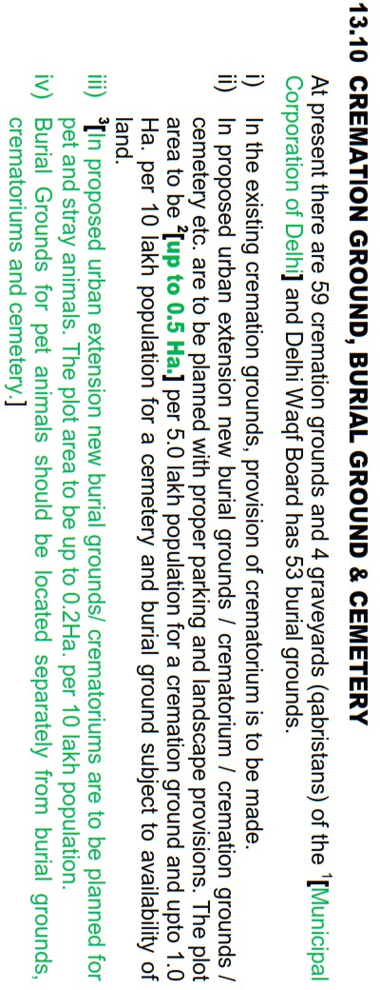
Planning Standards & Development Controls for Public Semi-Public (Government Use Premises)

Slide 5
SPORTS FACILITIES
Sports Complexes, were included in the green / recreational use category under the MPD-2001
MPD2021 - a separate category of sports as Delhi is emerging as an important centre for National and International sports events.
Sports facilities are being developed by various agencies. Need for planned and structured sports infrastructure which can take care of training needs of sportsmen and also act as integrated sports complexes for national and international events.
This will not disturb the green areas, which are meant for recreational purposes.

Slide 6
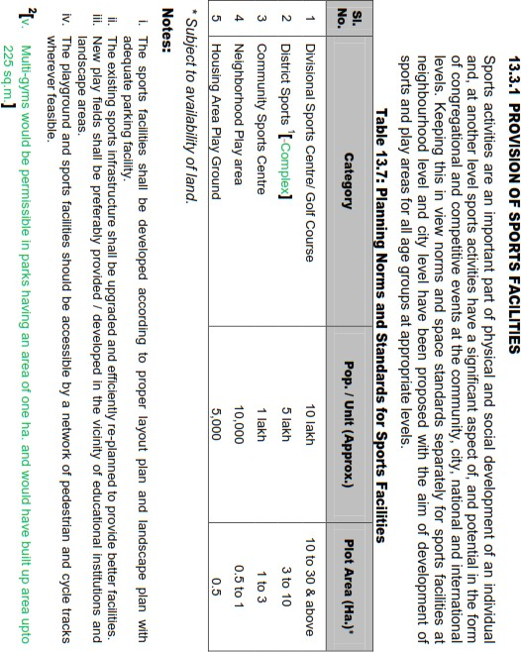
SPORTS FACILITIES

Slide 7
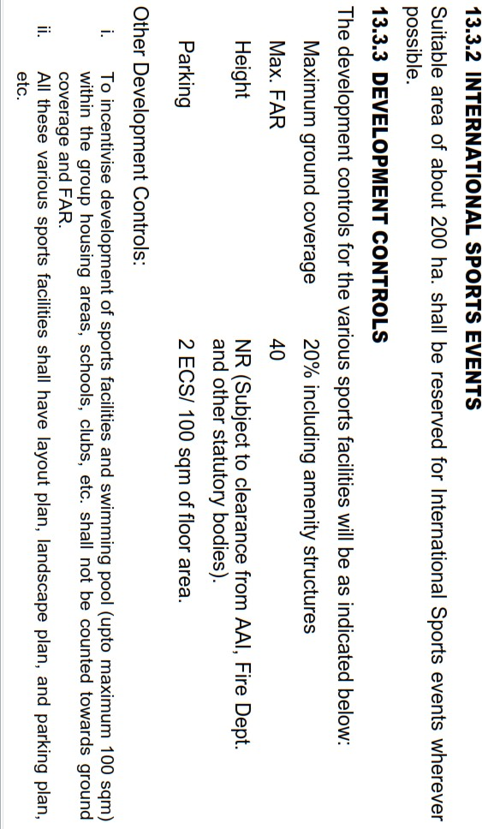
SPORTS FACILITIES

Slide 8
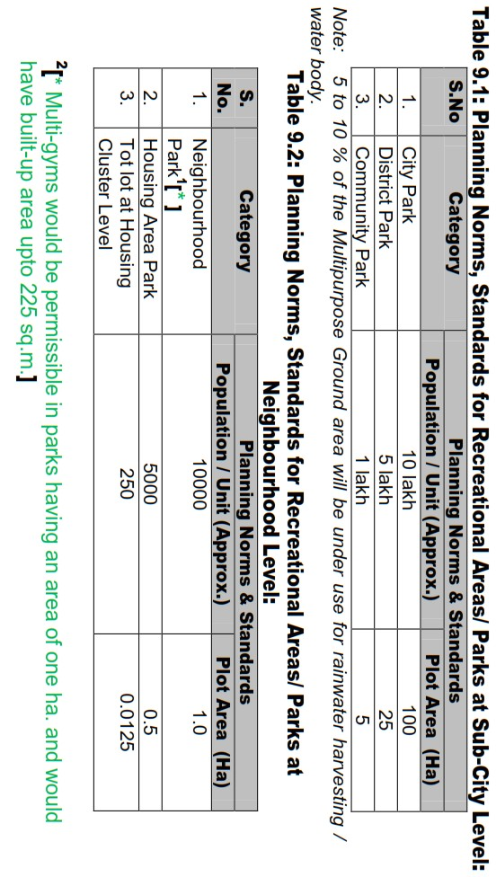
RECREATIONAL FACILITIES

Slide 9
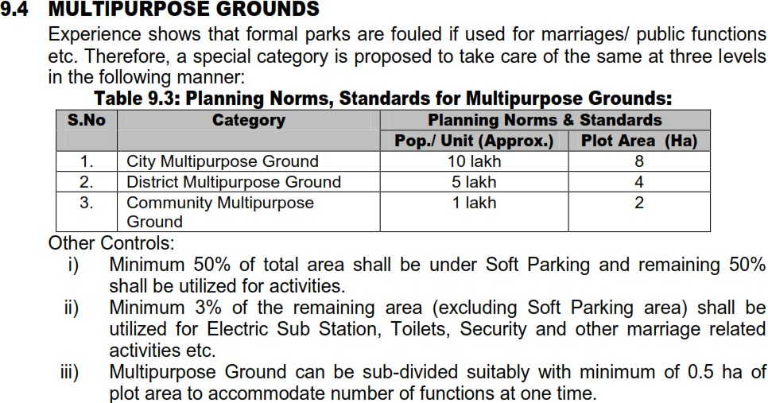
RECREATIONAL FACILITIES
iv) Park / multipurpose ground shall have provisions for rainwater harvesting

Slide 10
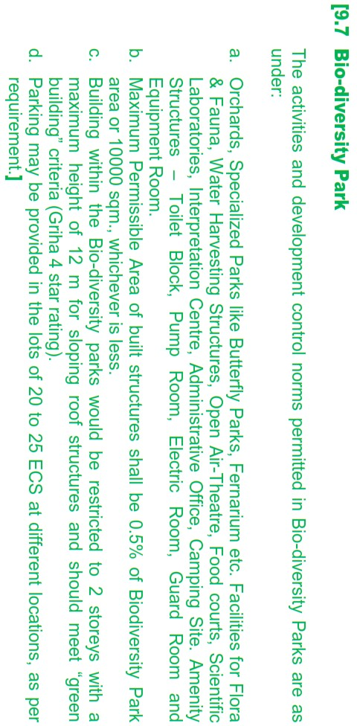
RECREATIONAL FACILITIES

Slide 11
Thank You

