Slide 1
Social Infrastructure
Pallavi Tiwari
Assistant Professor

Slide 2
CATEGORIES
Education Facilities
Healthcare Facilities
Socio‐cultural
Open Spaces
Sports Facilities
Distribution services
Police, Civil Defence and Home Guards
Safety Management

Slide 3
CATEGORIES
Other Facilities
Religious
Cremation/Burial Ground
Dhobi Ghat
Norms for Telephone, Postal and Banking facilities

Slide 4
CITY PROFILE
Location
Geography
Profile of city
DEMOGRAPHIC PROFILE
Demographic trends
Spatial spread and Population density
Composition of population growth
Natural
Migration pattern
Jurisdictional changes
Literacy rate and Gender ratio
Social composition and Income distribution
Population projection

Slide 5
Hierarchy:
The provision of social amenities in any urban area shall consider the regional bearings; as small towns cater to the requirements (especially of higher level facilities) of surrounding villages, medium size towns cater to small towns and villages and so on.
In case of large and metro cities, certain apex level facilities significantly cater to regional requirements in addition to the city demand. In order to efficiently plan for cities & regions, alternatives, which could be considered, may be to provide:
Source - URDPFI Guidelines, January 2015

Slide 6
Hierarchy:
Amenities for 25% additional population overall as a cushion, or exclude such apex level facilities from the total estimated needs provision.
In distribution of infrastructure, population plays the guiding role and therefore, indication of population served by a facility or service is given.
In some cases depending upon the regional requirements, a higher order facility becomes necessary in a lower order settlement.
Source - URDPFI Guidelines, January 2015

Slide 7
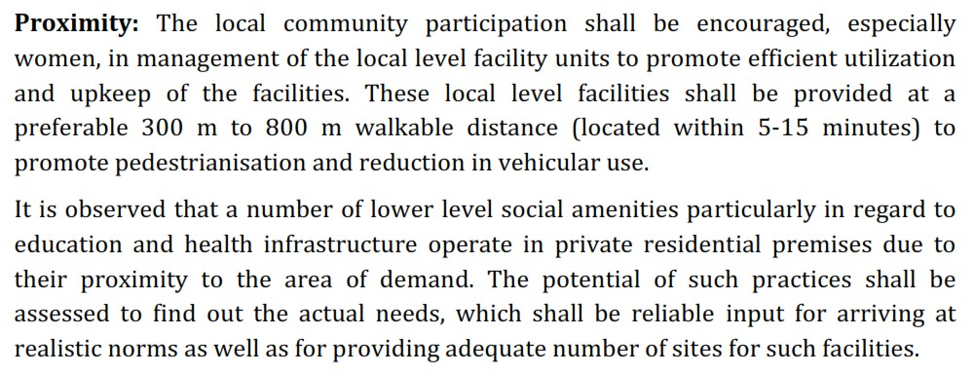
Proximity:
Source - URDPFI Guidelines, January 2015

Slide 8
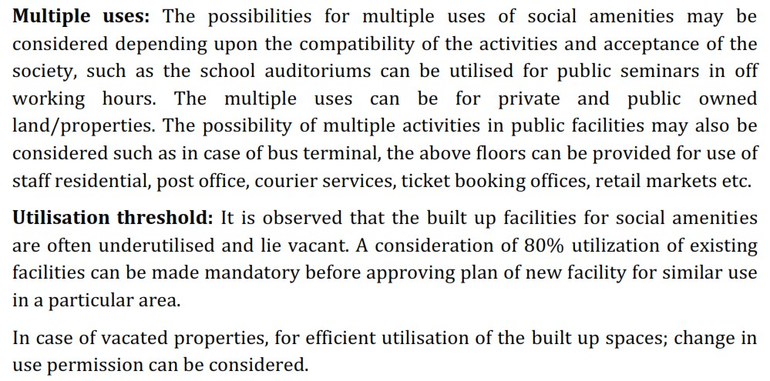
Source - URDPFI Guidelines, January 2015

Slide 9
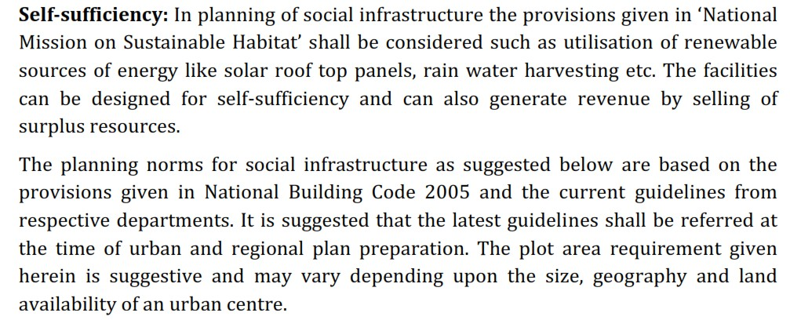
Source - URDPFI Guidelines, January 2015

Slide 10
Thank You

