Slide 1
Disaster Management
INTRODUCTION
Ar. Kavita Nagpal

Slide 2
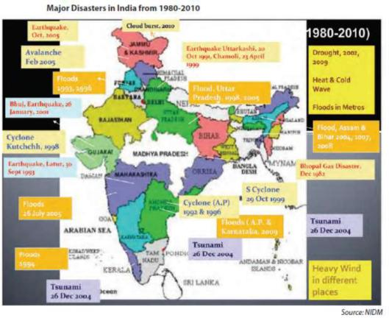
Introduction to Disasters- Background
Indian scenario:
The scenario in India is no different from the global context.
India’s geo-climatic conditions as well as its high degree of socio-economic vulnerability, makes it one of the most disaster prone country in the world.
The super cyclone of Orissa (1999), the Gujarat earthquake (2001) and the recent Tsunami (2004) affected millions across the country leaving behind a trail of heavy loss of life, property and livelihood.

Slide 3
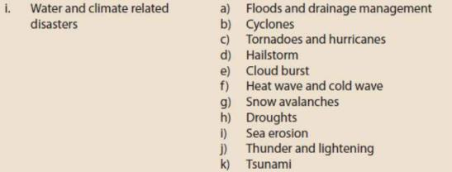
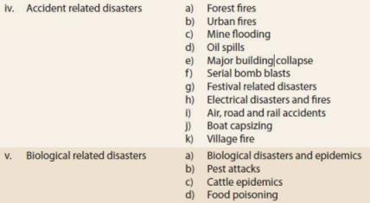
Introduction to Disasters- Background
LIST OF VARIOUS TYPES OF DISASTERS

Slide 4
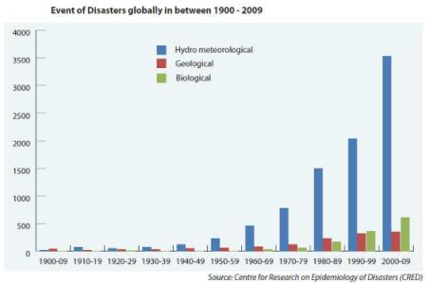
Introduction to Disasters
The main objective of this lecture is to have a basic understanding of various concepts used in Disaster Management, Disaster, Hazard, Vulnerability, Capacity, Risk and Disaster Management Cycle.
Apart from the terminologies, the lecture also tries to explain various types of disasters.
Disasters are as old as human history but the dramatic increase and the damage caused by them in the recent past have become a cause of national and international concern.
Over the past decade, the number of natural and manmade disasters has climbed inexorably.

Slide 5
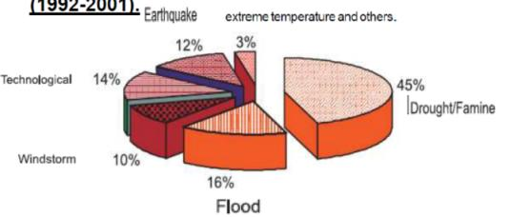
Introduction to Disasters- Background
From 1994 to 1998, reported disasters average was 428 per year but from 1999 to 2003, this figure went up to an average of 707 disaster events per year showing an increase of about 60 per cent over the previous years.
The biggest rise was in countries of low human development, which suffered an increase of 142 per cent.
Reported Deaths worldwide from all Disasters (1992-2001).
Global economic loss related to disaster events average around US $880 billion per year.

Slide 6
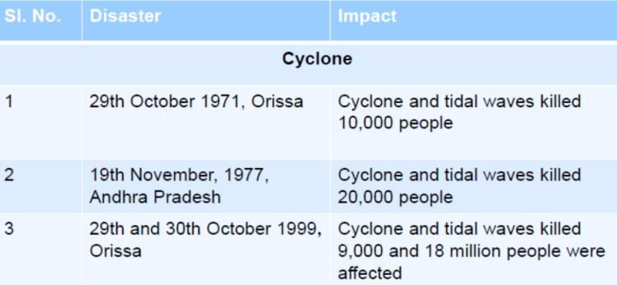
Introduction to Disasters- Background
MAJOR DISASTERS IN INDIA SINCE 1970

Slide 7
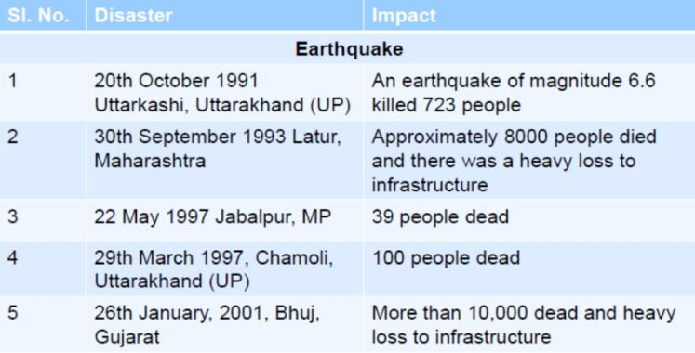
Introduction to Disasters- Background
MAJOR DISASTERS IN INDIA SINCE 1970

Slide 8
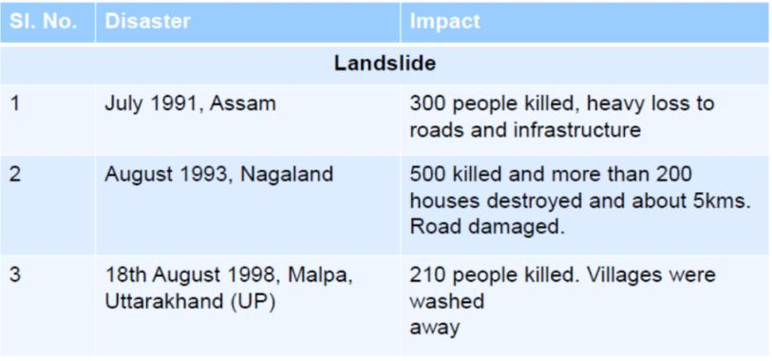
Introduction to Disasters- Background
MAJOR DISASTERS IN INDIA SINCE 1970

Slide 9
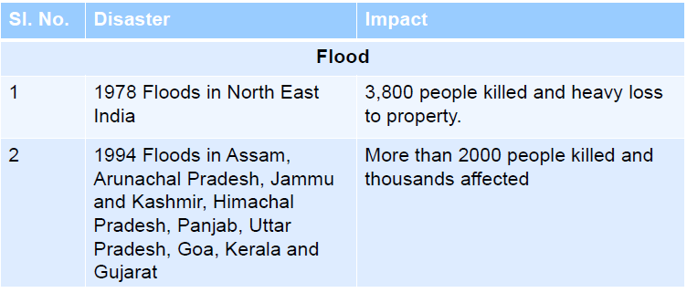
Introduction to Disasters- Background
MAJOR DISASTERS IN INDIA SINCE 1970

Slide 10
Introduction to Disasters- Background
While studying about the impact we need to be aware of potential hazards, how, when and where they are likely to occur, and the problems which may result of an event.
In India, 59 per cent of the land mass is susceptible to seismic hazard;
5 per cent of the total geographical area is prone to floods;
8 per cent of the total landmass is prone to cyclones;
70 per cent of the total cultivable area is vulnerable to drought.
Apart from this the hilly regions are vulnerable to avalanches /landslides /hailstorms/ cloudbursts.
It is therefore important that we are aware of how to cope with their effects.
We have seen the huge loss to life, property and infrastructure a disaster can cause but let us understand what is a disaster.

Slide 11
Disasters- Definition
What is a disaster?.
Almost everyday, newspapers, radio and television channels carry reports on disaster striking several parts of the world.
The term disaster owes its origin to the French word “Desastre” which is a combination of two words ‘des’ meaning bad and ‘aster’ meaning star. Thus the term refers to ‘Bad or Evil star’.
A disaster can be defined as “A serious disruption in the functioning of the community or a society causing wide spread material, economic, social or environmental losses which exceed the ability of the affected society to cope using its own resources.
A disaster is a result from the combination of hazard, vulnerability and insufficient capacity or measures to reduce the potential chances of risk.
A disaster happens when a hazard impacts on the vulnerable population and causes damage, casualties and disruption.
According to WHO disaster is- “ Any occurrence that causes damage, ecological disruption, loss of human life or deterioration of health and health services on a scale sufficient to warrant an extraordinary response from outside the affected community or area”

Slide 12
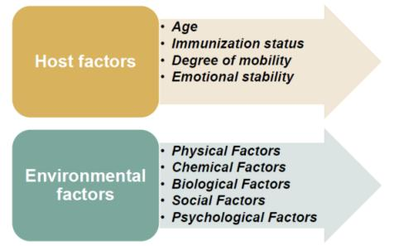
Disasters- Definition
Any hazard – flood, earthquake or cyclone which is a triggering event along with greater vulnerability (inadequate access to resources, sick and old people, lack of awareness etc) would lead to disaster causing greater loss to life and property.
Ex. An earthquake in an uninhabited desert cannot be considered a disaster, no matter how strong the intensities produced.
An earthquake is disastrous only when it affects people, their properties and activities.
Thus, disaster occurs only when hazards and vulnerability meet.
It is also to be noted that with greater capacity of the individual/community and environment to face these disasters, the impact of a hazard reduces.
Therefore, we need to understand the three major components namely hazard, vulnerability and capacity with suitable examples to have a basic understanding of disaster management.

Slide 13
Introduction to Disasters- Background
Effects of disaster :
Population displacement
Injury or Death
Risk of epidemic of diseases
Damage to infrastructure
Psychological problems
Food shortage
Socioeconomic losses
Shortage of drugs and medical supplies
Disruptive factors of disasters:
Death and destruction
Loss of basic amenities
Disruption of emergency services
Destruction of roads and modes of communication
Disorganization in response services
Characteristics of disasters:
Size and Scope
Unpredictable
Unfamiliar
Speed and Urgency
Threat

